Slide 1
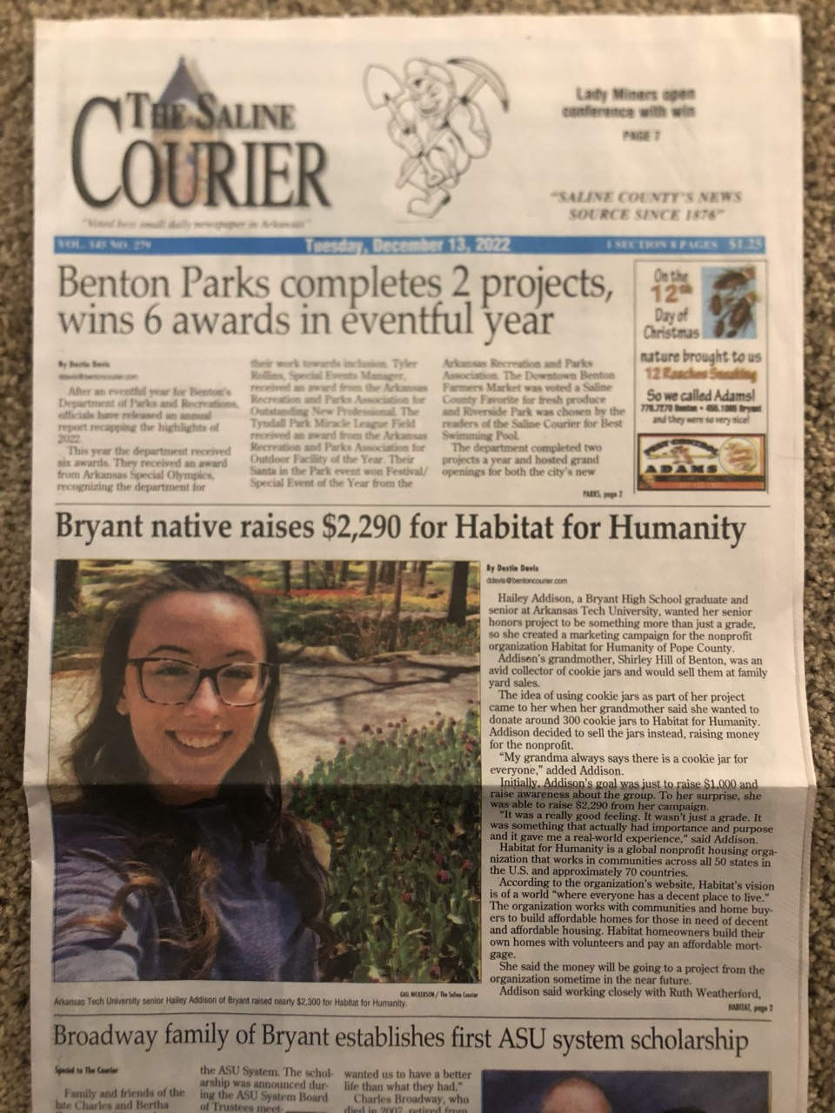
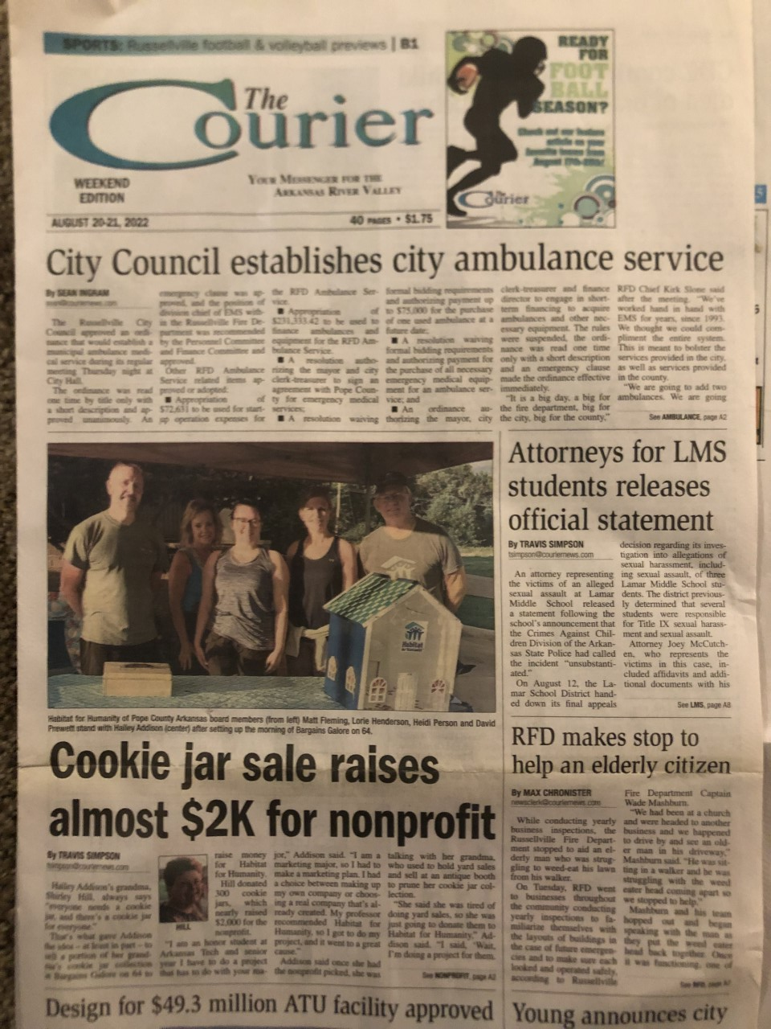
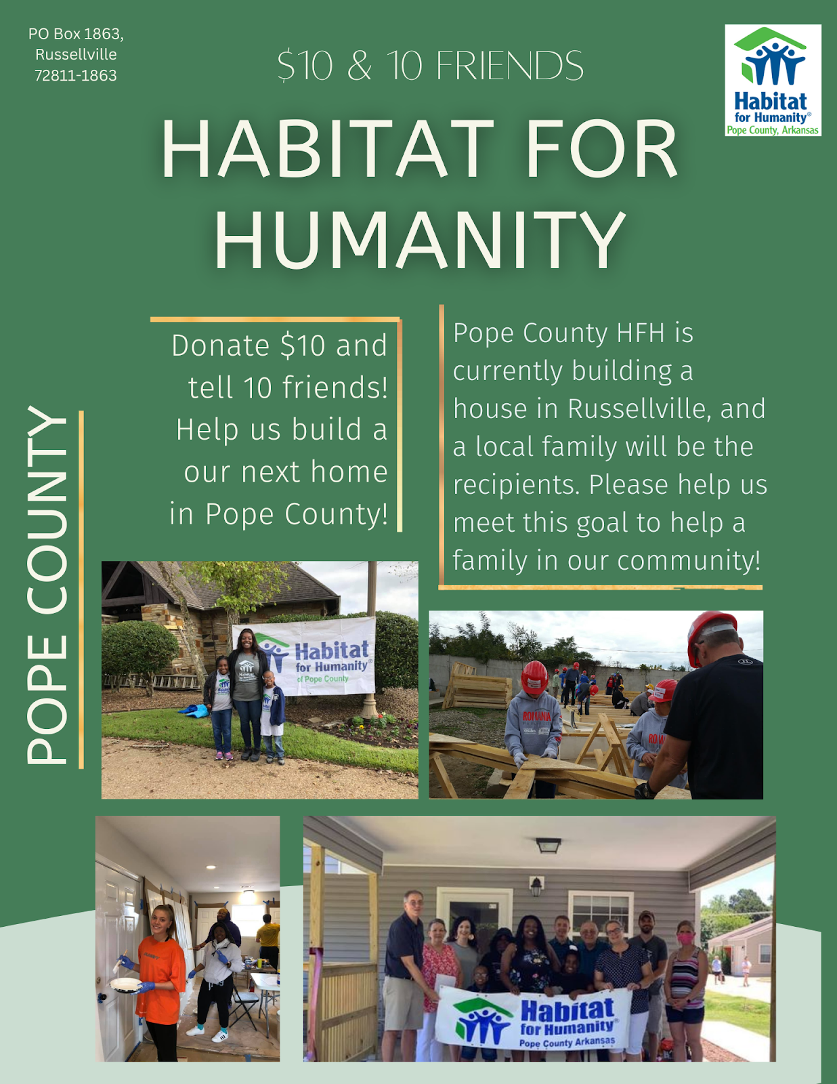
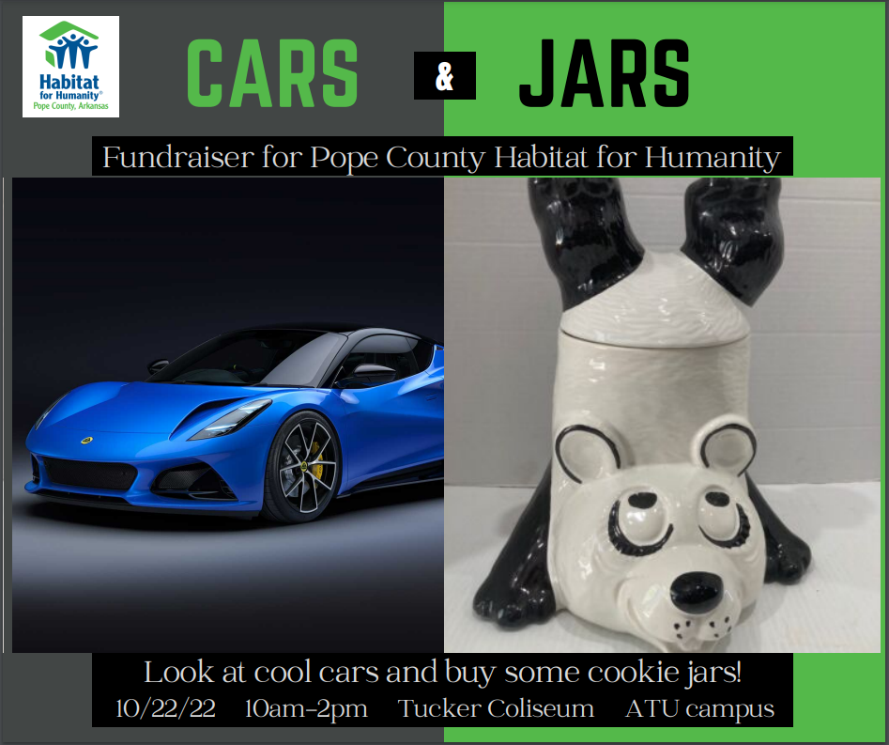
Habitat for Humanity Pope County Marketing Campaign
Hailey Addison
Flyer For $10 for 10 Friends Event
Arkansas Tech News
Saline Courier Article
Russellville Courier Article
This flyer was created to advertise for an event in which participants donate $10 and then spread the word to 10 of their friends. This was another event that was hosted to raise money for the newest house build in Russellville, AR.
This excerpt is from an article that was written about my project and published in the Arkansas Tech online newspaper. This helped to spread the word about HFHPCA around ATU campus, our secondary audience!
This image is of the front page of The Saline Courier newspaper from Saline County. My home town heard about my project, and ran a story about my marketing campaign. This widely expanded our marketing audience!
This image is of the front page of The Courier Newspaper from Russellville, AR. This article detailed the first cookie jar sale and helped to spread the word about the marketing campaign and HFHPCA around Russellville, our primary audience!
The Marketing Campaign
Situation:
This branch of Habitat for Humanity has been in place for ten years, yet many people do not know they are present in Pope County, much less that they have already built houses in this community. HFHPCA is currently building a house behind the Funky Town Mall in Russellville. The lack of awareness of Habitat for Humanity in Pope County is detrimental to the success of the organization, and is limiting the amount of funds that the organization can raise in order to help the people of this community. Therefore, HFHPCA needed a marketing campaign in order to build awareness of their program and to raise funds in order to start building their next house before the end of 2022.
Audience:
The primary audience of the marketing campaign was citizens of Pope County. Based on the geographics surrounding this branch of the organization, the people that were most likely to donate to the organization are people local to the branch. HFHPCA is building houses in Pope County. The citizens of Pope County are being positively affected by these house builds because they are helping local families purchase a home. The secondary audience of the marketing campaign was college students at Arkansas Tech University. Because Russellville is a college town, there are many students that need volunteer hours for a grade, organization, or scholarship. Conveniently, HFHPCA could always use volunteers.
Goals:
The two main goals for this marketing campaign were to build awareness of HFH’s presence in Pope County and of previous and current building projects, and to raise at least $1000 for HFHPCA’s current house build. They were required to break ground of this current project by the end of 2022, and any funds we were able to raise during this campaign helped them build this home.
Objectives:
The campaign was created in order to make Pope County and Arkansas Tech University students aware of Habitat for Humanity’s Pope County branch, and of the work they are doing and have already done. The campaign was designed to encourage an increase in support by creating a connection with our community and sharing with them our mission. The events that were hosted through this campaign also raised funds for the current house-build.
Strategies:
The main strategy for this campaign was the cookie jar sales. My grandmother donated 300 cookie jars to HFHPCA, and I used them in my marketing campaign to raise funds for the new house. We raised awareness of the sale by advertising on our social media pages and hanging signs and flyers. We increased support of HFHPCA by networking, speaking with the customers, and making connections.
Tactics:
Awareness: We created Facebook and Instagram posts on the HFHPCA page and our own personal pages on the days of the cookie jar sales. We also designed flyers for the cookie jar sales. Lastly, we contacted local newspapers to run a story about my grandmother’s cookie jars in order to increase interest.
Support: Many times, making personal connections with people is a wonderful way to create a repeat customer/donor. At our marketing events during this campaign, we told customers the story of my grandmother’s unique collection and generosity. We also told people about our mission and about how many other families HFHPCA has already helped in their community.
Timetable/Budget:
Because all of the resources we needed for the campaign were donated, HFHPCA had a 100% profit from the marketing campaign. We hosted two cookie jar sales. The first sale was concurrent with Bargains Galore on 64, a yard sale that spans miles down Highway 64. The second cookie jar sale was on Arkansas Tech Campus, and was concurrent with the Alpha Tau Omega Car Show. We raised $2,290 from the two cookie jar sales.
Evaluation:
Overall, I would say that this marketing campaign was a huge success. We accomplished the goals I set for us: to raise awareness of HFHPCA and to raise funds for their current house build. We made many new contacts at the cookie jar sales, and we raised $2,290 for their 2022 house build.
Facebook Post For $10 for 10 Friends Event
This Facebook post was created in addition to the flyer for the $10 & 10 Friends event. It was created to be posted on the PCHFH Facebook page.
Instagram Post For Cookie Jar Sale
This Instagram post was created to advertise for our second cookie jar sale which was hosted in conjunction with the ATU Alpha Tau Omega Fraternity Car Show.
Volunteer Hours!!
Attention students! Need volunteer hours for a grade, organization, or scholarship? Look no further! HFHPCA could always use more helping hands. Most of their need comes while they are actively building a house, but there is always work to be done! This organization does so much good for our community, and they give a hand up to people in our city that really need it. Now you have an opportunity to be a part of it. Please email Ruth Weatherford at contact@hfhpca.org for information to volunteer!
Special Thanks to our Project Sponsors:

