Slide 1
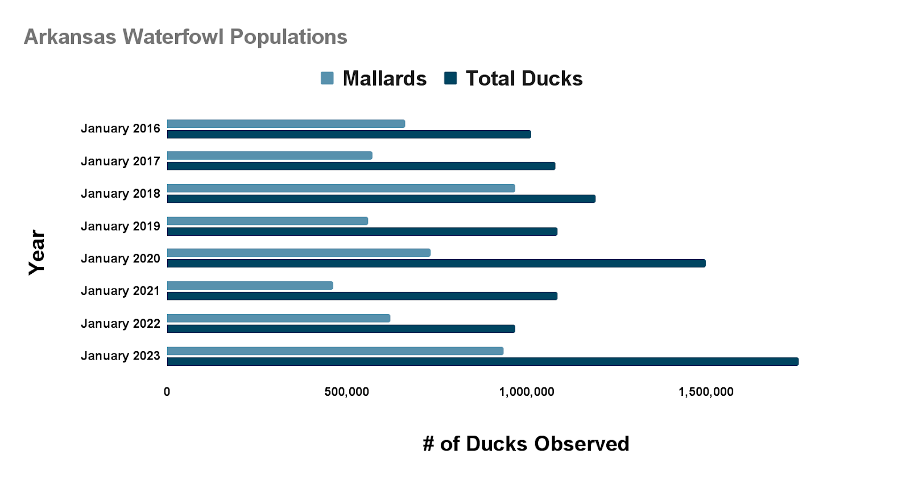
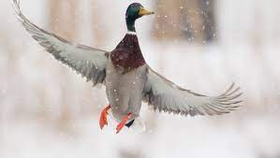
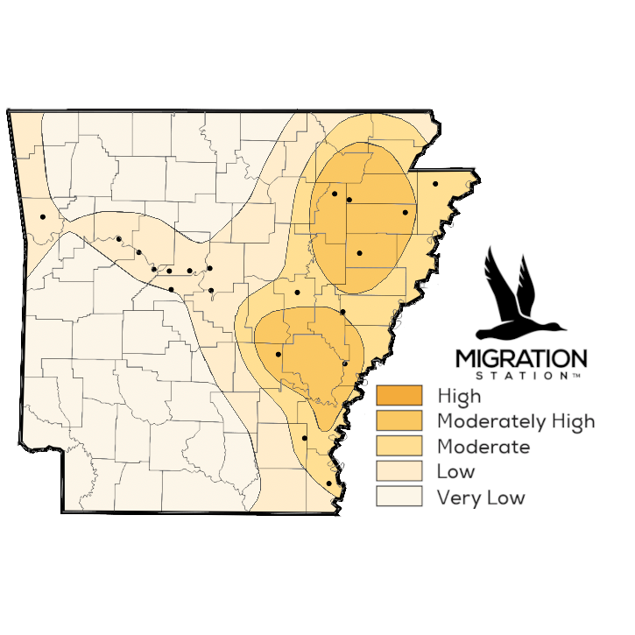
Environmental and Agricultural Effects on Waterfowl Population in Arkansas
Caleb Sipes, Ellison Stephens, Marisa Young
Introduction
Findings/Results
Discussion
With Arkansas being titled the “duck capital of the world”, thousand of people flock to the state to experience duck hunting. Waterfowl hunting also generates high revenue for the state. Therefore, it is vital to maintain a healthy population of waterfowl in this area.
Over the years, however, waterfowl levels in Arkansas have decreased due to changing weather conditions. Three main factors that help the breeding and overall waterfowl population in Arkansas thrive include crops, terrain, and weather. Improving and maintaining these factors is crucial in order to keep Arkansas as the “duck capital of the world”.
Overall, there are a multitude of factors that affect the waterfowl population in Arkansas. Whether it be deforestation, problems with crop farming, or the popularity and history of sport hunting in Arkansas. One of the main factors that can positively affect the waterfowl population is to properly maintain public Wildlife Management Areas within the state. There are also factors that can not be controlled such as mother nature. Say if there was a record rainfall for the year, naturally it will be a lot harder for farmers across the country to plant and harvest their crops which could skew the waterfowl population numbers for the year.
Research Purpose and Question
Figure 1: Major Wildlife Management Areas that are primarily used in Arkansas. Collected through aerial surveys throughout multiple regions in Arkansas by the Arkansas Game and Fish Commission.
The purpose of this study was to determine what environmental and agricultural factors affect waterfowl population in Arkansas.
One research question stated: What can be done to regulate crops and terrain in Arkansas to maintain a healthy waterfowl population?
The waterfowl population has been fluctuating over the past years. A critical factor of this has been related to weather. The lower population year are all correlated with the high heat and dry summers. When the ducks reach the northern states to breed there has not been enough water for them to do so. Whereas the wet summers allow the ducks to repopulate in the prairie's and use the water for a resource as nutrition and protection from predators allowing their offspring to survive.
Method / Data Source(s)
To collect the data the research consisted of multiple different articles from multiple reliable sources such as Ducks Unlimited and the Arkansas Game and Fish Commission. The goal was to get information from as many resources as possible over different topics and aspects that factor into why the waterfowl population in Arkansas is changing. Most of the articles used were published by Wildlife Biologists and/or conservation experts. The research focused on topics such as farming practices in Arkansas as well as deforestation as factors that affect the waterfowl population.
Conclusion(s) / Implication(s)
The biggest takeaway from this research project is that the main factor that affects waterfowl populations in Arkansas are humans. There are a plethora of things that humans do that will affect the numbers whether we realize it or not. The results were similar along the different articles that were analyzed. This information would be useful to any person that plans to duck hunt in the state of Arkansas as well as conservationist that wish to know why the population numbers are the way that they are.
Analysis
References
In order to test the hypothesis which stated, “if weather is changing over the years and ducks are less likely to inhabit Arkansas now versus in the past, then weather must be a major factor in what effects the waterfowl populations in Arkansas,” we first needed to understand the pattern in waterfowl population in the past 7 years. We used the Arkansas Game and Fish population survey to understand how many ducks have been in Arkansas since 2016.
Attracting ducks with crops. Mossy Oak. (2022, October 30). Retrieved April 11, 2023, from https://www.mossyoak.com/our-obsession/blogs/waterfowl/attracting-ducks-with-crops
Carbaugh, Jason, et al. “Waterfowl Surveys and Reports.” Waterfowl Harvest and Survey Reports, https://www.agfc.com/en/hunting/migratory-birds/waterfowl/waterfowl-surveys/
Covert, S. (2023, February 11). Could climate change and farming endanger Arkansas duck hunting? thv11.com. Retrieved April 11, 2023, from https://www.thv11.com/article/sports/hunting/climate-change-farming-impacts-arkansas-duck-hunting/91-8e98ff49-8f25-4183-b40d-cc91d47eb42b
U.S. Fish and Wildlife Service. “Duck Stamp Sales by Year.” FWS.gov, https://www.fws.gov/media/duck-stamp-sales-year
Special Thanks to our Project Sponsors:

