Slide 1
A comparative study of specific enthalpy of hydrocarbons with simple Carbohydrates
Kohl Kervin and Dr. Subha Pratihar
Notes:
NOTE:
To change the image on this slide, select the picture and delete it. Then click the Pictures icon in the placeholder to insert your own image.

Slide 2
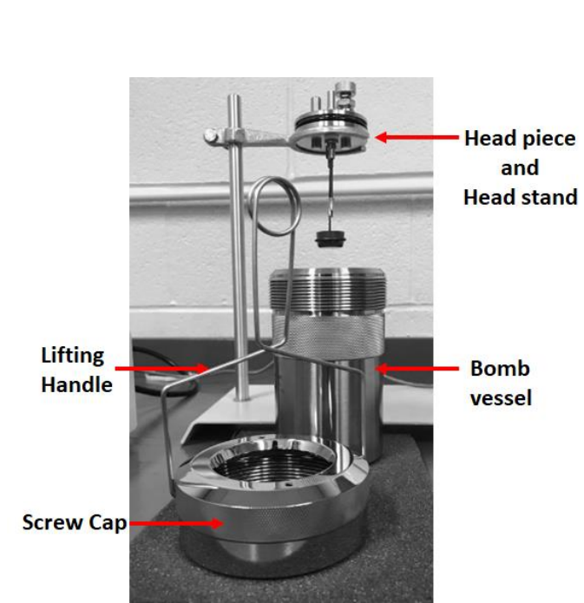
Combustion and Bomb Calorimetry
Bomb Calorimetry is the combustion of a material to determine its chemical properties
A process completed by the ignition of a compound in a constant volume
Determination of a calorimeter constant
Determination of heat of combustion and specific heat of formation
Pratihar, Subha, "Physical Chemistry I Laboratory Manual" (2023). Faculty Book Publications. 74. https://orc.library.atu.edu/atu_faculty_books/74

Slide 3
Literature Review
Similar calorimeters were first developed by physicist Adair Crawford¹
S.W. Parr developed the calorimeters that led to the one we use today²
Original studies were used for coal²
Modern studies include the effect of particle size on heat of combustion³ (∆H_{comb})
Other studies have focused on biophysical phenomena such as aerobic and anaerobic respiration⁴
1. Sheldon Kopperl and John Parascandola
Journal of Chemical Education (1971) 48 (4), 237
DOI: 10.1021/ed048p237
2. History https://www.parrinst.com/company/history/#:~:text=Parr%20Instrument%20Company%20was%20founded,devices%20were%20not%20generally%20available.
3. B. Wang, W., Dezieck, A., and Peng, B. (2022). “Measuring size-dependent enthalpy alterations in dry milled white rice via bomb calorimetry”. Journal of Food and Nutrition Research (Newark, Del. Print), 10(1), 74-80
4. T. D. Chapman and R. W. Schwenz, (1990). “The energetics of aerobic and anaerobic respiration”. Journal of Chemical Education.

Slide 4
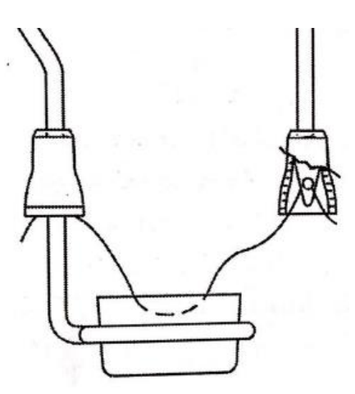
Method of Combustion
Pellet Creation
Wire Attachment
Water Measurement
Bomb Pressurization and Purge
Ignition and Data Collection
Gaussian 16 Calculation
Direct Placement
Short Circuit Placement
Density Corrections
Increased Pressure
Pratihar, Subha, "Physical Chemistry I Laboratory Manual" (2023). Faculty Book Publications. 74. https://orc.library.atu.edu/atu_faculty_books/74
Pratihar, Subha, "Physical Chemistry I Laboratory Manual" (2023). Faculty Book Publications. 74. https://orc.library.atu.edu/atu_faculty_books/74

Slide 5
Determining Calorimeter Constant
The standard deviation found for the calorimeter constant was 10.2717 ± .0565 kJ/°C
The average change in temperature was 2.5697 ± .0325 °C.

Slide 6
Optimization of Sucrose Combustion Trials
∆H_{comb} (kJ/mol) | Literature (kJ/mol) | Error (%)
-5870.445 | -5643.14±1.8* | 4.028
-5726.679 |  | 1.480
-5596.605 |  | .8292
Average heat of formation was -2128.47±123.95 kJ/mol
Literature value is -2221.2* kJ/mol
*Obtained from NIST database

Slide 7
Naphthalene Results
∆H_{comb} (kJ/mol) | Literature (kJ/mol) | Error (%)
-4945.11 | -5150.09* | 3.98
-4918.88 |  | 4.49
-4965.342 |  | 3.61
These results were found at 20-22 PSI
Specific heat found at 38.65±.168 kJ/g
*Obtained from NIST database

Slide 8
Naphthalene Frequencies
B3LYP/6-311++g(d,p)
174.029666 | 185.642141 | 368.811499
398.574583 | 485.424685 | 492.682747
501.52658 | 502.618081 | 612.670827
614.796239 | 703.808872 | 747.712526
760.647445 | 774.228146 | 782.363055
818.50328 | 864.57503 | 920.194919
929.294825 | 947.782876 | 959.504242
966.571848 | 1001.39186 | 1011.86095
1113.20512 | 1131.92111 | 1133.37799
1146.71865 | 1192.19166 | 1228.77363
1245.71082 | 1346.30583 | 1353.60738
1371.35566 | 1441.19323 | 1441.3237
1497.15217 | 1559.8476 | 1584.81091
1614.7708 | 3054.31192 | 3056.16061
3058.1269 | 3061.50651 | 3071.99255
3073.19565 | 3084.36783 | 3085.31685
Roser, J.E. and Allamandola, L.J. (2010). “Infrared Spectroscopy of Naphthalene Aggregation and Cluster Formation in Argon Matrices”. The Astrophysical Journal. 722. 1932-1938
Anderson, M.P and Uvdal, P. (2005). “New Scale Factors for Harmonic Vibrational Frequencies Using the B3LYP Density Functional Method with the Triple-ζ Basis Set 6-311+G(d,p). J. Phys. Chem. A. 109. 2937-2941.

Slide 9
Applications
Foods
Determining calorific value
Fuels
Purity
Effectiveness
Identification
Drugs
Determination of stability
The authors acknowledge the Department of Physical Sciences for supporting this research project.

