Slide 1
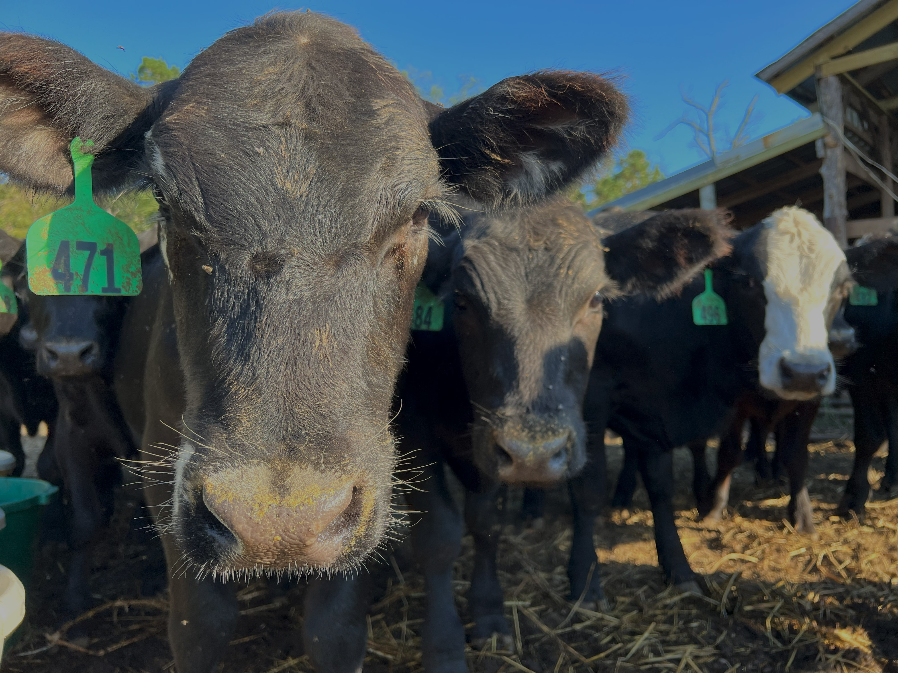
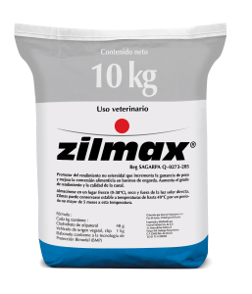
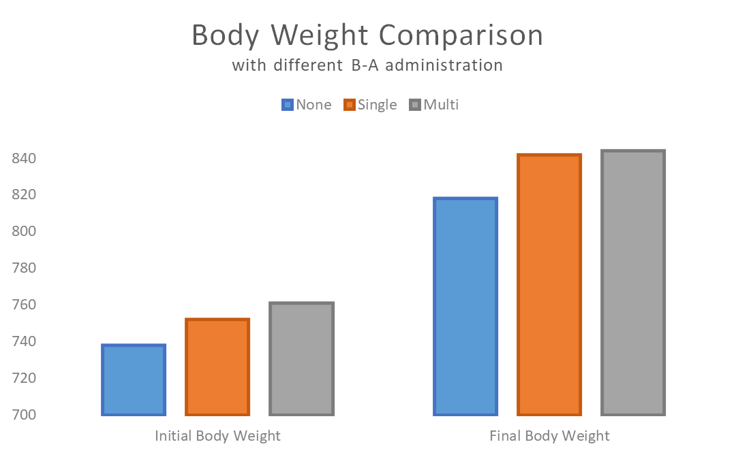
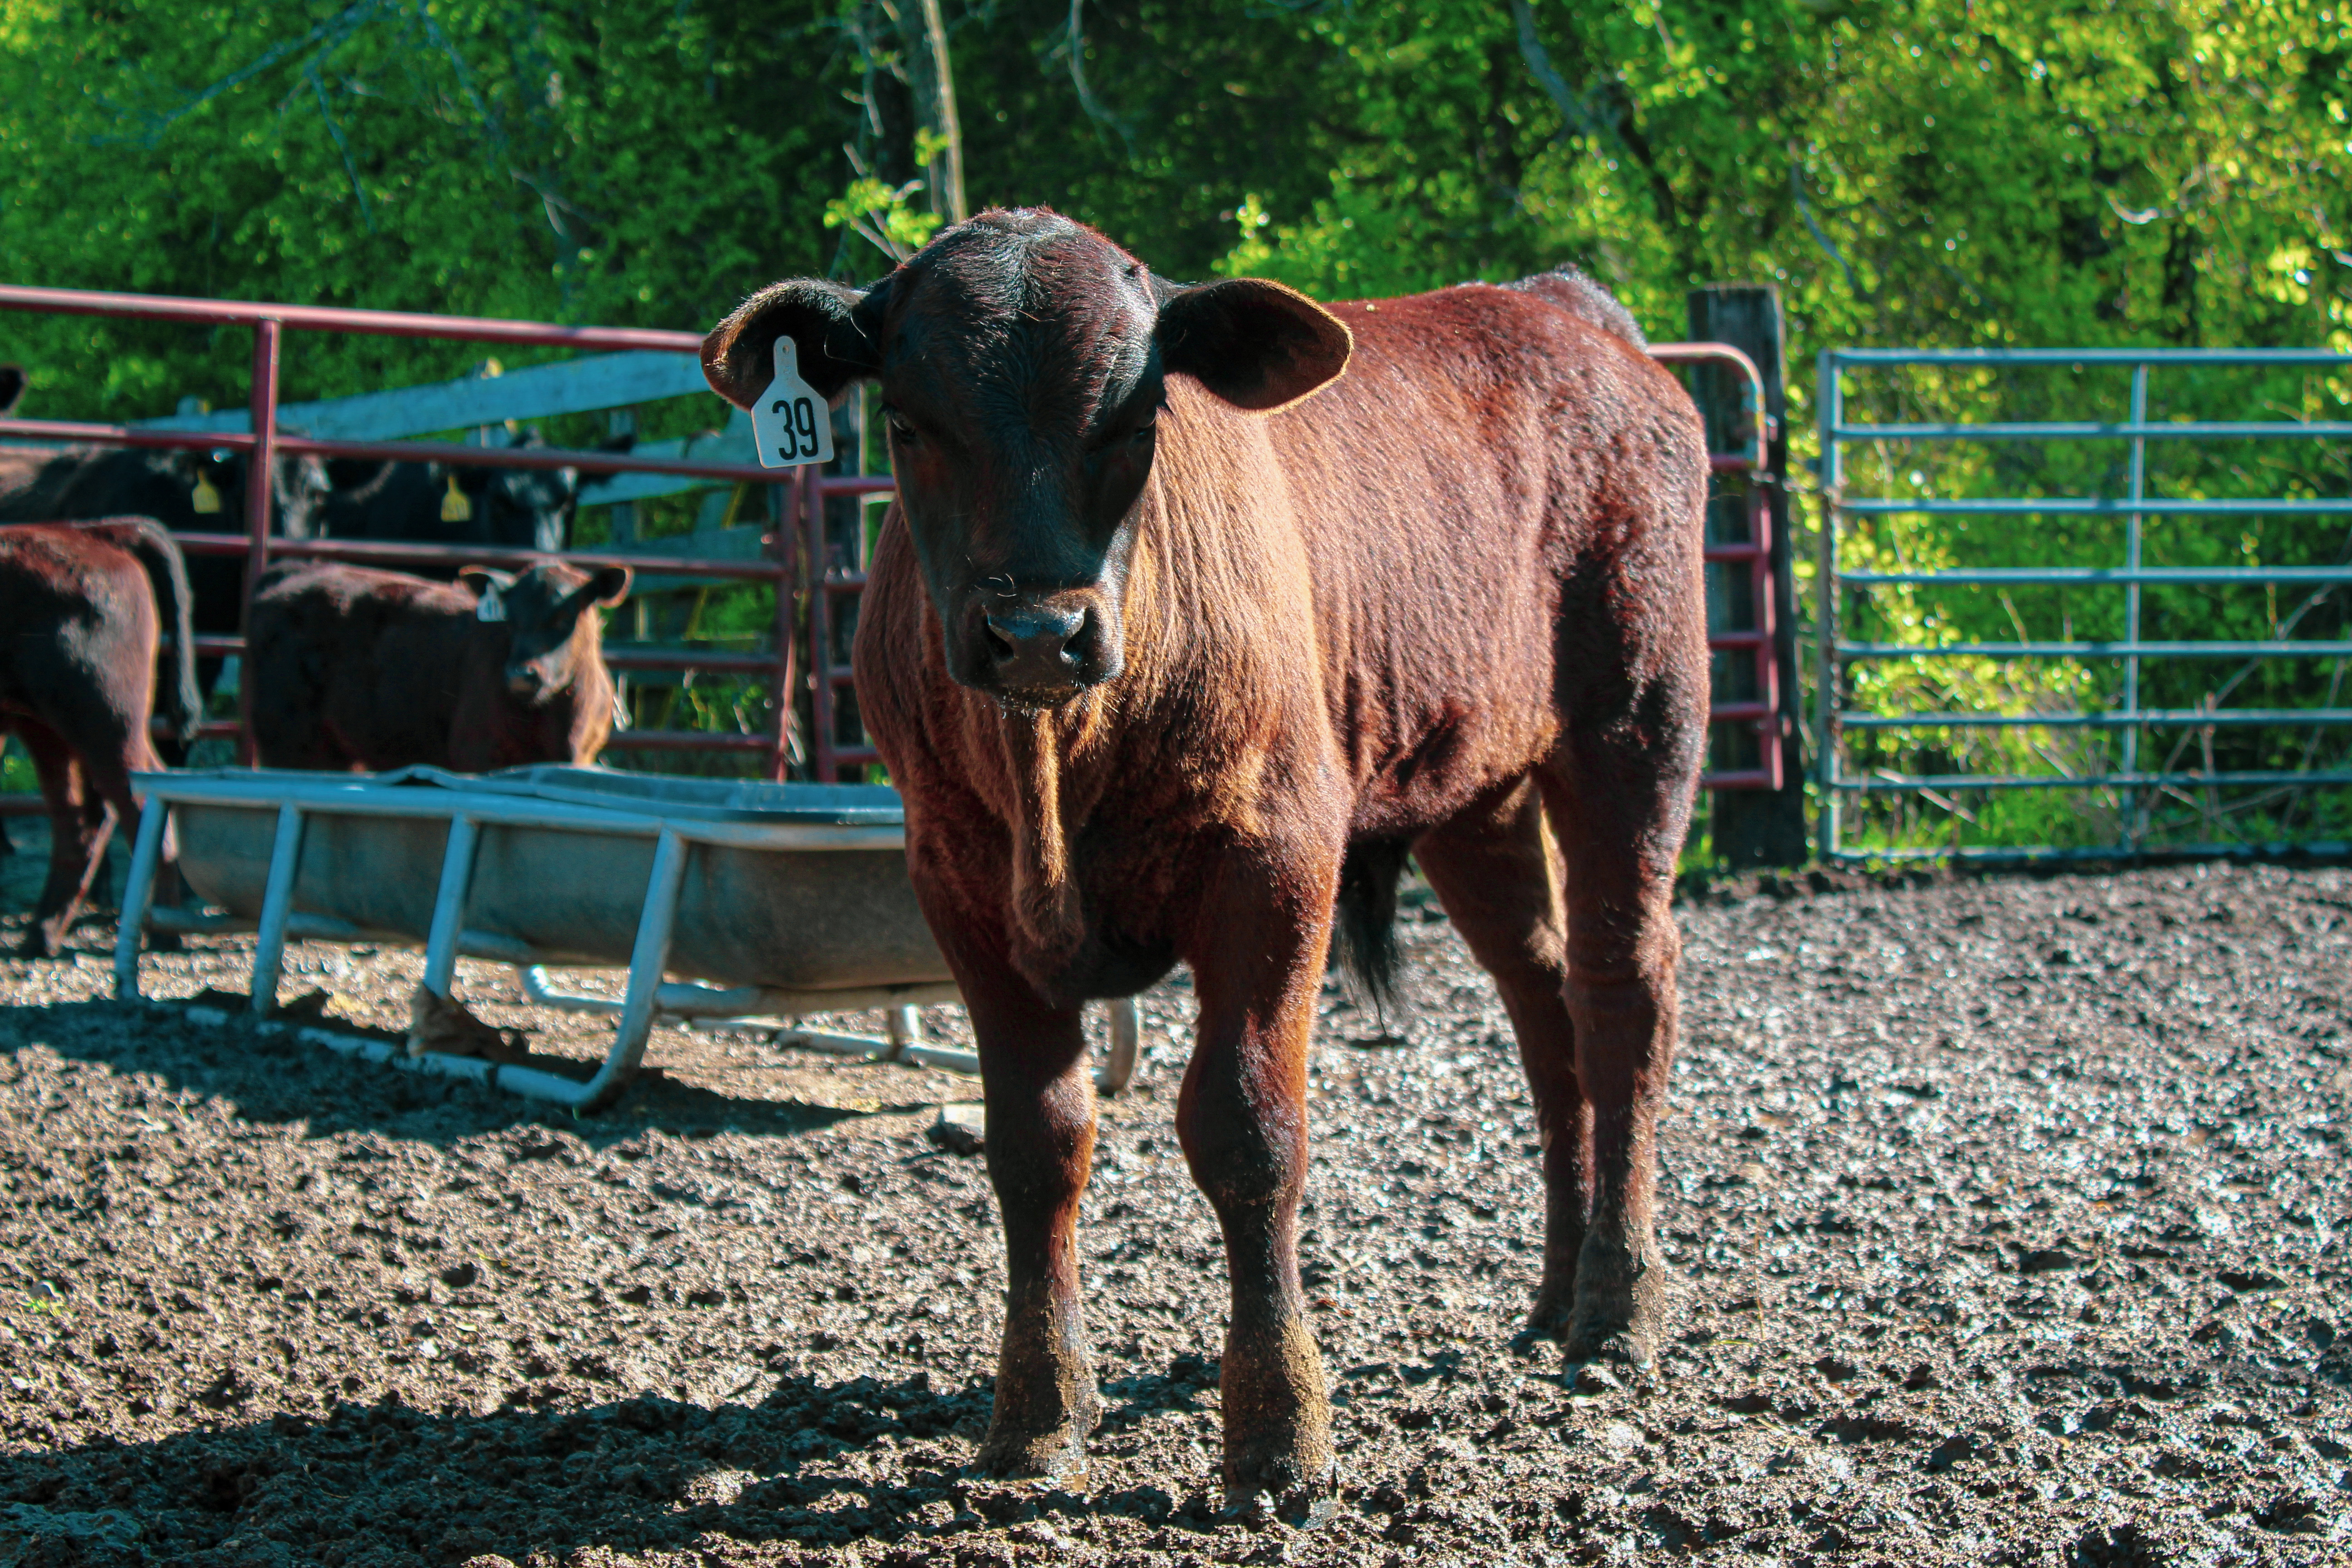
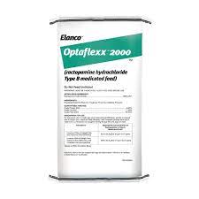
Utilization of Beta-Agonists on the Effects of Marbling / Fat Deposition in Beef Cattle
Rafael Andrade, Sara Erby, Blaine Holzman
Arkansas Tech University
Department of Agriculture and Tourism
Introduction
Findings/Results
Discussion
Many beef producers in the U.S. asks themselves, “How are we able to increase our meat quality to improve the market?”.
With modernization of technology, these questions are answered. One measure is the utilization of anabolic implants, but the focus here is understanding the other measures producers take. ¹
In this case, a specific measure we are going to be looking at is the use of synthetic compounds called Beta-Adrenergic Receptor Agonists. Commonly referred to as Beta-Agonists. This research displays a set of criteria on how these Agonists can work within the industry. Extensive research done on these synthetic compounds have shown the profitability and productiveness through the use of the product. There is intent to fully understand the way a Beta-Agonist works and how to use it more effectively and efficiently.
Other questions that relate are: Why aren't they advertised more? What could this product do for the market? Are there any economic benefits? Any health concerns? How can we improve it?
Increasing yield, i.e., muscle mass, while also increasing feed efficiency would greatly benefit the cattle industry.²
The use of this drug has provided producers with a 100% return on investment by making two dollars for every dollar spent. ³
Optaflexx, an FDA approved beta-agonist, when fed correctly increases rate of gain by 17.9% on a carcass adjusted basis and increases overall average gain by 19.7 pounds.
Steers experienced an additional 11.2-pound gain during finishing period during the use of the drug and were 14% more feed efficient.
Optaflexx improves carcass and performance in many areas of beef cattle when fed according to label
Additional 17 pounds in live weight
Additional 14 pounds in carcass weight
.30 square inch increase in ribeye area
.30% increase in dressing percentage
Through the research, we have gone into detail on how these agonists are administered, the effect producers will see, and the different claims of side effects. Many producers who have been introduced and not introduced to Beta-Agonists have worried about their use. Using implants is beneficial, as well as the agonists. The HCW increase and overall additional weight gain from the use of these products go straight into the economy as money.
Findings/Results
When given a beta-agonist implant at a low ADG target, steers gained 1.22 lbs/day; gains exceeded .22 lbs/day from target weight.
Implants are shown to increase steers fed at high and low ADG targets by 11.4% during the winter phase.
This implant strategy resulted in an additional 26 lbs of body weight at the end of winter backgrounding.
Compensation rates with the use of a beta-agonist were considerably lower than those with implant use
Implanted steers experienced a 9% compensation rate of gain; whereas steers without experienced a 21-23% compensation rate of gain
Conclusion(s) / Implication(s)
When it comes down to making lean and healthy meat, cattle producers get the best results after the use of Beta-Agonists.
The overall performance of the animal increases tremendously and it affects the entire herd
With the use of Beta-Agonists, there is less land usage due to the increase of feed efficiency. Less land would be used in order to help with the production of crops that are used to make cattle feed.
Utilization of Beta-Agonists is going to make a drastic change in the quality of life for the animals and the quality of meat bought by the consumer.
Beta-Agonists contribute to improved performance, in regard of poundage, and contribute to the economy and beef industry, via increased hot carcass weight.
Method / Data Source(s)
Particularly studying the effects, the agonist has on an animal that uses it, versus an animal that does not use it all, and animals that use implants
We are going to be comparing the results based on the animals, cattle only in this case. Mainly:
Heifers
Steers
Specifically, 2 kinds of agonists; Optaflexx and Zilmax
Two kinds of administration
Implants
Feed additives
References
Digler, A. (2015). Beta-Agonists: What Are They and Why Do We Use Them in Livestock Production? American Meat Association, 1-2.
Chung, K.Y., Johnson, B. J., Smith, S. B. (2014). Historical Overview of the Effect of β-Adrenergic Agonists on Beef Cattle Production. Asian-Australian Journal of Animal Sciences, 12 (5), 757-766.
Ishmael, W. (2005). New Gains On Old Money. Beef Magazine,2 (42).
Figure 2 Body Weight Comparison
Note: Figure 2 illustrates the difference in initial body weight and final body weight of groups using different implant strategies.
Special Thanks to our Project Sponsors:

