Slide 1
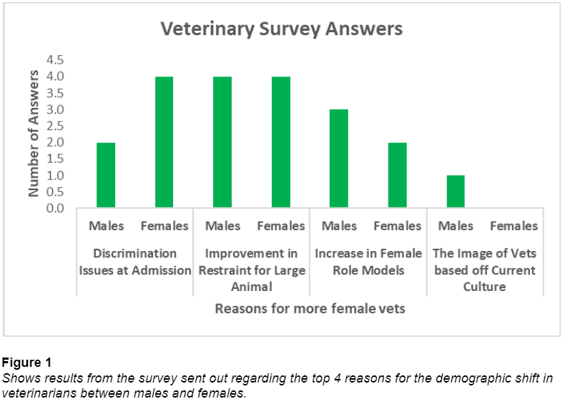
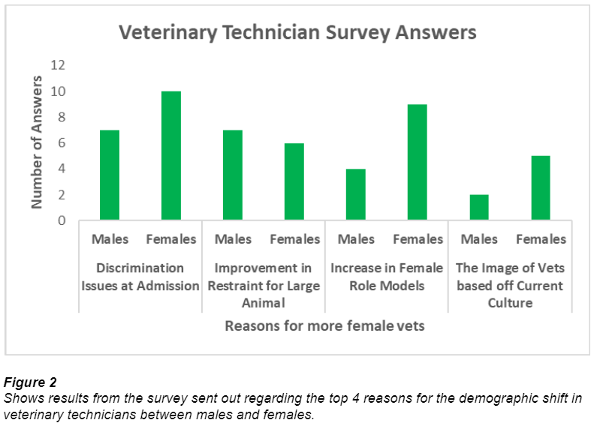
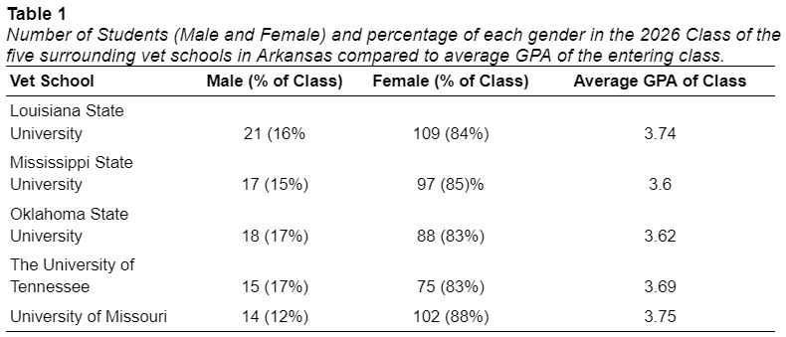
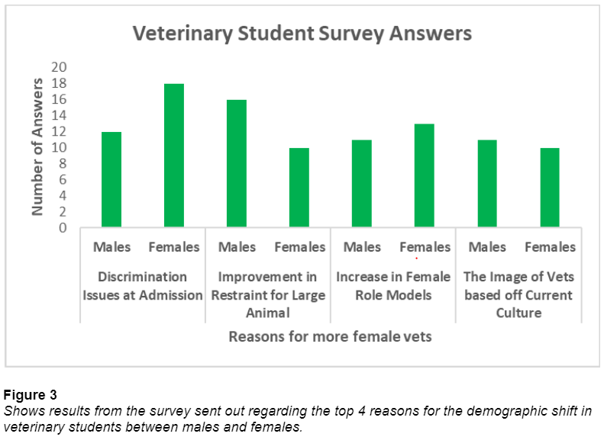
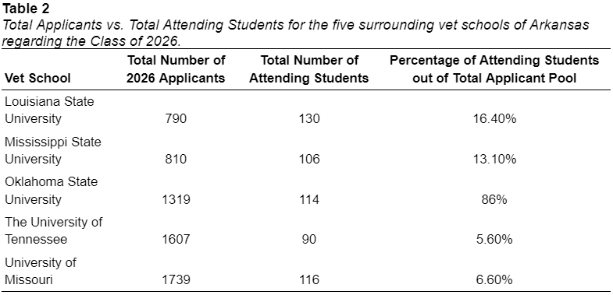
The Demographic Shift of Males and Females in Veterinary Medicine
Dalton Tatum, Eddy Patterson, Mia Ratliff
Introduction
Findings/Results
Discussion
Veterinary Medicine is rapidly changing. ⁵
New technologies ⁵
Ethical and moral standards ⁵
Demographic changes ⁵
In recent years, there was a major female shift
Initial studies contradicted why this shift occurred ⁴
Less annual income than males ¹
Less free time for families ⁴
For Kansas State in 2030, the following will occur (based off Class of 2026):²
104 females will enter the field²
19 males will enter the field²
This is true for many other veterinary schools²
The male to female ratio suggests the shift happens during Veterinary School³
This theory opens many more questions:
Is there a lack of interest in the field?
What are the GPAs of men and women in undergraduate programs?
Research Question: What caused the major shift from males to females in the field of Veterinary Medicine?
There are four leading causes for the shift:
Absences of discrimination issues against women at admission
Improvement in restrain for large animal
Increase in female role models
Image of veterinarians based off current culture
Based on the Figures, the most votes went towards absence of discrimination issues against women at admission
Table 2 supports the discrimination issues claim by showing the competitiveness level for veterinary schools surrounding Arkansas
Schools with more total applicants accepted less students into the program
Lower number of accepted students correlates with a lower male population within schools
Table 3 shows that the shift occurred in 2009
Women surveyed voted higher in all categories for female role models
Table 1 shows that females consistently make up 80% of the classes
However, having more female students had no effect on raising GPA
GPA had no effect on acceptance rates of women
Average GPA ranged from 3.6-3.75
Research found women are out competing males at the Veterinary College entry level
Survey suggests the image of vets based off current culture was insignificant and the elimination of discrimination issues towards women at admission played the biggest role
Discourages of males towards the field: decreased salary
Lack of motivation therefore less males in the field
All results collected through the study relate back to the competitive nature of veterinary medicine.
Method / Data Source(s)
(Part 1) Surveys were sent to the following: Veterinarians, Veterinary Technicians, Veterinary Students
(Part 2) Demographics analysis of the following schools: Louisiana State University, Mississippi State, Oklahoma State, University of Tennessee, University of Missouri
Findings/Results
Conclusion(s) / Implication(s)
Our research sought to explain factors that may be influencing the shift of veterinary medicine to consist primarily of females. Perceived explanations from traditional studies in unison with examining data collected both from institutions as well as individuals were utilized in our approach to better understand this hundred-year trend.
Our literature review explores previous studies on the feminization of veterinary medicine which conclude sociological and economical factors can be seen as major contributors to the offset of gender representation. These factors are highly subjective in nature and are difficult to accurately quantify and in turn lead to further speculation.
The present research suggests the disproportionate representation among males and females in veterinary medicine may be propelled by not only an array of social and psychological elements that can drive individual choices but is also influenced by the high level of competition the field of veterinary medicine is experiencing.
Additional research can be directed to better understand the evaluation methods of admission officers and their views on the feminization of veterinary medicine. This perspective could shed light on some of the possible factors that may be contributing to the unequal acceptance rates by gender.
References
1) Burns, K., & Malinda Larkin. (n.d.). The gender gap. American Veterinary Medical Association. Retrieved April 10, 2023, from https://www.avma.org/javma-news/2013-04-01/gender-gap
2) Class statistics. (n.d.). Retrieved April 10, 2023, from https://www.vet.k-state.edu/admissions/snapshot/
3) DVM 360. (2020, April 28). The gender shift. DVM 360. Retrieved April 10, 2023, from https://www.dvm360.com/view/gender-shift-0
4) Gould, R. • B. E. (n.d.). What is the gender pay gap and is it real?: The Complete Guide to how women are paid less than men and why it can't be explained away. Economic Policy Institute. Retrieved April 10, 2023, from https://www.epi.org/publication/what-is-the-gender-pay-gap-and-is-it-real/
5) Lofstedt, J. (2003, July). Gender and Veterinary Medicine. The Canadian veterinary journal = La revue veterinaire canadienne. Retrieved April 10, 2023, from https://www.ncbi.nlm.nih.gov/pmc/articles/PMC340187/
Special Thanks to our Project Sponsors:

