Slide 1
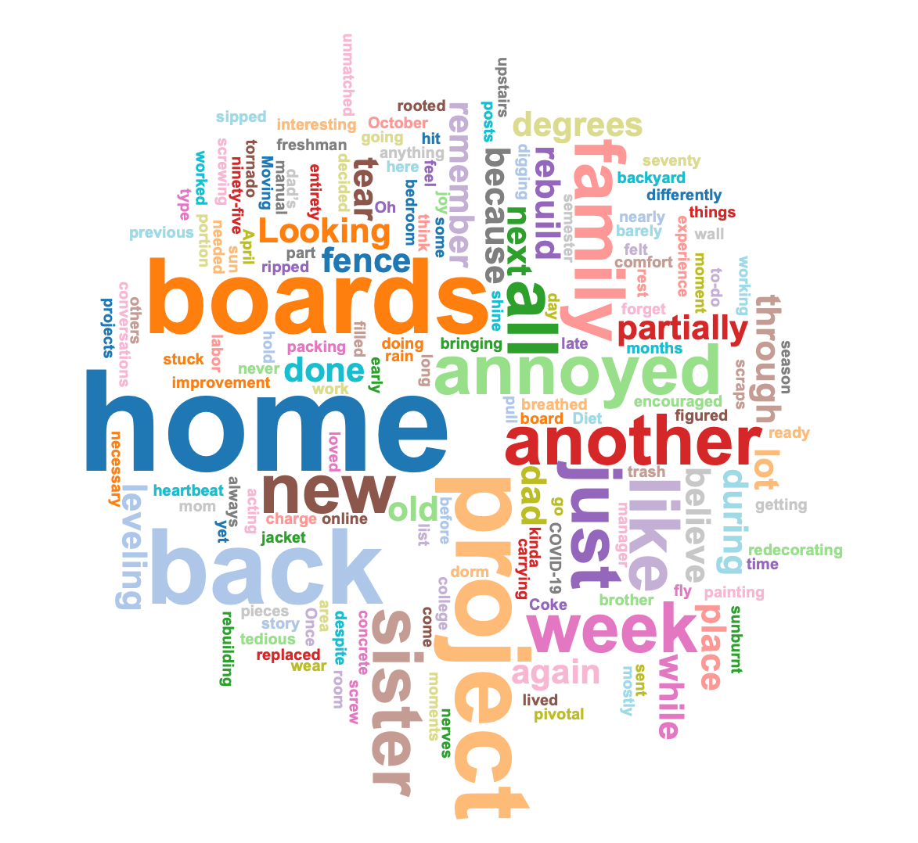
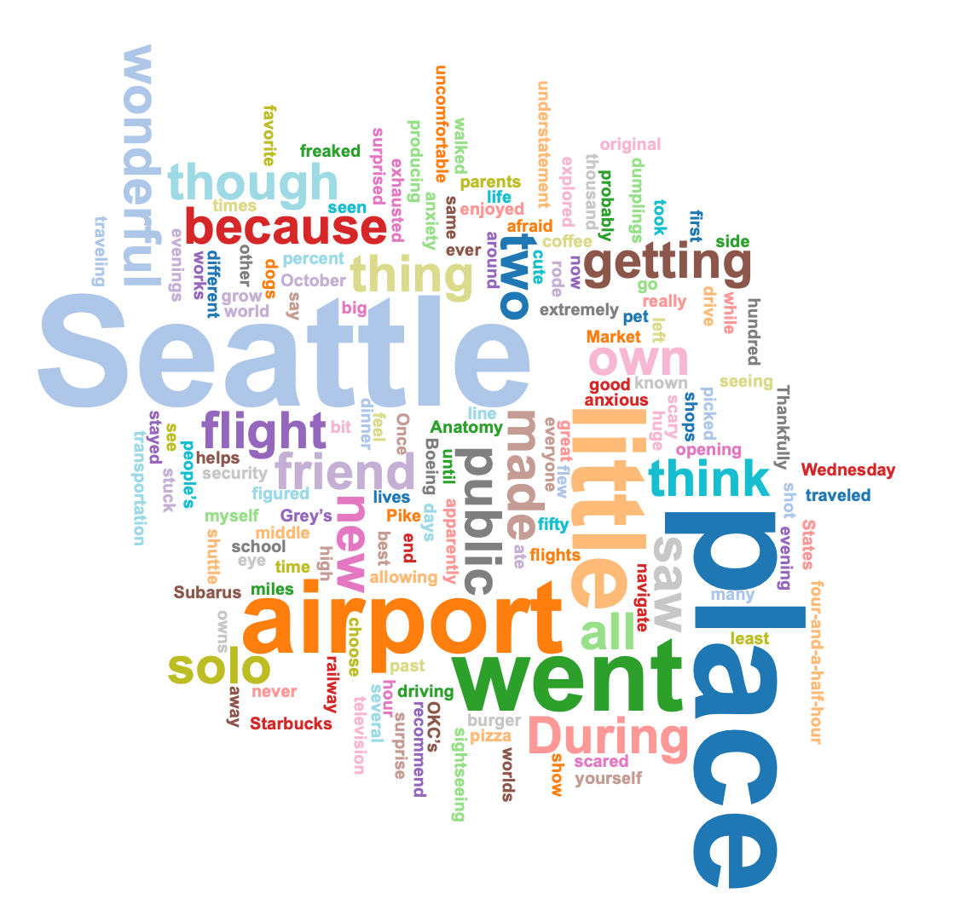
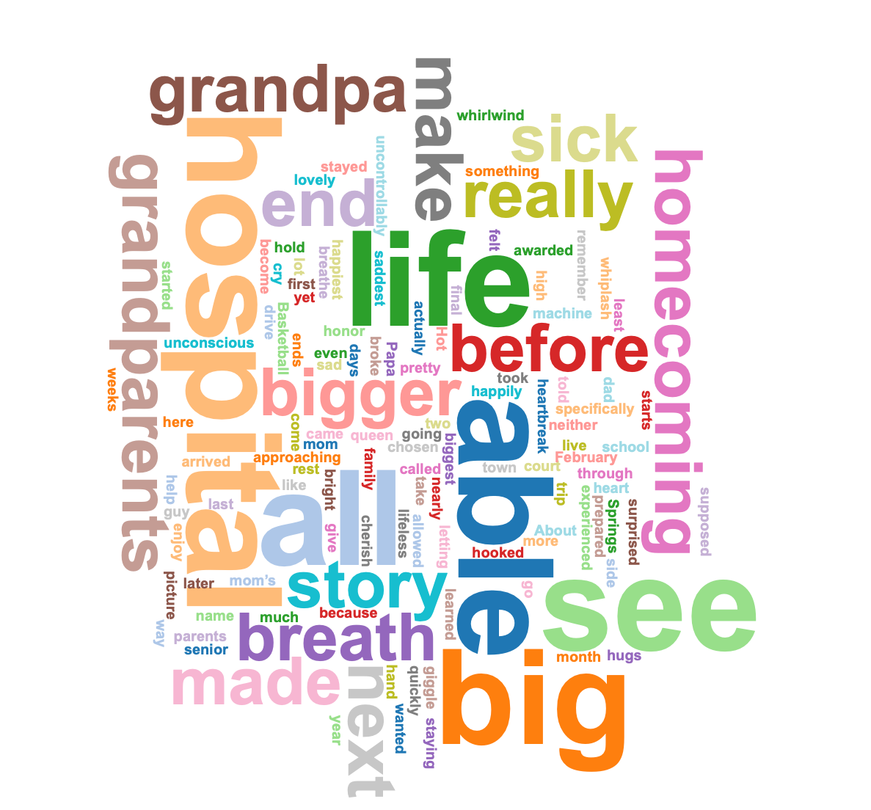
Growing Up and The Emotions That Come With It
McKenzie Blanchard
Artist’s Statement
Word Clouds
Poems
Many people roll their eyes when asked to read a twenty-plus page article and pull out key facts. They also usually do not pull out relatable emotions, but only information. When reading, though, whether poems or short stories, people do not mind the task because they get much more out of it. They walk away with feelings – ones they know from previous, personal experience, and also new ones which relate to the writer’s own story.
My work is an examination of stories of my past that have shaped me into who I am today. The stories are told from the heart – memories strong enough to stand the measure of time. The poems are to reflect the emotions I held. Some of the feelings resurfacing for the first time since, and some of them ones I have felt for what seems like for way too long now. My work is how I process these feelings.
What do I want to say with my portfolio?
You are human. Emotions are real – good, bad, ugly, sweet. You are stronger than you know, and you can handle when it seems like the world has put too much on your plate. I hope to inspire you to face your life head-on. Take the emotions and feelings as they come. Reflect on your life. Do not process to forget, but process to grow.
The Hardest Week Of My Life
I looked like Cinderella
You laid in a hospital bed
I got a crown
You got medicine
I know you wanted to be there
You would have told me I was beautiful,
You had never been more proud,
Would’ve asked if I could feel your love
But nineteen days before my eighteenth birthday
I was breath-taking
And eighteen days before my eighteenth birthday
You were taking your last breath
So, let’s raise a glass to mourning
Months of change, not ready for this new
The mark of the hardest time of our lives
But we know
We will see you on the other side
So, here’s to remembering you.
What Comes After A Tornado
October was full of tornadoes
The fence in our backyard
Torn down by one of those
March came with disease
“In-Person Classes To Cease”
My home away from home
Now empty
It takes time to restore
Rebuilding, redoing
To make something you adore
I never thought we’d get here
The fence felt like an accomplishment
But with the world
I wasn’t content
Rebuilding a fence
Rebuilding the world
Both a mess
Both annoying
But both beautiful
Solo in Seattle
TSA took my pocket knife
But that was the worst of it
Restless Leg Syndrome in the window seat
Four hours til my trip is complete
I’ve never seen so many trees
Evergreens
Seattle made me smile
Even if just for a little while
Daytime is for exploring
Flowers in the market
Fresh fish-throwing, too
Nighttime is for dining
Dumplings only served in two cities in the States
President Obama’s favorite chocolate
And pizza – I stuffed my face
Coffee shops at every corner
Public transportation made me seem a foreigner
A sense of independence
“I am an adult”
Not felt before
The realization
“I am a kid no more”
Purpose
I wanted to better understand emotions in relationships. Looking at this project through the lens of narrative theory helps to understand why these stories have stayed with me. Emotions are meant to be felt and processed. The reason why these are the stories that stuck are because of the feelings that come with them. Without emotion, these are simply just words strung together. As a poetry writer, your job is to create stories that pull at the heartstrings. That is what these experiences have done in my life, and my job was to convey that so the reader walks away feeling something, too. Narrative theory says that we use our stories to make sense of the world (Phelan & Ferrera, 2022). Addressing this project from an ethno-autobiographical approach has allowed me to make sense of my own world (Goodall, 2004). My stories matter, and reflecting back to them allows me to grow. I learn from my mistakes and I work to be better. The reader should also be able to read these stories and learn from my mistakes, and hopefully relate to mistakes in their own life.
Poetry evokes emotion. It creates a bridge between an average story and the emotions felt within the story. The reason I chose to write poems is because I wanted a closer look at the emotions in the stories, not the stories themselves. Poetry uses language that is not used in a research paper, and it brings more focus to what the reader feels after reading. It’s not so much about the details they walk away with, but the emotions they relate to.
What Not To-Do When You Fail A Quiz
Crushed, defeated, disappointed
So ashamed of myself
I couldn’t avoid it
If I could go back
I’d tell her to do it again
Not for the same reason
Though
I needed to learn
Right then
That I didn’t have to earn
Forgiveness
I’d take the shame
For my aim
Is not to cheat, but to grasp
That grace fills the gap
My perfection incomplete
Does not mean defeat
But relies on a Savior
Who gave himself
Despite my misbehavior
Special Thanks to our Project Sponsors:

