Slide 1
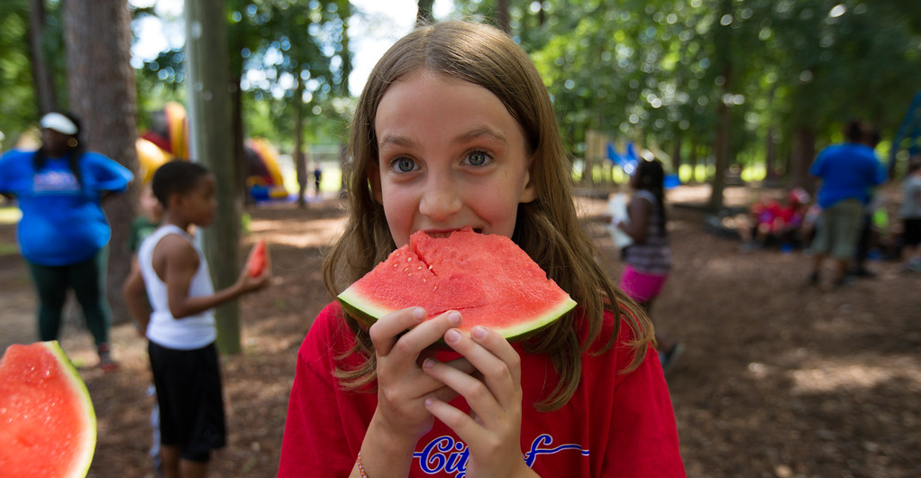
Residence Camps for Youth with Physical Disabilities
Amberlin Piles & Michael Bradley, Ph.D.
Introduction
Social Acceptance and Quality of Life of Pediatric Campers with Physical Disabilities
Results / Findings
A residence camp consists of a facility or campsite that is utilized for the purpose of camping, requires an overnight stay, and is a popular summertime commodity. Youth with disabilities can benefit from residence camps because it allows them to have a sense of belonging while being surrounded by nature and varying aspects of inclusion. The programming at residence camps for youth with disabilities can consist of indoor or outdoor activities, designed and modified to accommodate the needs of individuals to enjoy and feel included.
The qualitative results from the 2006 article provided three themes that emerged: (a) not alone, (b) independence, and (c) a chance to discover. “These themes demonstrated feelings of belonging as a result of experiences and opportunities while at the [segregated summer camp].” (2006). Individuals with disabilities become dependent on others for their care and personal needs, this reliance often creates a safety net where the individual tends to rely on others when making decisions for themselves. Overall, the experiences of the campers resulted in more independence and confidence in terms of their decision-making skills without the reliance on their safety net.
The purpose of the (2015) study was to learn if SA had any impact on the camper’s (N=51) QOL. Data analysis revealed no change in the mean for the General Well-Being Scale between the pre and post-test (pre-test M=3.39; post-test M=3.42) and only a slight change for the SA scale (pre-test M=4.43; post-test M=4.54). A correlation was detected (rs 0.523; p<0.05) between the post-General Well-Being Scale and SA scales. The “qualitative data indicated that the weeklong camp offered experiences that were memorable to the participants and that these activities were well received.” (2015). Overall, the three-month post-camp interviews provided three themes associated with the camper's experience. These areas associated with the camp include vivid recollections of the activities, positive social experiences, and a lack of transference of camp activities to their home environment due to the lack of resources.
(Children's Health Care, 44:1-16, 2015) Youth with disabilities face many social and physical barriers in their lifetimes. Opportunities to connect with others with the same disabilities or life experiences are among the many aspects that these individuals lack in their early childhood. A great way to incorporate social acceptance (SA) into the lives of youth with disabilities is through disability-specific residential camps. Specifically, these "camps offer the chance to learn independent living, communication, social interaction skills as well as important lifelong recreation and leisure skills" (2015). The camp experience can positively benefit one's life by creating a sense of community among campers. Through the community-building aspect of disability-specific camps, youth can be most influenced because of the sense of belonging and social acceptance that they experience there.
Research Purpose
The purpose of this study is to examine the perceptions of youth with disabilities at summer camps. Typically, campers spend the entire week at camp where they can experience the therapeutic value of community, social acceptance (SA) among their peers, and participate in recreationally-based activities that implement skills, which can be used in their everyday life. The research provided correlates three journal articles that were published between the years 2006 and 2020. The articles examined the same topic, residence camps for youths with disabilities, and two of the three articles (2006, 2015) provided qualitative analysis through semi-structured (phone) interview guides and sample questions to gather data from participants following their stay at a summer residence camp.
Sports Camp Continued During Pandemic for Children with Visual Impairments
(Palaestra, Vol. 34, No. 3, September 1, 2020) Much like the rest of the world, the COVID-19 pandemic that struck the world in early 2020 put a massive halt to many in-person opportunities for youth with disabilities. However, when it comes to summer camps, programming is already being modified to meet the individual needs of the participants so making changes to accommodate pandemic guidelines was not out of reach for many programming directors. For the health and safety of all involved, many camps provided virtual opportunities that could be utilized instead of canceling the summer camp experience altogether. The virtual format for “planning discussions resulted in activities that could be done inside or outside the home with relatively minimal equipment and space” (2020). The content included pre-recorded sport activity videos, live sessions of dynamic stretching activities, 30-minute yoga and relaxation sessions, and wellness sessions that covered a range of topics including nutrition, the science of exercise, and stress management. The positive response from participants and families was a key component to the successful facilitation of safe activities throughout the virtual camp amidst the global pandemic.
Summer Camp Experience from the Perspective of Youths with Disabilities
Conclusion(s) / Implication(s)
(Palaestra, Vol. 22, No. 2, March 1, 2006) With inclusivity being a huge priority among the disability community, segregated summer camps offer youth the opportunity to explore identity alternatives. In terms of identity development, the process includes individuals with disabilities negotiating their disability identity together and integrating their non-disability identity through a social context. A camp that created a youth exchange provided “an enjoyable experience for the youths while fostering friendships and providing opportunities to experience a wide range of physical activities.” (2006). The program received positive results from the participants as many felt successful in finding ways to execute new skills and accomplish activities based on their own strengths and abilities. The exchange also allowed participants to discover a positive self-image, which can be realized in a variety of different ways through friendships, attempting and accomplishing new tasks, experiencing success, and gaining a sense of personal control and independence.
It has been shown through rigorously unprecedented situations such as the COVID-19 pandemic that programming for youth with disabilities can be modified in various ways. With positive feedback from participants and their families, disability-specific camps have been proven to benefit youths with disabilities in numerous ways through programs and opportunities. Maintaining safe and inclusive opportunities for youth to access disability-specific summer camps and programming plays a significant role in the positive feedback and facilitated success. The continuation of these programs will allow youths with disabilities to apply the numerous accomplishments, experiences, and skills that they learned into adulthood.
Method / Data Source(s)
References
In A Summer Camp Experience from the Perspective of Youths with Disabilities (2006), youth participants that volunteered for the study were accompanied by their guardians to do separate interviews. Interviewees ranged in age from 14 to 19 years and included both females (N=4) and males (N=5). Sample questions for the youth participants included: What did you learn most about yourself? What experiences were the most meaningful? What was it like to meet other youths with disabilities? Seven of the nine youths provided photographs, with written explanations of why they chose their respective photos, which were taken over the course of their summer camp experiences.
In Examining Perceptions of Social Acceptance and Quality of Life of Pediatric Campers with Physical Disabilities (2015), the study gathered data through a post-camp quantitative and qualitative assessment to collect and analyze data related to social acceptance (SA) and quality of life (QOL). The study participants followed the same criteria from the previous article; however, the age ranges were between 8 to 18 and the interviewee pool was much larger for this study. Out of 95 campers, 51 campers (n=20 male; n=31 female) consented to participate in the pre- and post-camp questionnaire. The quantitative analysis included the Social Acceptance Scale and the PedsQL General Well-Being Scale on the first and last day of camp. The qualitative analysis included the phenomenological approach to investigate participants’ recollections of the camp experience three months post-camp, in which 12 out of the 51 campers participated.
Foster, E. A., Lepore-Stevens, M., Adams, D., & Lepore, M. (2020). The Sports Camp Experience Continued During COVID Pandemic for Children with Visual Impairments. Palaestra, 34.
Knapp, D., Devine, M. A., Dawson, S., & Piatt, J. (2013). Examining perceptions of social acceptance and quality of life of pediatric campers with physical disabilities. Children's Health Care, 44(1), 1–16.
Practical Applications: A Summer Camp Experience from the Perspective of Youths with Disabilities. (2006, Spring). Palaestra, 22, 7-9.

