Slide 1
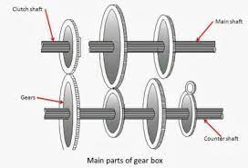
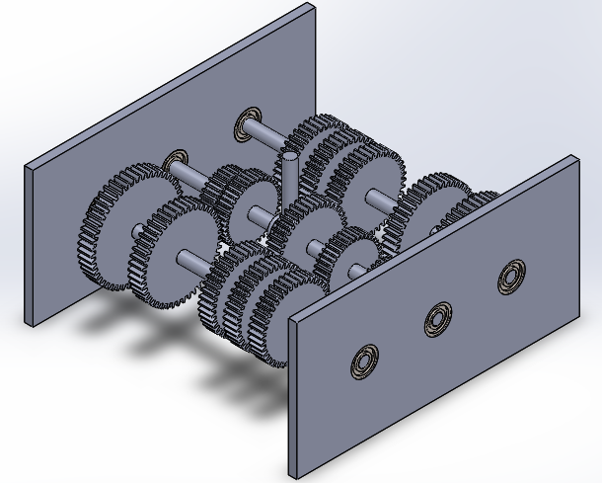
Design and Fabrication of Gearbox
Project Description
Working Principle of Gear Box
Technical Specifications
In this project, the gears and other mechanical parts of the gearbox will be created using 3D printing technology, and they will be joined to shafts and combined with ball bearings for smooth motion. This is constructed to make the ideas of gear mechanics and gear shifting simple to visualize and comprehend.
The working principle of a gearbox involves the use of toothed wheels (gears) to transmit power and motion between rotating shafts. By changing the size and arrangement of gears, a gearbox can change the speed, torque, and direction of motion in a mechanical system.
Operable temperature range: 70℃ to 90℃
Minimum rotation per minute (RPM) of gear shafts: 1500 to 2500
LCD display showing speed (RPM) and gear count
4 shifting gears in the gearbox
Soft body plastic material chosen for minimal friction
Engineering specifications
Project Objectives
Factor of safety: 2
Operating temperature range: 70℃ to 90℃
Minimum RPM of shafts: 1500 to 2500
Gearbox size: Within 16′′ × 16′′
Material: Minimizes friction between gears
Number of shifting gears: At least 4
LCD display: Shows speed (RPM)
Detailed Literature Review of the gearbox.
Complete and Comprehensive Mathematical Modelling of the gearbox.
Computer-Aided Design of the gearbox and Simulations of the gearbox
Fabrication of the gearbox
CAD Model of Gearbox
Problem Statement
Conclusion
We are designing a gearbox to understand the basics and international/local standards of gearbox production, aiming for a cheaper alternative with reduced vibrations compared to advanced but expensive gearboxes commonly used in vehicles.
Functional gearbox for educational purposes, demonstrating cross-disciplinary learning and the use of technical specifications in real-world situations.
The "Gearbox project" focuses on gear mechanics, gear shifting, and possible applications in engineering education and maker culture.
Notes:
To change this poster, replace our sample content with your own. Or, if you'd rather start from a clean slate, press the New Slide button on the Home tab to insert a new page. Now enter your text and pictures in the empty placeholders. If you need more placeholders for titles, subtitles or body text, copy any of the existing placeholders, then drag the new one into place.

