Slide 1
Student Willingness to Report Weapons and School Violence at a Rural Secondary School in Arkansas: A Quantitative Study
Dr. Travis B. Poole
Arkansas Tech University Research Symposium
April 25, 2023

Slide 2
Statement of the Problem
Problem
School Violence/Shootings/Weapons at School
Reporting
How often at school?
Little/no research into reporting these incidents in Arkansas, also nationwide.

Slide 3
Purpose Statement
Purpose of the Study
Examine how often weapons or violence are observed at a rural public secondary school in Arkansas and whether these are being reported.
Examine the characteristics of students associated with reporting or not reporting.
Examine barriers that exist that may explain why students do not report weapons or violent incidents to staff members or adults.

Slide 4
Significance of the Study
Helped identify issues related to students reporting weapons/violent incidents at school.
Identified characteristics of students who report versus those who do not.

Slide 5
Contribution of this study to school/educational Leadership
No studies involving Arkansas students exist for a study of this kind.
Lead to a safer school environment.
Give administrators data to use when implementing/changing policies regarding school safety.
Study can be replicated.
Results shared with state groups/agencies.

Slide 6
Literature Review Overview
School Violence Overview
Violence Prevention
Averted Violence
Threat Assessment
Bullying Prevention
School Intervention
Students Reporting Violence and Weapons

Slide 7
Method and Design
Quantitative study and analysis of secondary students grades 6-12
Focused on reporting weapons/violent incidents at school
Students Surveyed from two campuses from a rural school district in Arkansas.
T-tests and ANOVA

Slide 8
Research Questions
1. Is there a significant difference in students' willingness to report violence or weapons on campus considering factors of grade, gender, or ethnicity?
2. Is there a significant difference in students' willingness to report violence or weapons on campus between students who have a positive perception of school climate compared to those who do not?
3. Is there a significant difference in students' willingness to report violence or weapons on campus perpetrated by a friend between students who would report their friend compared to those who do not, considering factors of grade, gender, or ethnicity?

Slide 9
Research Questions
4. Is there a significant difference in students' willingness to report violence or weapons on campus between students who fear the likelihood of personal consequences compared to those who do not?
5. Is there a significant difference in students' willingness to report violence or weapons on campus between students who have high grades in school compared to those who do not?
6. Is there a significant difference in students' willingness to report violence or weapons on campus between students who are knowledgeable about the resources available to them at school compared to students who are not?

Slide 10
Hypotheses
1. There is no significant difference in students' willingness to report violence or weapons on campus considering factors of grade, gender, or ethnicity.
2. There is no significant difference in students' willingness to report violence or weapons on campus between students who have a positive perception of school climate compared to those who do not.
3. There is no significant difference in students' willingness to report violence or weapons on campus perpetrated by a friend between students who would report their friend compared to those who do not, considering factors of grade, gender, or ethnicity.

Slide 11
Hypotheses
4. There is no significant difference in students' willingness to report violence or weapons on campus between students who fear the likelihood of personal consequences compared to those who do not.
5. There is no significant difference in students' willingness to report violence or weapons on campus between students who have high grades in school compared to those who do not.
6. There is no significant difference in students' willingness to report violence or weapons on campus between students who are knowledgeable about the resources available to them at school compared to students who are not.

Slide 12
Participants/Sample
Study collected responses from students grades 6-12 within a rural school district in Arkansas.
800 students invited, 52 responded to the survey from grades 6-9
26 males/26 females
20 students from grades 6-7, 32 students from grades 8-9
46.2% Hispanic, 42.3% White, 11.5 identified as other races

Slide 13
Instrument
38 Question Survey created or modified from existing school safety studies.
Divided into 5 sections
Demographics
School Climate
Community/Home Values
Personal Incidents
Reporting
Likert-type questions of Strongly Agree to Strongly Disagree

Slide 14
Data Collection Procedures
Assent, Consent forms were distributed to each campus.
Letter to parents and announcement to students.
Incentive
Administered paper copies to all students, students who returned forms completed were locked in safe box.
Can Skip questions if do not feel comfortable.
Google Forms - Excel
SPSS

Slide 15
Limitations
Can not guarantee perceptions and results align with other students
Open to grades 6-12, only able to receive 6-9
Voluntary, not required
Participant reliability

Slide 16
Data Analysis and Results
3 students of the 52 reported knowing of someone who has brought a weapon to school in the past twelve months.
Of those 3 students, two reported this to adults.
29 reported that they heard a student threaten someone in the past 12 months
9 students reported that someone injured them or assaulted them in the past 12 months.
Students reported to whom they would most likely report incidents to:
31.4% teacher, 29.4% principal, 27.5% parents, 11.8% close friend. 65.7% or the respondents indicated it didn’t matter if it was a male or a female they would report to.

Slide 17
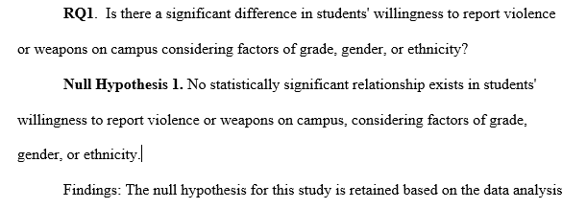
Data Analysis and Results Research Question 1

Slide 18
Data Analysis and Results Research Question 1
One way ANOVA conducted to compare willingness to report considering the student’s grade level and descriptive statistics run on factors of grade, gender, and ethnicity.
No statistically significant differences were found based on grade, gender, ethnicity
One response showed a statistical significance based on a student’s grade: F(3,48) =2.87, p=.046, however, the Sidak post hoc analysis did not reveal any between the grade levels.

Slide 19
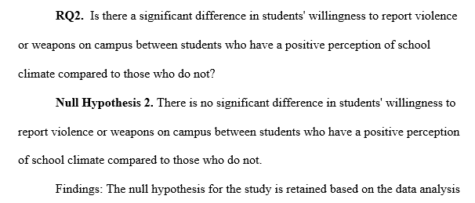
Data Analysis and Results Research Question 2

Slide 20
Data Analysis and Results Research Question 2
No statistically significant difference observed between the two groups of students who had a positive perception of school verse a negative perception of school regarding the 14 statements on school climate.
Some groups had less than five observations.

Slide 21
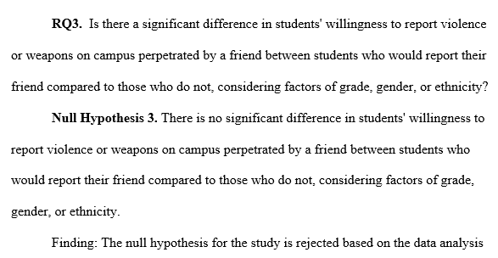
Data Analysis and Results Research Question 3

Slide 22
Data Analysis and Results Research Question 3
A Mann-Whitney test conducted based on the factors of the willingness to report a friend showed to a be a statistically significant factor in 8 of the reporting statements.
1. If I heard a student threaten to hurt someone else with a weapon, I would tell an adult.
2. If I heard about or saw a violent act or someone bringing weapons to school being committed at school, I would report it to a school adult staff member.
3. I would report a student exhibiting violent behavior or bringing weapons to school even if I believed that the student who carried the weapon would probably not use it.
4. I would a student exhibiting violent behavior or bringing weapons to school even if the student might get arrested.
5. I would report a student exhibiting violent behavior or bringing weapons to school, even if the student who carried the weapon would get in trouble.
6. I would report a student exhibiting violent behavior or bringing weapons to school, even if people might think that I am a snitch or tattletale.
7. I wouldn't tell an adult about a violent incident on campus because the adults can 1t protect me from retaliation from other students.
8. I wouldn't report violent incidents in my school because I feel that telling an adult is a betrayal to my classmates.

Slide 23
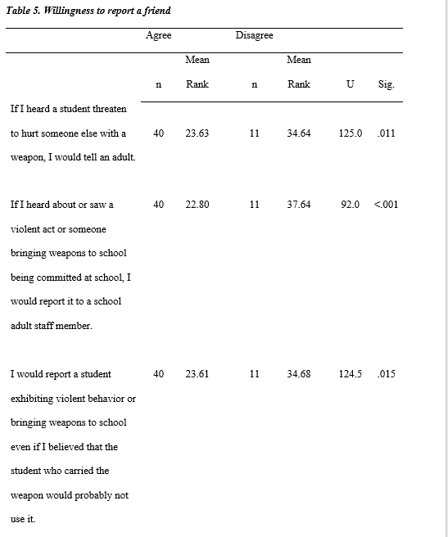
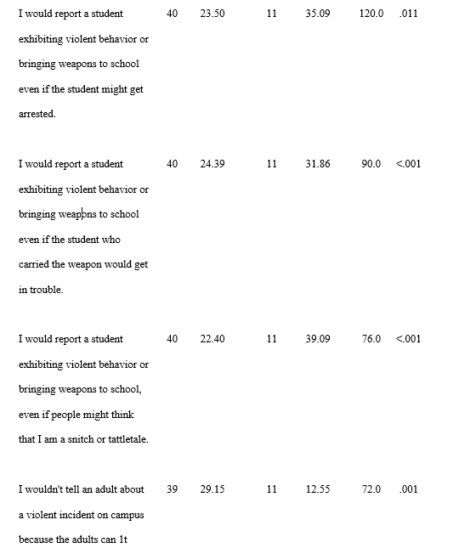
Data Analysis and Results Research Question 3

Slide 24
Data Analysis and Results Research Question 3
Two groups, those who would report, verse those who would not report a friend if could do so anonymously compared responses to the 13 reporting statements.
Two statistical significant reporting questions found:
I would report a student even if she/he was my friend.
I would be more likely to report violent activities or weapons on campus if I could do so anonymously.

Slide 25
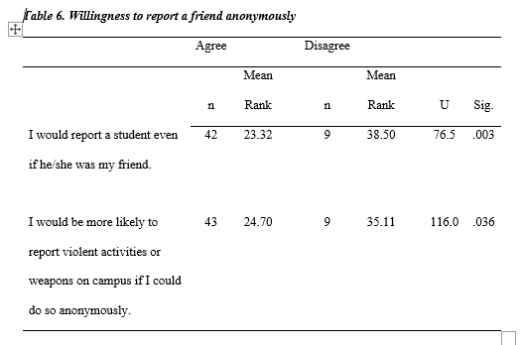
Data Analysis and Results Research Question 3

Slide 26
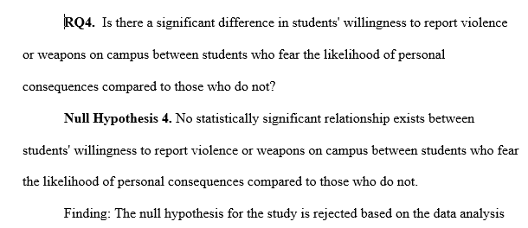
Data Analysis and Results Research Question 4

Slide 27
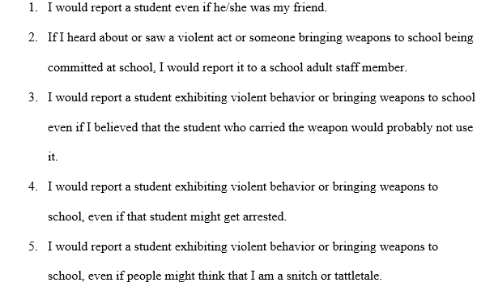
Data Analysis and Results Research Question 4
Statistical test compared the relationship between students who fear the likelihood of personal consequences to those who do not and found that in 5 of the 13 reporting state statements, there was a statistically significant relationship.

Slide 28
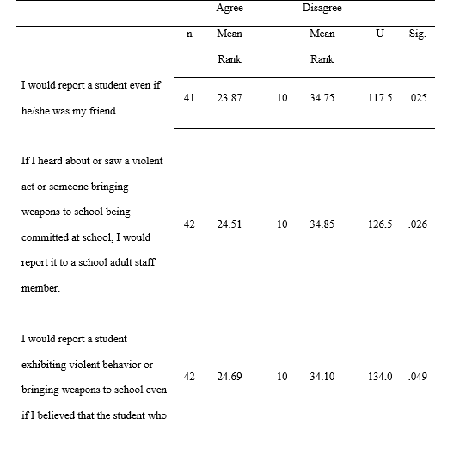
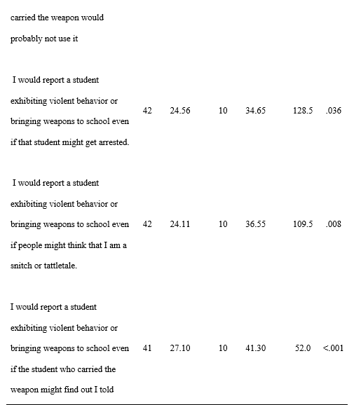
Data Analysis and Results Research Question 4

Slide 29
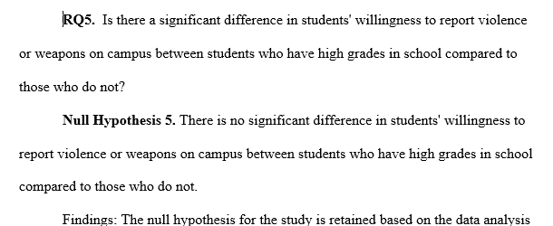
Data Analysis and Results Research Question 5

Slide 30
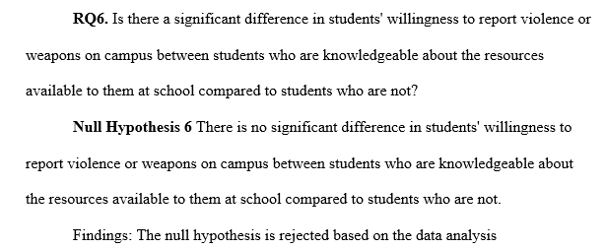
Data Analysis and Results Research Question 6

Slide 31
Data Analysis and Results Research Question 6
Knowing whom to report and where to report were significant factors in the willingness to report violence or weapons on campus.
The analysis indicated that there was a statistically significant difference in:
students who know whom to report to versus those who do not, t(49) = -5.253, p= 0.001
Students that know where to report versus those who do not, t (50)= -5.296, p = .001
Students that agree/disagree on if the school has made it clear about who they should report to, t(47) = -5.168, p = .001

Slide 32
Summary of the findings
No difference in willingness based on demographics or academic performance.
Statistically significant differences in:
Willingness to report based on those who would report their friends v those who would not (code of silence)
Students who fear personal consequences or retaliation v those who do not.
Students who have a higher knowledge of resources about reporting at school
Who to report to
Where to report
How to report

Slide 33
Recommendations For Education
Campaign regarding the importance of reporting violent behaviors.
Create opportunities for staff and students to learn about reporting behaviors.
Create resources for students to report and educate students about resources.
Look into additional anonymous reporting tools and a variety of methods of reporting.
Educate students on whom to talk to, where to go, and how to report.
Topic should be presented more than once per year to staff and students.

Slide 34
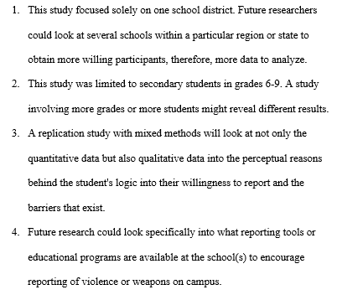
Recommendations for Future Research

Slide 35
Acknowledgements
Dr. Steve Bounds, Chair, Arkansas Tech University
Dr. John Freeman, Arkansas Tech University
Dr. David Hopkins, Superintendent, Clarksville School District

