Slide 1
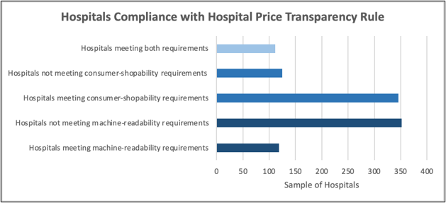
Critical Appraisal: Hospital Price Transparency of Acute Care Hospitals
Raegan Parker and Kylie Moore
Introduction
Method / Data Source(s)
Findings/Results
A rule implemented by Centers for Medicare & Medicaid Services (CMS) in January 2021 states that acute care hospitals are required to post online a machine-readable file that makes changes in hospital price transparency. It aims to improve the affordability of hospital care by promoting price competition. The hospitals that are compliant with the Hospital Price Transparency Final Rule will facilitate online price shopping for patients by making prices for services available. We reviewed the research to explain the purpose of determining how compliant acute care hospitals have been with the Hospital Price Transparency Final Rule since its implementation. A cross-sectional observational study found that 55% of the 3,558 Medicare-certified acute-care hospitals had not posted a machine-readable file. We reviewed research and found that hospitals aren’t compliant with the Final Rule which would compromise the effectiveness of this regulation.
A cross sectional study was done to determine the percentage of acute care hospitals compliancy with the Final Rule. The methods used are both descriptive and analytical. A binary compliance rating of "noncompliance" means there was not a machine-readable file posted, and "compliance" means there was a machine-readable file posted.
After data and samples and a multivariate regression analysis, we understand that more than half acute care hospitals have not been compliant with the Final Rule.
Conclusion(s) / Implication(s)
This influences reimbursement in the HIM profession. The Final Rule has had a positive impact on a hospital's IT preparedness. Hospitals that follow this rule are more likely to have better financial resources, IT preparedness, and the overall affordability of hospital care. In conclusion, the compliancy of this rule is a barrier for some hospitals.
References
Bai, G., Jiang, J. X., Littlejohn, J., Polsky, D., Wang, Y., & Zare, H. (2021). Factors associated with compliance to the hospital price transparency final rule: a national landscape study - Journal of General Internal Medicine.
Nikpay, S. (2021). Taking the pulse of hospitals’ response to the new price transparency rule. Medical Care Research and Review, 79(3), 428-434. https://journals.sagepub.com/doi/abs/10.1177/10775587211024786
Jacobsen, K. H. (2021). In Introduction to health research methods: A practical guide. essay, Jones & Bartlett Learning.
Special Thanks to our Project Sponsors:

