Slide 1
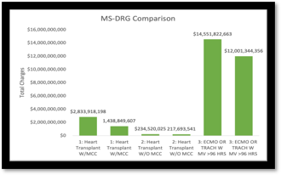
Critical Appraisal: Do MS-DRGs Financially Impact Highly Volumed
Admissions in Post-acute/ Acute Care Hospitals?
Jalynn Bottoms, Kinlee Runnels, Megan Tyler
Introduction
Method / Data Source(s)
Findings/Results
The purpose of our research is looking at Medicare Severity- Diagnosis Related Groups (MS-DRGs) is to categorize Medicare patients into various groupings based on the attributes of their hospital stay. Medicare bases their payments on these MS-DRGs, rather than the hospital length of stay. The article Financial Impact of MS-DRG conversion for high-volume admissions focuses on investigating the Medicare payments on the five most prevalent DRGs and whether savings occur for both the hospital
The methods for this study is descriptive. The data was provided through several descriptive articles which explained how MS-DRGs impact high volume admissions. This articles presents the different MS-DRGs and the outcome of the MS-DRGs.
By looking at the Medicare Provider Analysis and Review (MedPAR) and identifying the most prevalent and frequently assigned DRGs over a 5-year period , it was found that MS-DRGs with the presence of a complication or comorbidity (CC) or major complication or comorbidity (MCC) showed significantly higher reimbursements.
Conclusion(s) / Implication(s)
MS DRGs (Medicare Severity- Diagnosis Related Group) allow CMS (Centers for Medicare and Medicaid Services) to provide accurate payments based on the patient condition and the presence of a complication or comorbidity (CC) or major complication or comorbidity (MCC). This accuracy in billing has provided savings to both the Medicare program and to hospitals.
References
Anonymous. (2008). Financial impact of MS- DRG conversion for high-volume admissions. Healthcare Financial Management, 62(7), 120–120.​
​
Mitchell, K. C. (2007). Understanding the financial impact of ms-drgs. Healthcare Financial Management, 61(11), 56–8.​
​
Anonymous. (2008). Assessing the financial impact of ms-drgs. Healthcare Financial Management, 62(10), 132–3.
Special Thanks to our Project Sponsors:

