Slide 1
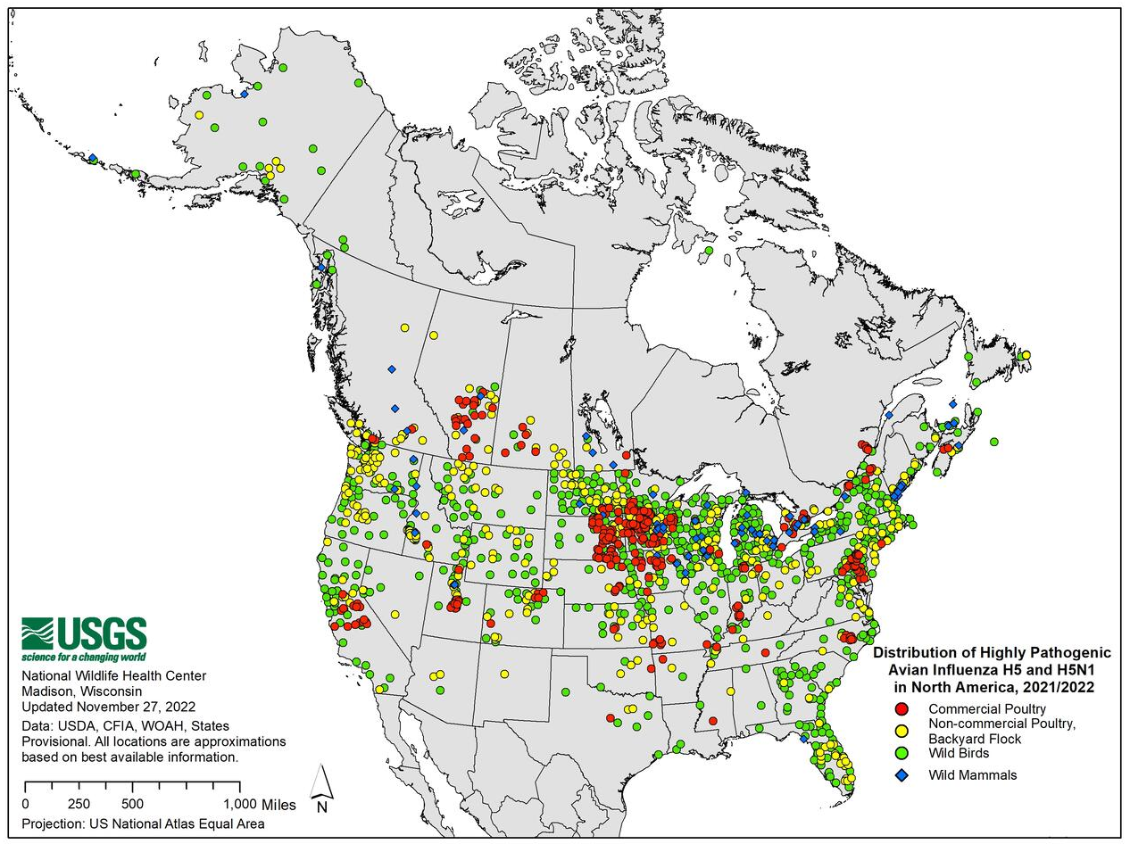
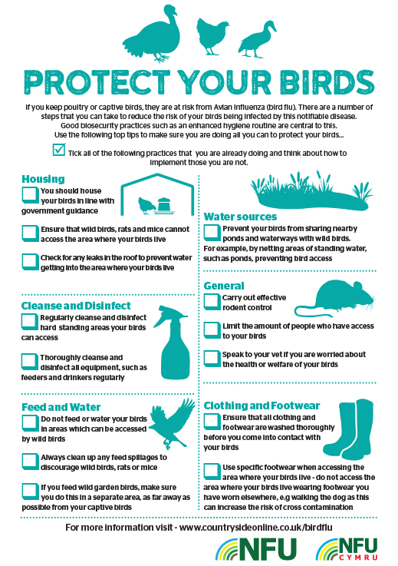
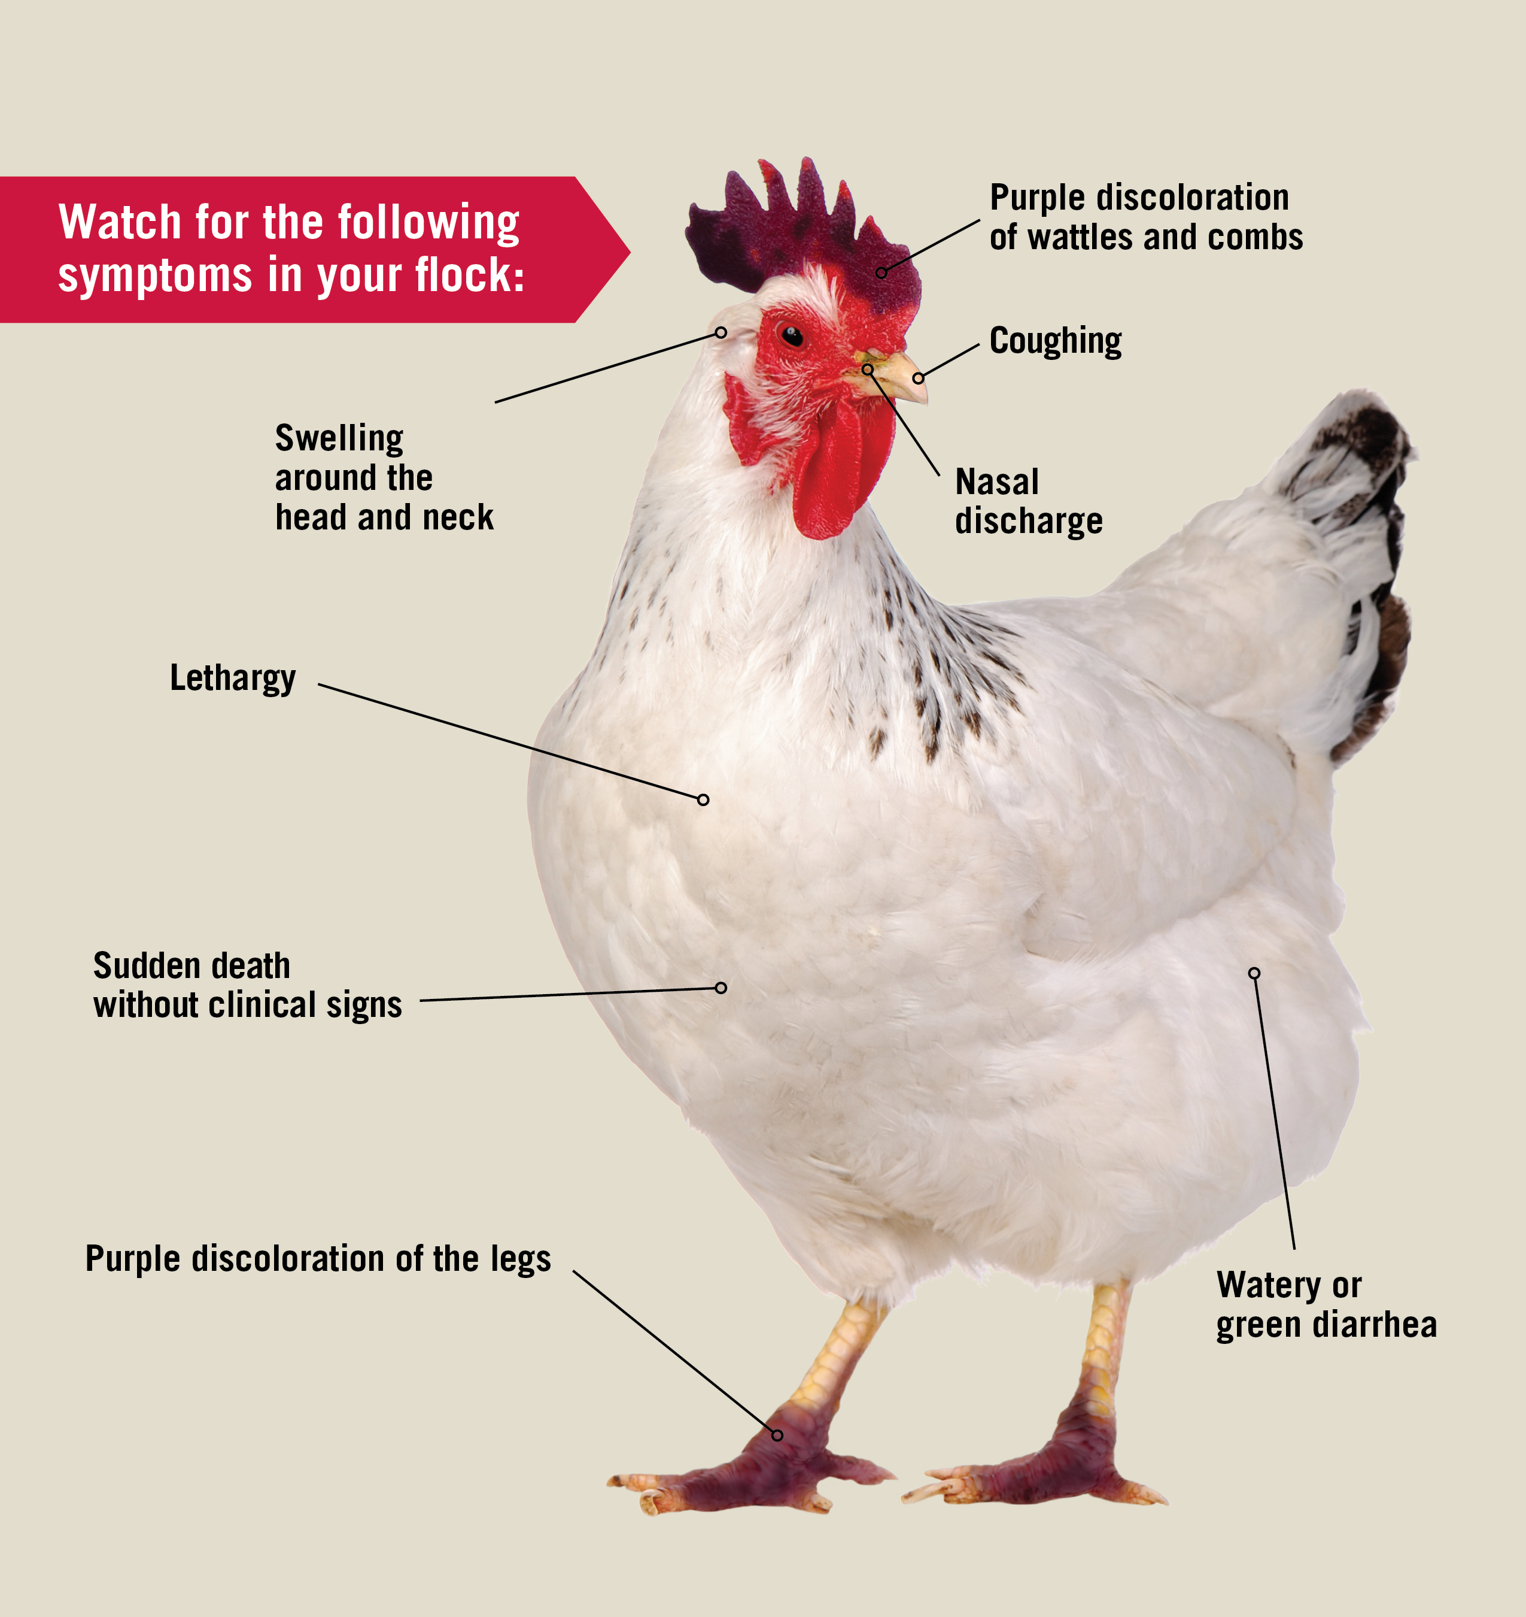
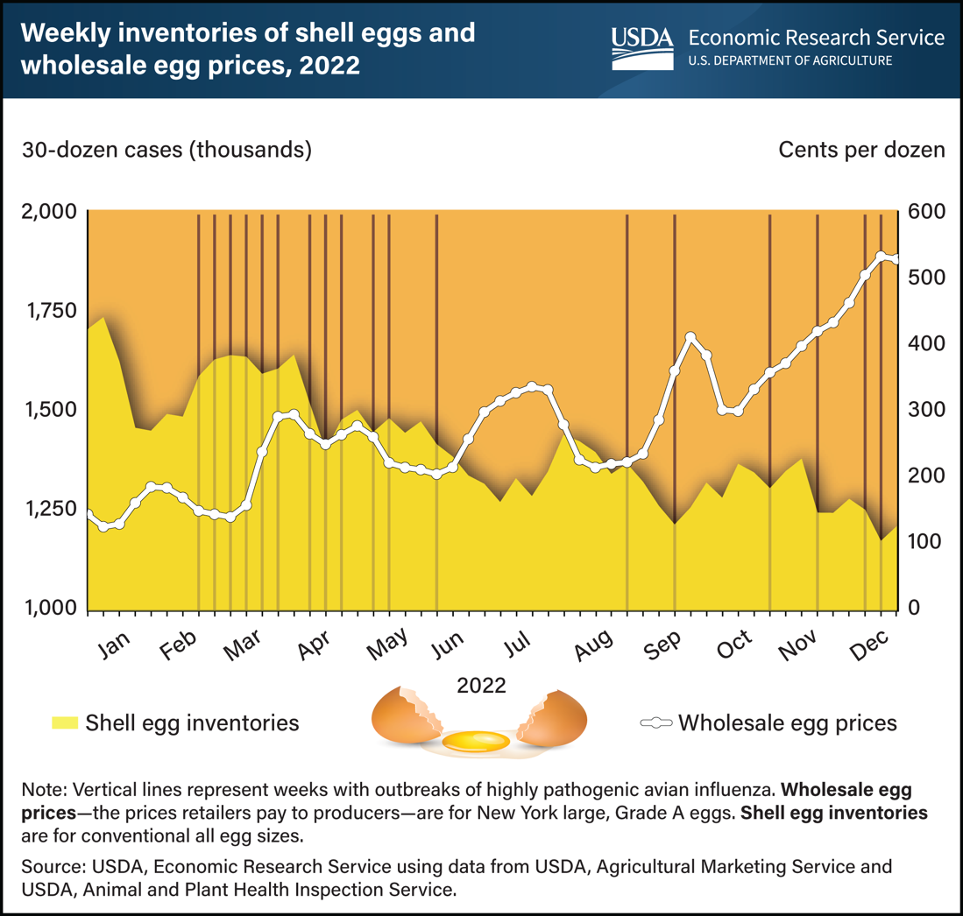
Avian Influenza in the United States and the Ramifications on the U.S Market in the Poultry Industry
Alaini Carrington, Jada Trotter and Savannah Sanders
Arkansas Tech University
Department of Agriculture and Tourism
Introduction
Findings/Results
Discussion / Conclusion
Avian Influenza (AI) has recently received much attention in the last few years due to outbreaks in the poultry industry. There has been a continuous impact of the virus on the United States (US) economy due to the price increase in poultry products. The last significant outbreak was in 2015, and it occurred in nine states killing 50 million birds and costing the industry 3.3 billion. The current avian influenza outbreak has spread to 47 states and currently has over 800 reported outbreaks, according to the Center of Disease Control (CDC).
Signs of flocks with Avian Influenza are sudden death without clinical signs, lack of energy and appetite, decreased egg production or soft-shelled or misshapen eggs, swelling in areas, and nasal discharge, coughing, or sneezing (USDA, 2023). There is no current vaccine or treatment for Avian Influenza.
Avian influenza has caused a major effect on the production of egg-laying numbers around the US. The United States Department of Agriculture (USDA) stated that about 43 million egg-laying hens had been cut from the US flock through the month of December due to the Avian Influenza Virus (USDA, 2023). According to the USDA egg prices reached $4.25 per dozen on average in the month of December 2022.
The impact of highly pathogenic avian influenza (HPAI) has caused farmers to be financially stressed due to the loss of their flocks. Once a farm does contract AI the poultry house must be kept empty for a certain amount of time which leads to an even greater loss of income. The efforts to prevent this outbreak are holistic and global, including surveilling wild birds and strengthening biosecurity measures on poultry farms.
Based on the data collected and the current poultry market, the sway of AI has resulted in a loss not only for the poultry industry but also for local consumers. Almost every state has had a positive AI case which has greatly affected how the industry and consumers have acted. Many cases of AI are not just from commercial farms spreading to each other, but backyard birds contracting and spreading it. Backyard birds are more susceptible to getting infected because many do not have the same measures placed to keep their birds isolated but also keep them from infecting others. As of April 11th, 2023, 496 cases of AI have been reported in backyard birds versus commercial birds having 323 cases (USDA, 2023).
Overall, AI has impacted the United States since the rise of numbers in 2022.The spread of AI largely reflects the migrations and the movement of wild birds. Highly Pathogenic Avian Influenza is the most prevalent variation that is deadly and continues to infect commercial and backyard farms.
From the data collected, other than backyard birds, egg laying hens are the most vulnerable to AI. This is because they are placed in these houses longer than other poultry. In commercial broiler farms chickens are kept for about only 21- 47 days and turkeys are placed for approximately 84-105 days. Comparatively hens that are laying eggs will stay on the farm for around 315 days. This leads the hens to be vulnerable and more time to contract the virus.
For farms to reduce the risk of contamination and spreading AI, biosecurity is the most preventive measure that they can take. By instilling preventive measures this will reduce the risk for farm-to-farm risk and decrease getting the virus from wild birds. ​All commercial farms have required measures in place, but backyard farms do not have the same preventative measures in place.
Figure 1: Distribution of Highly pathogenic Avian Influenza in North America
As of April 11th, 2023, an updated number of 58.6 million birds have been affected by avian influenza. Currently forty-seven states are affected by the bird flu, according to the Centers for Disease Control and Prevention (CDC, 2023).
References
Avian influenza outbreaks reduced egg production, driving prices to record highs in 2022. USDA ERS - Charts of Note. (n.d.). Retrieved April 6, 2023, from https://www.ers.usda.gov/data-products/charts- of-note/charts-of-note/?topicId=7f4bc0a8-e023-49b9-ba3a-1c4665534017
Avian Influenza (AI). USDA APHIS | Avian Influenza (AI). (n.d.). Retrieved April 12, 2023, from https://www.aphis.usda.gov/aphis/ourfocus/animalhealth/nvap/NVAP-Reference-Guide/Poultry/Avian- Influenza
Avian Flu Prevention Flyer . (n.d.). University of Georgia . Retrieved April 2023, from https://extension.uga.edu/topic-areas/animal-production/poultry-eggs/avian-flu.html.
Centers for Disease Control and Prevention. (2022, March 9). Avian influenza in birds. Centers for Disease Control and Prevention. Retrieved April 5, 2023, from https://www.cdc.gov/flu/avianflu/avian-in-birds.htm
Centers for Disease Control and Prevention. (2022, November 3). U.S. approaches record number of avian influenza outbreaks in wild birds and poultry. Centers for Disease Control and Prevention. Retrieved April 12, 2023, from https://www.cdc.gov/flu/avianflu/spotlights/2022-2023/nearing-record-number-avian- influenza.htm
CountrySide. (2023). Protect Your Birds . Preventing bird flu. Retrieved from https://www.countrysideonline.co.uk/articles/preventing-bird-flu/.
USGS (Ed.). (2022, November). Distribution of highly pathogenic avian influenza in North America, 2021/2022 active. Distribution of Highly Pathogenic Avian Influenza in North America, 2021/2022 | U.S. Geological Survey. Retrieved April 2023, from https://www.usgs.gov/centers/nwhc/science/distribution-highly-pathogenic-avian-influenza-north-america- 20212022
Methods
The data gathered for this research was collected from publicly available information for poultry production, rates, and figures. Data was also collected from government sources that have a good representation of the industry. Egg production cycles and flock dynamics changes quickly and have a short turnover which results in a short time frame in which data is collected.
Figure 2: The United States Department of Agriculture (USDA).
Figure 2 shows how Avian Influenza has affected birds and egg-laying hens since 2022 (USDA, 2023) by observing weekly inventories of shell eggs and wholesale egg prices. At the start of January 2022, egg prices were 200 cents per dozen. Then in December 2022, the price rose to 600 cents creating a 400 cents difference.
Special Thanks to our Project Sponsors:

