Slide 1
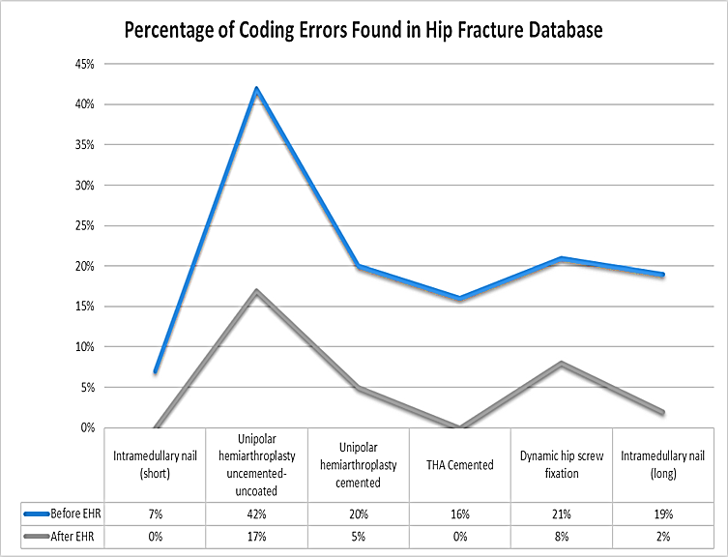
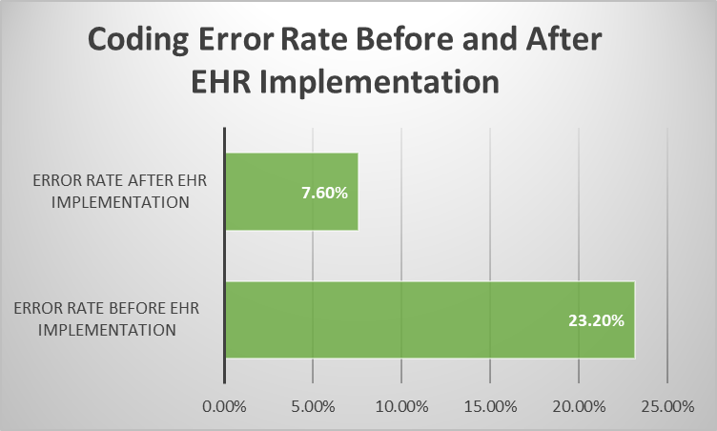
A Research Appraisal of how Electronic Health Record Implementation has Impacted Coding Efficiency
Abby Phillips & Jasmine Ware
HIM 4093-M01, Fall 2022
Introduction
Findings/Results
This research project highlights the ways that coding efficiency has been improved in healthcare over the years, with an emphasis on EHR implementation. This research project references and analyzes trends concerning coding and the revenue cycle from both credible and reliable sources. In this research study, we will reference articles that analyze trends and create a visual understanding of the data collected. This study will highlight a broad spectrum of the impact of electronic health record implementation in the healthcare setting. (Tsai et al., 2020)
Based off this study, the use of an electronic health record significantly minimized the number of coding errors in the National Hip Fracture Database (NHFD), as opposed to the number of errors that occurred in the database before the implementation of an electronic health record. The coding error percentage rate decreased from 23.2% to 7.6% after EHR usage.
Conclusion(s) / Implication(s)
Research Purpose and/or Question(s)
According to this specific study, EHR usage does improve the accuracy and efficiency of coding and reimbursement. An EHR system provides automated capabilities that can assist many HIM professionals in their day-to-day tasks. The EHR system in this study provided an automated auditing system, hence the error reduction in coding. The main goal of a HIM professional is to provide quality of care that is efficient. The EHR system in this study increases both efficiency and quality in reimbursement care.
The purpose of this study is to provide insight on how Electronic Health Record usage has alleviated the presence of coding errors in the medical record.
Method / Data Source(s)
In this study, researchers gathered information from sources who compared archived records (before EHR usage) and recent records (after EHR implementation). This study involved specific hospitals and specific procedures. In these studies, researchers highlighted the presence and frequency of coding errors before and after EHR usage. They analyzed their findings by conducting sensitivity and specificity tests to determine the impact.
References
Lawrence, J.E., Cundall-Curry, D., Stewart, M.E., Fountain, M.D., & Gooding C.R. (2019). The use of an electronic health record system reduces errors in the national hip fracture database. Oxford University Press, 48(2). https://doi.org/10.1093/ageing/afy177​
Tsai, C. H., Eghdam, A., Davoody, N., Wright, G., Flowerday, S., & Koch, S. (2020). Effects of Electronic Health Record Implementation and Barriers to Adoption and Use: A Scoping Review and Qualitative Analysis of the Content. Life, 10(12), 327. https://doi.org/10.3390/life10120327​
Special Thanks to our Project Sponsors:

