Slide 1
Graduate Faculty Directory
Christopher Andrews, Cody McKenney, Drake Traylor, and Joseph Freeman

Slide 2
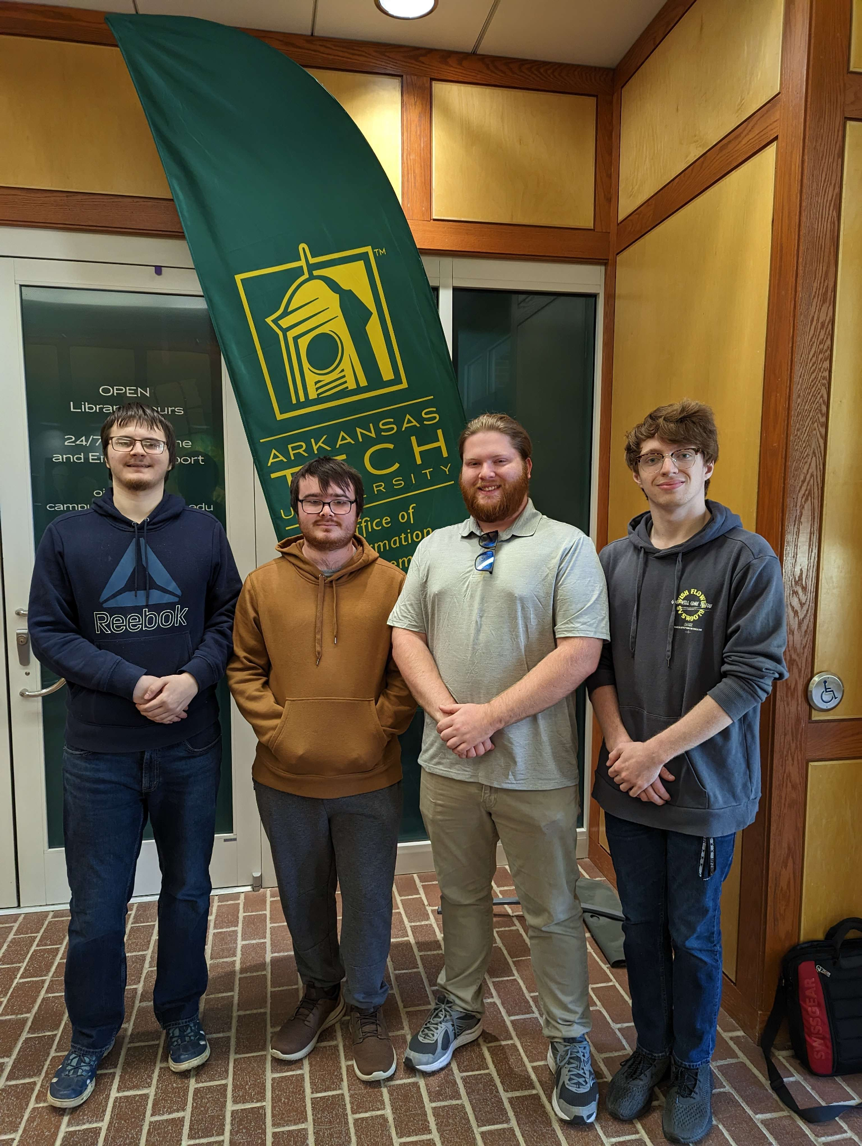
Team Roles
Christopher Andrews
Contact/meeting with clients
Documentation for weekly reports
Cody McKenney
HTML Webpage
CSS
Drake Traylor
PHP
User Manual
Joseph Freeman
Oracle / Database Implementation

Slide 3
Introduction & Customer
Client is the ATU Graduate College
Graduate Faculty Search system
Allows Searching for faculty by certain parameters
Notes:
The Arkansas Tech Graduate College, specifically Graduate Student Support Services are a part of ATU that deals with Graduate Students going for Degrees past Bachelors and helps these students and those who are interested with information for the Graduate degrees offered
Graduate Students
Prospective Graduate Students

Slide 4
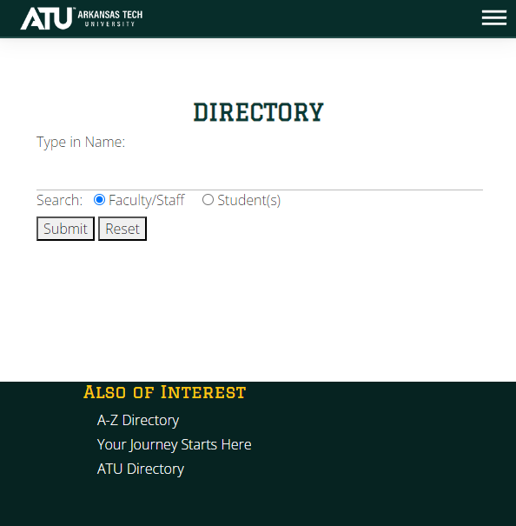
Problem Statement
Lack of resources that allow for the searching of faculty
Current search directory requires you to know information about faculty beforehand
Extremely difficult to find graduate faculty that can help with specific research
ATU’s Current Directory

Slide 5
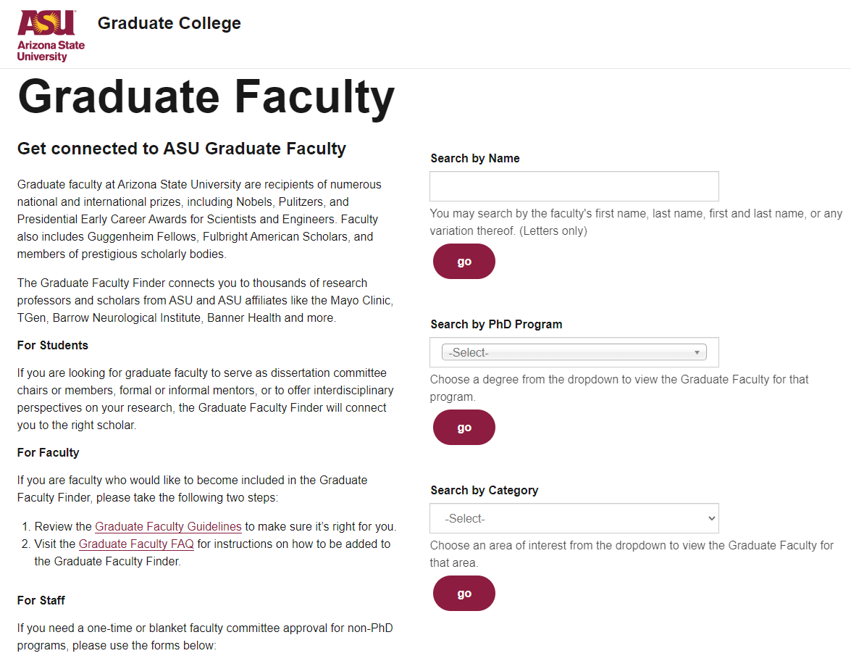
Requirement Determination
A search function that falls under the following parameters
A site design that matches the layout of the ATU domain
Can update the webpage with a table displaying information accurate to user search
ASU Example

Slide 6
Planning
Must have compatibility with ATU’s current Information Systems
Oracle Database
ATU assets (css, bootstrap, font awesome, etc.)
Must use a mock database
Library has Excel Sheets that includes research information for faculty
Use PHP to fetch data from the database and display it back after a user search
No current variable in ATU’s database for Research Interests
Search by: Name, Department, and Research Interests
Displays: Name (links to ATU faculty page), Email, Department, Research Interests

Slide 7
Weekly Team Meetings
Met weekly via Discord
Filled out weekly reports
Discussed project progress
Group coding

Slide 8
Meetings with client and project sponsor
1/19/2023 - First meeting with (Graduate College)
1/21/2023 - Technical considerations and requirements (OIS)
2/14/2023 - Website design and clarification (Graduate College)
2/23/2023 - Meeting with Librarian over faculty information
3/16/2023 - Site and database framework of project (OIS)
4/11/2023 - Showing site functionality (Graduate College)
Notes:
We met with our client on multiple occasions starting with 1/19/2023 for the introduction to the project and what the ATU Graduate Office would like to have done
We met another time on 2/14/2023 to go over a framework of the site and what it should somewhat look like when finished for approval to continue with the planned design
Our last meeting with the client was on 4/11/2023 to showcase what the final site will look like when being used and what last changes would like to make before the project is finished and handed off to OIS for final changes for ATU Implementation.

Slide 9
Analysis Models

Slide 10
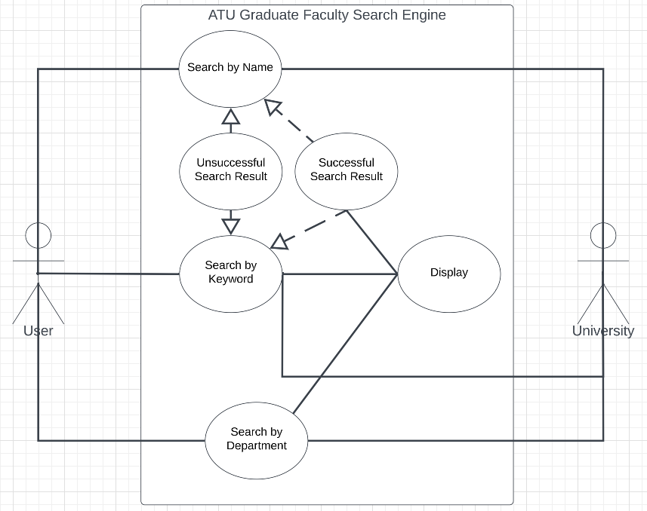
UML Diagram

Slide 11
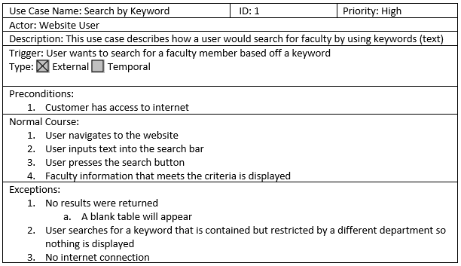
Use Case

Slide 12
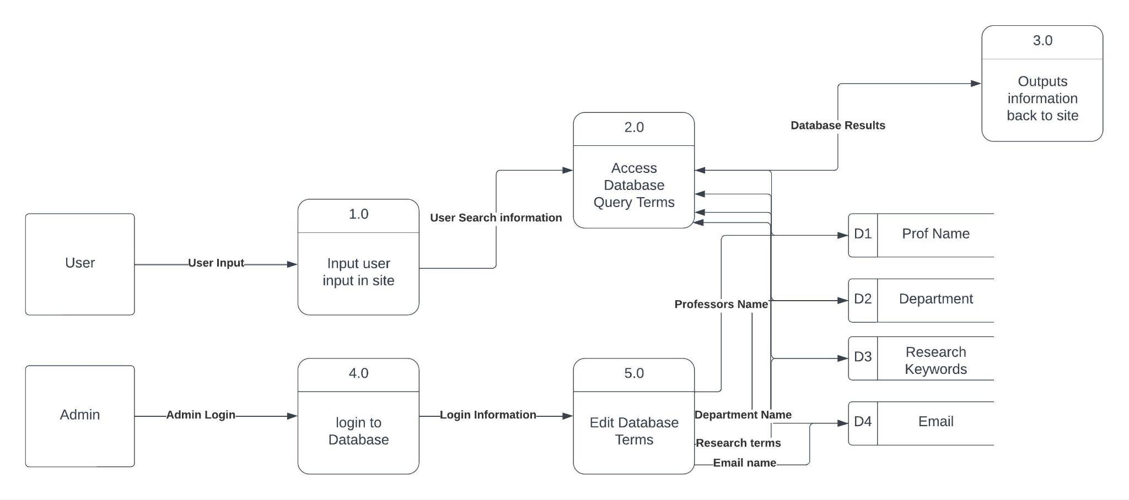
DFD

Slide 13
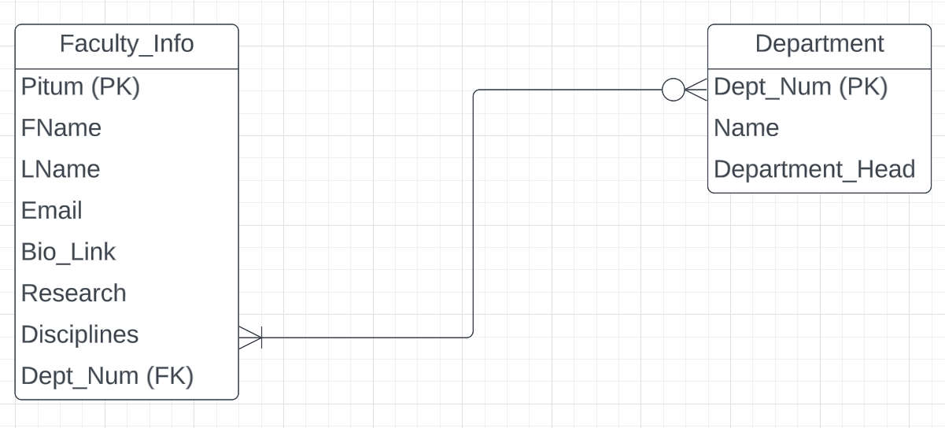
ERD

Slide 14
Database

Slide 15
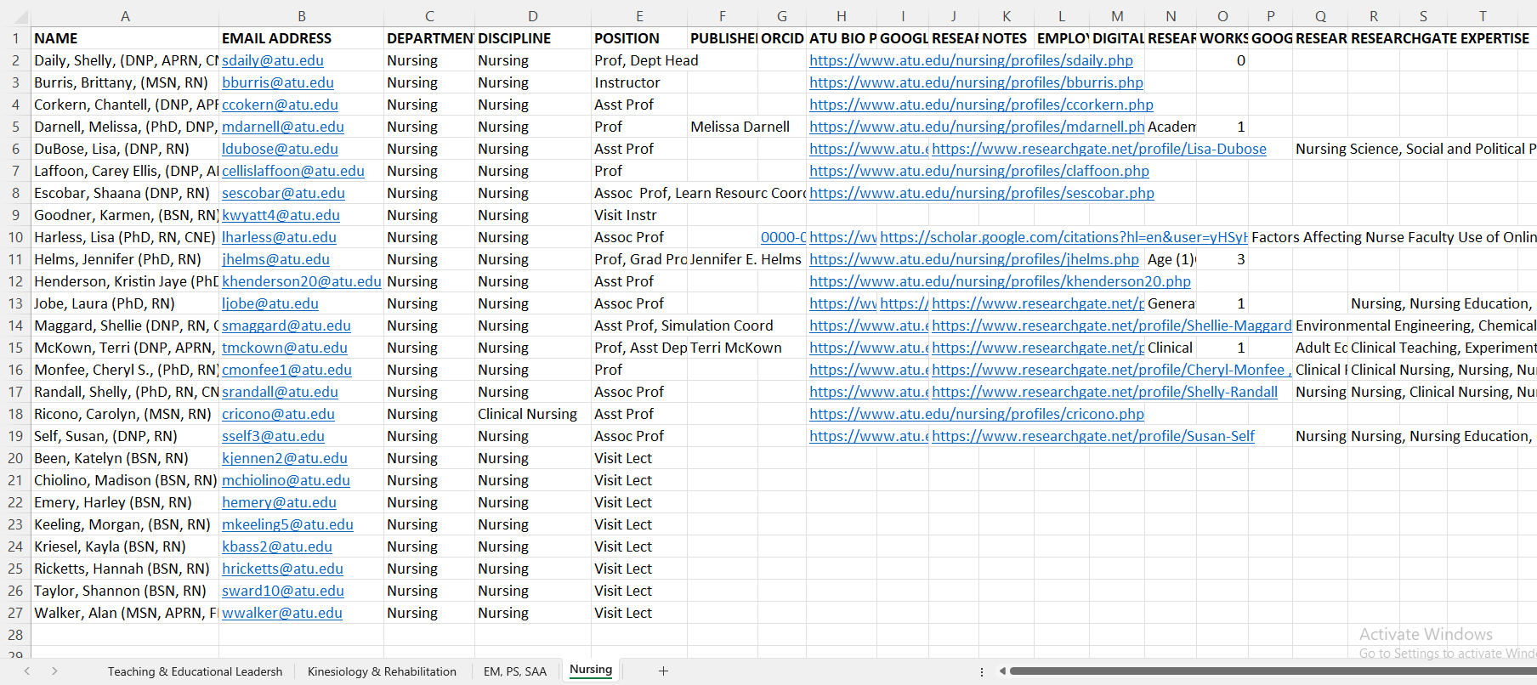
Original Excel Spreadsheet

Slide 16
Reworked Excel Spreadsheet

Slide 17
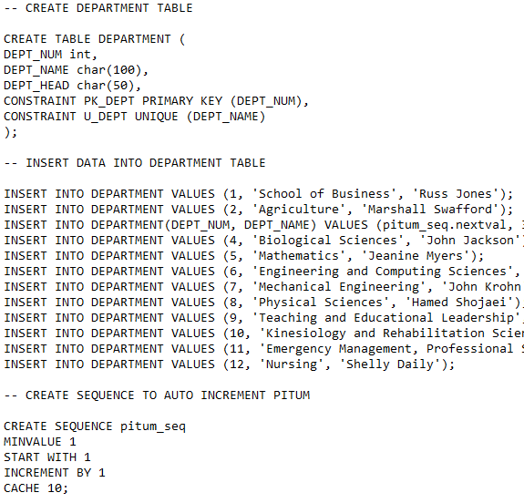
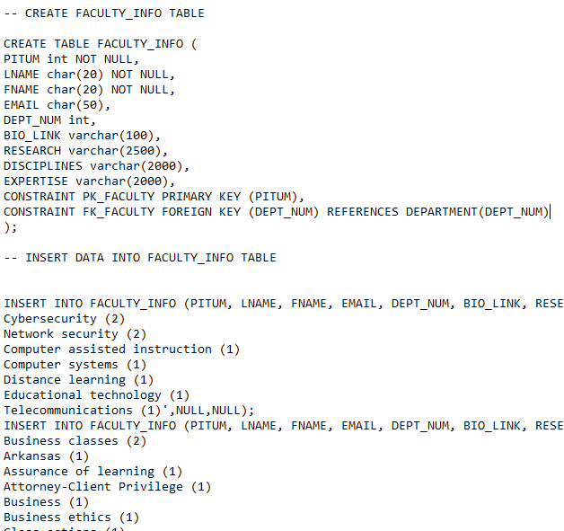
Converting Excel to Oracle

Slide 18
Database Connectivity
Database functionality with PHP
Using XAMPP for Database connectivity and to run our PHP Script
Makes use of Oracle Instant Client to enable Oracle to connect to the web server as well

Slide 19
Coding

Slide 20
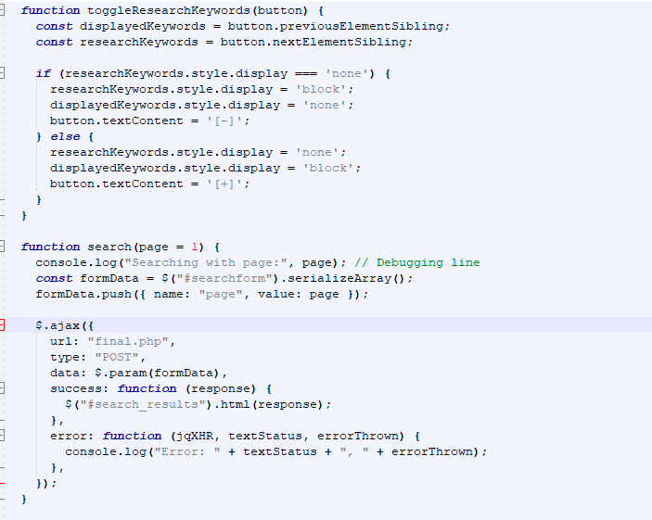
Javascript
Enables certain features in our system
Dynamic search results with ajax
Expand and collapse buttons for the research keywords
Gives the pagination page number buttons actual function

Slide 21
PHP
PHP is responsible for a multitude of different tasks in our system.
Connecting to the database
Pulling information relevant to the user search from the database
Displaying that information in the form of an html table
Sorting that information into separate pages with pagination

Slide 22
PHP Cont.
Database Query PHP
Pagination Count PHP

Slide 23
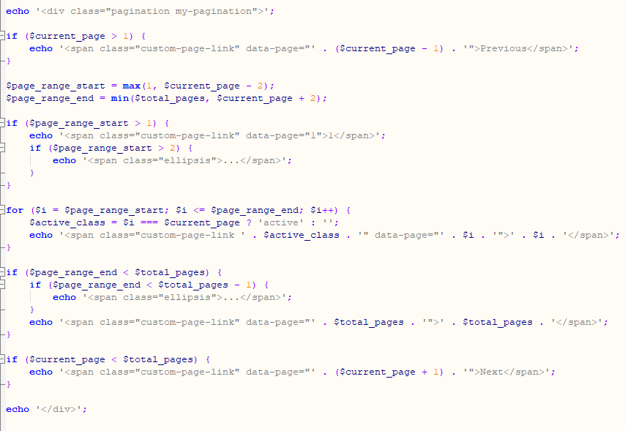
PHP Cont.
Pagination PHP

Slide 24
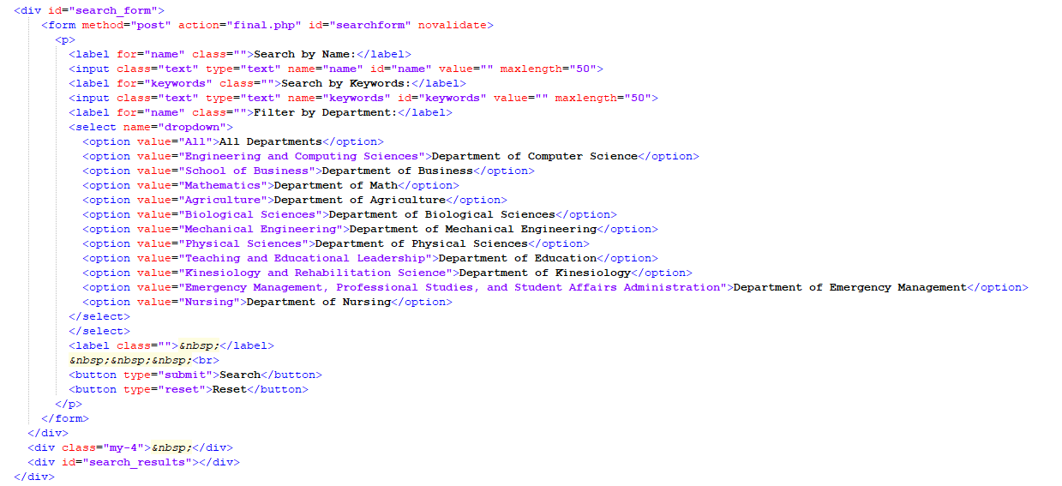
HTML
Search Options HTML

Slide 25
Used Libraries / Frameworks
Font Awesome
Bootstrap
Jquery

Slide 26
Conclusion

Slide 27
Security Risks
SQL Injection
Cross Site Scripting (XSS)
SQL Injection Example:
Cross Site Scripting Example:

Slide 28
Legal and Ethical Implications
Publicly available information on Faculty

Slide 29
ATU’s In Place Security Features
ATU’s current system uses XML (Extensible Markup Language)
XML stores and transmit data using tags to define the structure of data
Separates data from code (SQL Injection)
Allows data to be encoded before being displayed (XSS)

Slide 30
Issues faced
Oracle setup
Web server setup
Expand and collapse feature for keywords
Pagination with PHP
User search showing up on a different page than the search

Slide 31
What we learned
How to work with a client and sponsors to complete a project
Semi-frequent meetings to discuss project requirements and previews
How to work as and consistently meet as a team
Weekly reports
Frequent meetings
Technical Skills:
PHP
Oracle Database (SQL)
Web Server
HTML & CSS
Javascript

Slide 32
Future Implementation
Adjusting PHP to work with XML
Hosted on ATU’s domain
Semi-consistent updates of faculty information
Expanding search to include all faculty

Slide 33
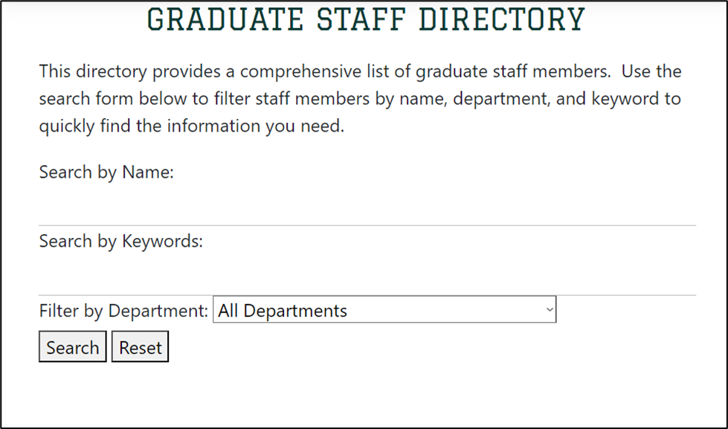
System Demo
Graduate Faculty Directory: http://localhost/web4.html

Slide 34
Questions?

