Slide 1
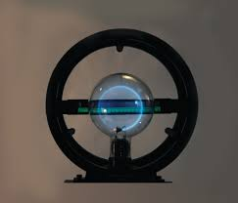
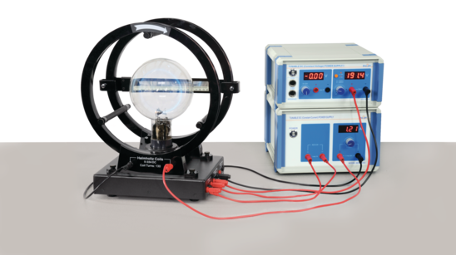
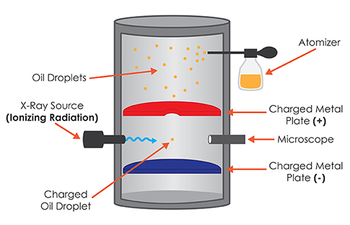
Electron Charge to Mass Ratio
Tori Freeman, tfreeman21@atu.edu | Quinlin Reynolds, qreynolds@atu.edu
Introduction
Method/Data Sources(s) (continued)
Discussion
The purpose of this experiment is to confirm the e/m ratio and charge of an electron discovered initially by J.J. Thomson. We use an electron beam generated inside an e/m tube and Helmholtz coils that generate a magnetic field which deflects the path of the electrons. The radius of the path can be measured and from there the magnitude of the magnetic field and the charge-to-mass ratio can be found. This experiment was successful in confirming the results found by J.J. Thomson and his cathode ray experiments. The results of this experiment had a 0.5% error with the accepted e/m ratio value of 1.76 x 10¹¹ C/kg.
The setup was allowed to warm, and then tuned to an appropriate current that allowed for a uniform deflection of the electrons in a circular pattern until a complete circle was formed. To collect data within the experiment the 12V DC Voltage Power Supply was tuned in accordance with the 3.5A/6.3 DC Current Supply to create various electron beam circles. These various circles were measured, and the radius was recorded, to calculate the overall ratio of charge to mass for each electron beam
The average experimental electron charge to mass ratio is (-1.771 ± 0.155) × 10¹¹ C/kg, and the accepted value is -1.759 × 10¹¹ C/kg. The calculated percent error is 0.68%.
Using the experimentally determined electron charge to mass ratio and the accepted mass of the electron, 9.1093837 × 10⁻³¹ kg, the experimental value for the charge of an electron is (-1.613 ± 0.414) × 10⁻¹⁹ C. The accepted value for the charge of an electron is -1.602 × 10⁻¹⁹ C, resulting in a 0.44% error.
Research Purpose and/or Question(s)
The purpose of this study is to confirm the results of J.J. Thompsons cathode-ray experiments and the results of later oil-drop experiments performed by Robert Millikan.
Method / Data Source(s)
PASCO e/m tube
PASCO Helmholtz Coils and Base
PASCO Mirrored scale
12V Tunable DC Voltage Power II
3.5A/6.3V Tunable DC Current Supply
850mm red and black connecting cables
Connecting cable for PASCO 85 Universal Interface
PASCO power cord
Conclusion(s) / Implication(s)
Figure 2: Circular electron beam within helium-filled glass bulb
The experimentally determined values did support the accepted values and prove that the electron's mass is proportional to the electric charge.
Possible sources of error are the measurement method. The ruler needed to be adjusted into the middle of the electron beam loop which took precision and accuracy. The radius of the loop appeared to change when head placement changed and a mono-focal versus a bi-focal perspective was utilized. These adjustments were subjective and could be possible sources of error within experimentation.
The results of this experiment align with the previous Millikan oil drop experiment performed. Determining the charge of the electron is best done using the methods outlined in this report. Compared to the Millikan oil drop experiment, there are less possible sources for error, data collection is simpler, and the experiment is less time consuming, which allows for more data collection and better accuracy. The results from this experiment aligned with the accepted values for electron charge to mass ratio and electron charge more than the results from the Millikan oil drop experiment. The data collected from the non-ionized portion of the Millikan oil drop experiment was 73% error.
Figure 3: The Millikan Oil Drop Experimental Setup
Findings/Results
Figure 1: lab set-up for PASCO E/M tube, Helmholtz coils, power supply, and current supply
For each trial, the voltage (U) and current (V) were varied resulting in electron beams with different radii (r). The results of each experimental trial as well as the calculated E/M ratio and electron charge are recorded in Table 1.
Knowing the current passing through the Helmholtz loops from the 3.5A DC Power Supply and the Biot-Savart Law for the total magnetic field within a coiled loop, the magnetic field B, can be derived. From the setup of the two coil's symmetry only the z component of the B field is left resulting in:
When the loops are on either side of the bulb at the origin (z=0) simplifying B in the z component to :
The electron beam accelerating through a perpendicular magnetic field produces a perpendicular Lorentz force inward (1), equating this force to the circular centripetal force of the moving electron beam (2) an equation is produced that can be substituted with the velocity from the electron gun (3) to produce an equality for the charge over mass of an electron (4).
1.
2.
3.
4.
Table 1: Experimental values and obtained results for trials 1-5
Trial | U (V) | I (A) | r (cm) | E/M ratio (10 C/kg) | Electron Charge (10 C)
1 | 120 | 1.20 | 4.25 | 1.686 | 1.535
2 | 140 | 1.80 | 3.15 | 1.591 | 1.453
3 | 150 | 2.40 | 2.25 | 1.880 | 1.714
4 | 165 | 3.00 | 2.00 | 1.675 | 1.526
5 | 180 | 3.57 | 1.60 | 2.016 | 1.838
11
-19
Data obtained from the experiment was analyzed using standard deviation to determine the discrepancies in results between each trial and percent error to determine the difference between the experimentally determined values of the E/M ratio and electron charge to the respective accepted values.
Variables
B = Magnetic field (T)
R = r = Radius of electron loop (m)
F = Lorentz force (T)
M = Mass (kg)
V = Velocity (m)
U = Accelerating voltage (V)
E = Electron charge (C)
H = Number of current carrying loops
µ = 4π × 10⁻⁷ N/A²
I = Current (A)
Z = Distance from current loop (m)
Table 2: Analysis and comparison of experimental results
 | ​Accepted Values | ​Average Experimental Values | ​Percent Error (%)
E/M ratio (10 C/kg) | ​-1.759 | ​-1.771 ± 0.155 | 0.68​
Electron Charge (10 C) | -1.602 | -1.613 ± 0.414 | 0.44
References
E/M apparatus • se-9629. PASCO scientific. (n.d.). Retrieved April 18, 2023, from https://www.pasco.com/products/lab-apparatus/electricity-and-magnetism/magnetic-fields/se-9629
Millikan oil drop apparatus • AP-8210A. PASCO scientific. (n.d.). Retrieved April 18, 2023, from https://www.pasco.com/products/lab-apparatus/fundamental-constants/ap-8210
11
-19
Special Thanks to our Project Sponsors:

