Slide 1
Distracted Driving Detection System
Tristan Caja
Chance Gregurek
Elizabeth Riney
Wesley Heikes
ARKANSAS TECH UNIVERSITY

Slide 2
Introduction
In 2020, distracted driving claimed the lives of 3,142 people in the United States.
There are different kinds of distracted behavior.
Our solution to this problem uses computer vision to classify distracted driving and aims to work with insurance agencies in the process.
Notes:
According to the CDC vehicle safety division, one in five car accidents is caused by a distracted driver. The goal of our project is to create an incentive for drivers to practice safe driving more thoroughly.
Working with insurance agencies, our idea is to use machine learning to analyze a driver's performance and use that metric to hopefully improve their insurance rate.

Slide 3
10 Classes of Driver Behavior
Notes:
Taking this further, our model will be able to distinguish what kind of distracted behavior was present while driving.
Here we can see the 10 classes that will be used in this project. Note that only one of these classes falls under safe driving.

Slide 4
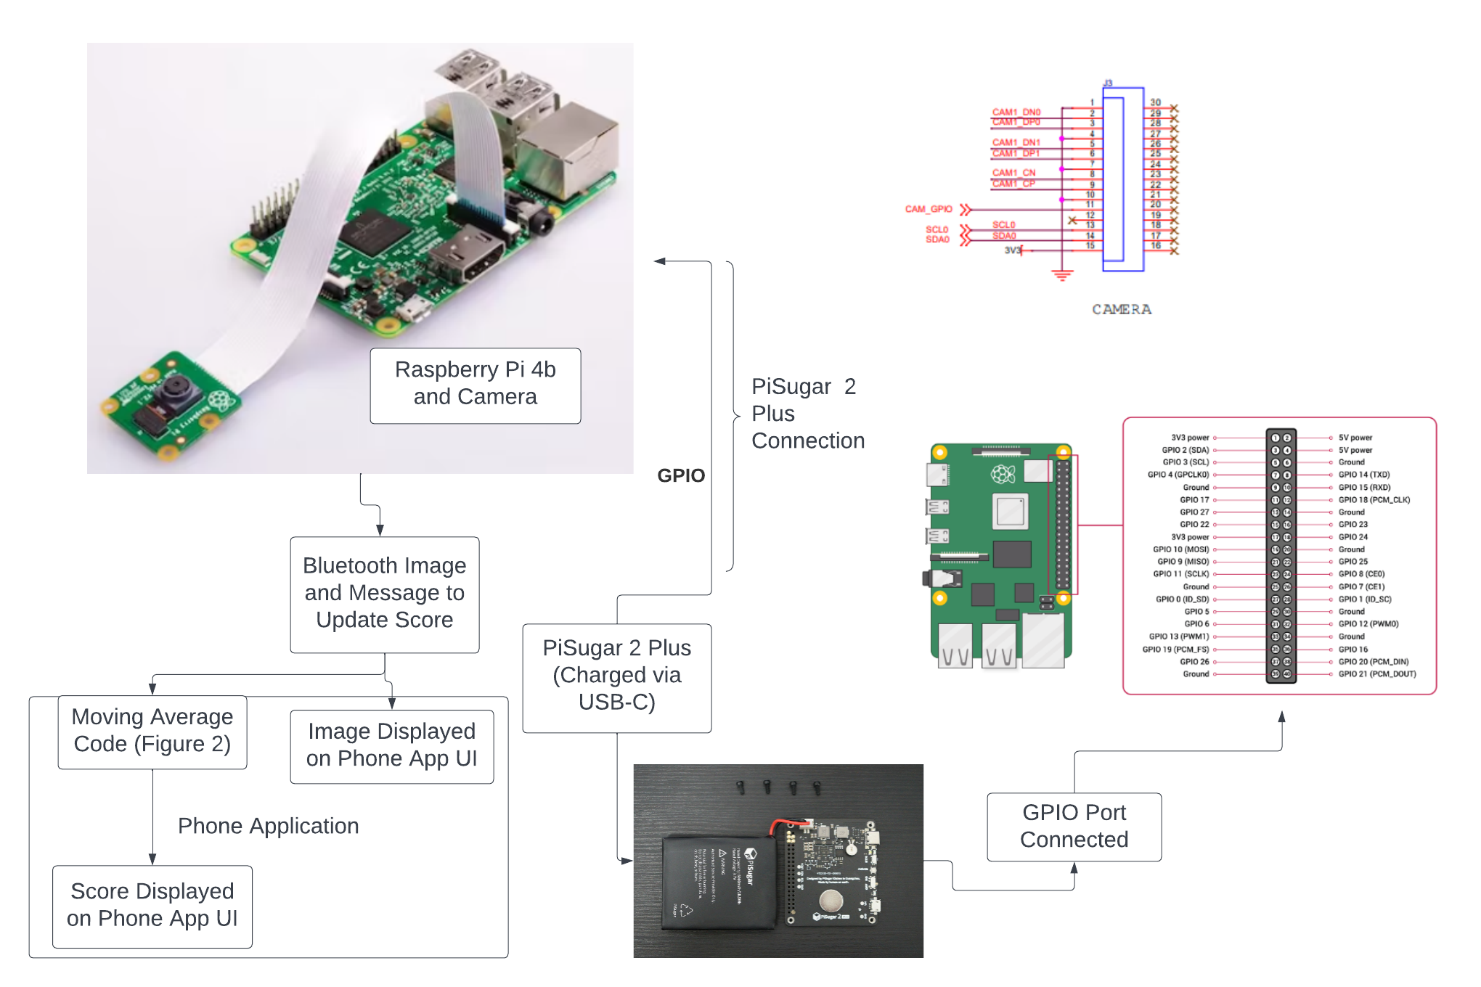
Functionality
Notes:
At the core of this project is a deep learning algorithm that is deployed onto a microcontroller, which will be mounted within the vehicle with a connected camera and power supply.
In short, the system will classify periodically taken images of the driver and then determine a performance metric by taking a moving average of safe driving classifications. This metric is then sent to the insurance company through a mobile application. From there, the insurance company will adjust the user’s insurance rate based on their safe driving performance. Thus, an incentive for drivers is made to adopt the product and practice safe driving more thoroughly.

Slide 5
Requirements
Microcontroller:
Capable of deep learning
Bluetooth capability for communications
Camera:
Resolution of the camera used must be greater than 256 pixels
Algorithm:
Classifies the majority of images taken correctly
Uncertain predictions are classified to the drivers benefit as safe
Application Displays:
Most recent image taken
Measurement of safe driving.
Notes:
The general requirements listed here revolve around 4 primary components: the microcontroller, the power supply, the camera, and our software. Note that this design includes aspects of microcontroller programming, communications, and electrical calculations such as battery sizing, as this product will be powered remotely with the ability to work within any vehicle.

Slide 6
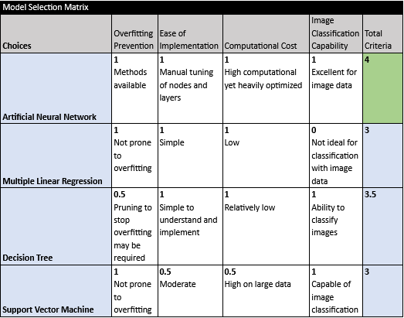
Algorithm Architecture
ANNs are best suited for image classification tasks.
The convolutional layers in CNNs can reduce the dimensionality of images without losing valuable information.
Notes:
Upon comparing machine learning models for this task, neural networks were found to be the most promising option in spite of their high computational cost.
Convolution neural networks in particular can reduce the dimensionality of images without losing information, which makes them especially useful in image processing and classification.

Slide 7
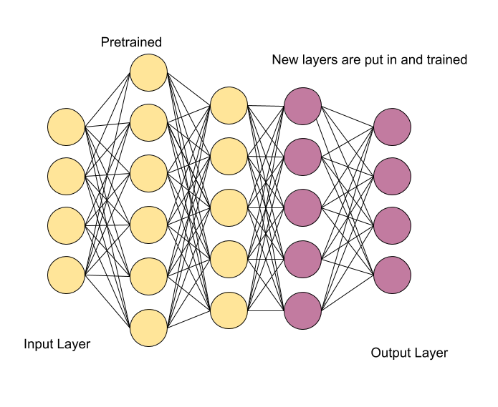
Transfer Learning
Transfer learning is a machine learning technique where a model trained on one task is re-purposed on a second related task.
Notes:
Even so, the dataset we started with only contained around 22,000 images. Though this sounds like a lot, it’s not a tremendous amount of data to train a reliable network with.
To tackle this problem, we adopted transfer learning techniques, that is, taking an available pretrained network that serves a similar purpose and adding new layers on top of the network, training them to obtain the desired outputs.

Slide 8
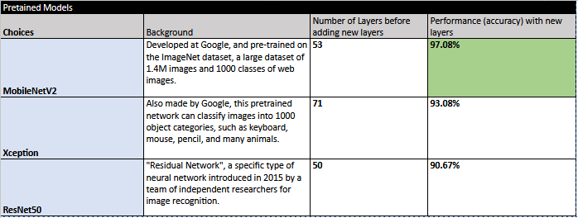
Models used in experiments
Notes:
In our transfer learning experiments with three different models, we found that Google’s MobileNet yielded the highest accuracy given our image data. This is compared to using the Xception and ResNet pretrained models, which gave high accuracies as well.

Slide 9
Notes:
** Desktop software demonstration **
We would now like to demonstrate our model within our desktop application.

Slide 10
Requirements
Microcontroller:
Must be capable of deep learning
Must be able to have wireless connectivity
Notes:
Moving onto microcontroller requirements, it was necessary the controller be capable of supporting deep learning, since this is a computation-heavy task that not all boards may be able to handle. Along with this, wireless capability was also made a requirement, as communication between the microcontroller and mobile device would be made with or without internet.

Slide 11
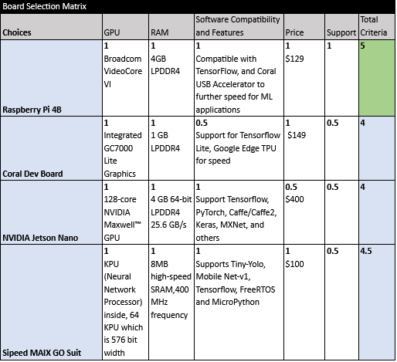
Microcontroller
Requirements
Tensorflow Lite Compatibility
Wireless Communication
Affordable
Notes:
The constraints in regards to the microcontroller include both its price and the previously listed capabilities. Whereas machine learning focused microcontrollers can cost over $400, we are shooting for a more affordable “machine learning capable” microcontroller to stay within bounds of our project budget. The Raspberry Pi 4B was chosen due its affordable price and extensive community support.

Slide 12
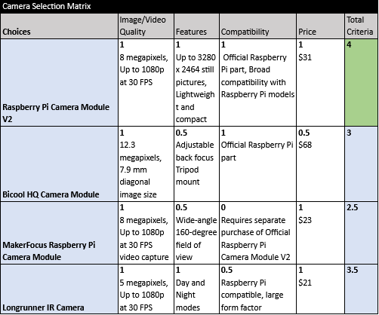
Camera
The camera used must produce images of a quality comparable to the training data for proper classification (an easy 256 x 256 pixels).
Size and microcontroller compatibility are also weighted here for our selection.
Notes:
Another small but important requirement was camera pixelation. In order to match the resolution of both the training data and testing data, a camera with a resolution greater than 256 pixels is necessary.
The Raspberry Pi V2 Camera Module was chosen as it is an official Raspberry Pi product that is affordable with high quality imaging. All of the camera options shown here support the necessary resolution, however the size of the V2 module and its ease of setup made it the best choice for our project.

Slide 13
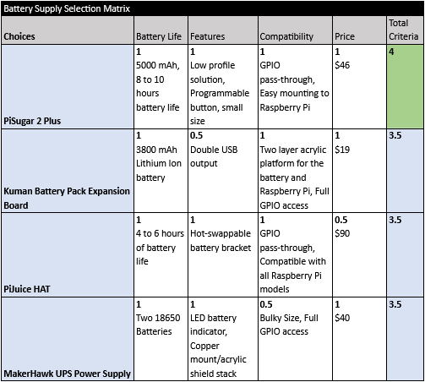
Power Supply
Using battery supply pack allows:
Device can be powered within any vehicle.
Absence of wires is less distracting for driver.
Why PiSugar2 Plus?
Can conveniently fit directly on the back of the Raspberry Pi.
PiSugar2 Plus has a minimum operational time of 1.6 hours (max load) (5000mAh / 3000mA)
Notes:
It has also been considered that certain aspects of this device could be distracting to the driver. Therefore, wiring should not be extensively done throughout the vehicle, and the size of the device itself should not hazardously impair the view of the driver. To evade these issues of size and wiring, a battery supply pack, the PiSugar2 Plus, was chosen to power the device due primarily to its convenient size and significant battery life.

Slide 14
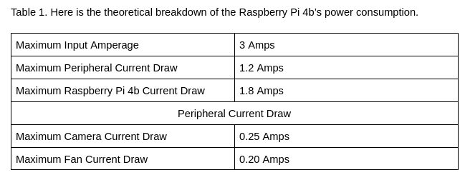
Battery Calculations
Battery Life:
4 hours 35 minutes

Slide 15
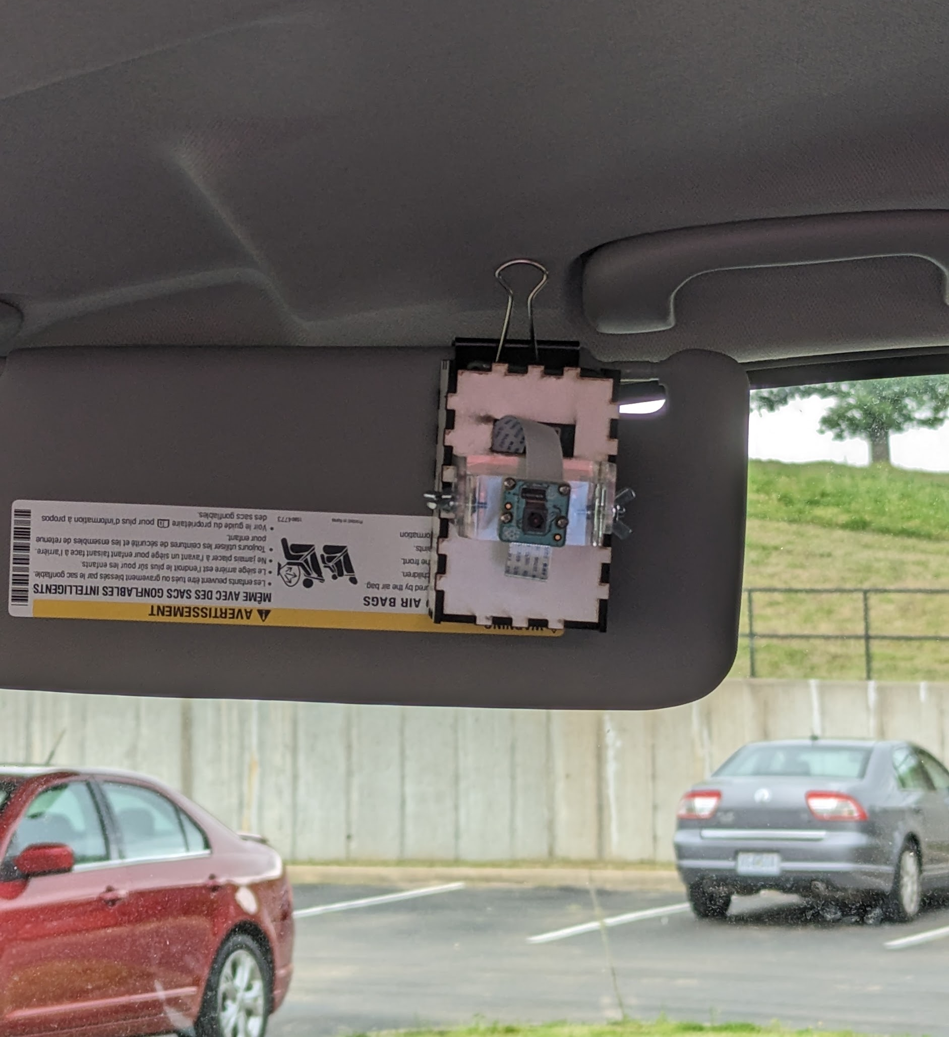
Case Design
Case:
Laser cut Masonite using Lightburn and Boxes.py software
Acrylic Camera Mount (purchased)
Fastened to sunvisor with large binder clip

Slide 16
Specifications – Communications and App Development
Android | Target Application Framework
Kivy | GUI and Interface + Python Utilization
SocketServer | Wifi Connectivity
The application’s user interface will display the most recently taken image, its classification, and a quantitative measurement of safe driving.
Notes:
For our mobile application, we will be developing for Android devices using the Kivy framework. We took this approach due to us having Android devices readily available to us and due to Kivy allowing us to solely use Python.
Interaction between the Raspberry Pi and our mobile application will be done wirelessly over a wifi connection using the “socket” and “socketserver” libraries. “Socketserver” will act as the actual server, while socket takes care of the rest. Doing this will allow us to easily control the Raspberry Pi’s resources wirelessly and to handle any incoming and outgoing data.

Slide 17
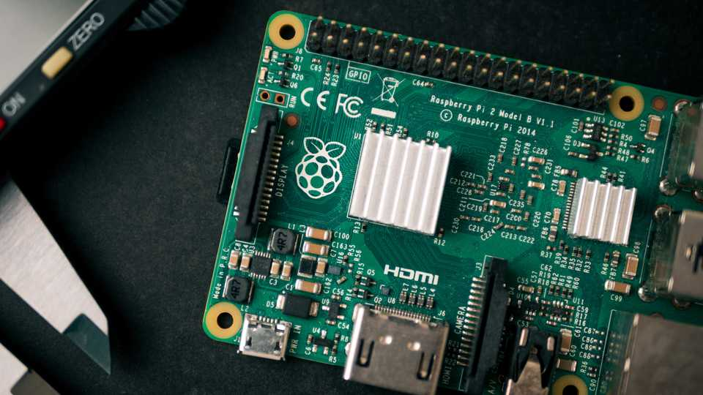
Basic Communications
Raspberry Pi acts as Wifi Hotspot
Raspberry Pi listens for client connection
Raspberry Pi captures, classifies, and transfers data to the client
Process continues
Notes:
After training, we will need to convert our deep learning model to a Tensorflow Lite Model. This is to take advantage of Tensorflow Lite’s optimizations towards mobile and edge devices. The OpenCV framework will also be used, but solely to grab images from the Pi’s camera. Any issues regarding the installation of these frameworks can be easily troubleshooted from the Raspberry Pi’s command line feedback.

Slide 19
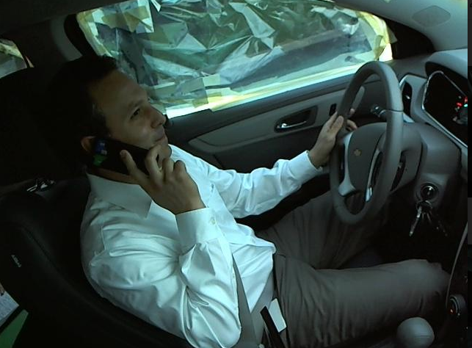
Cost Estimate
Raspberry Pi 4B | $224
V2 Camera Module | $30
PiSugar 2 Plus | $50
TOTAL | $304
Notes:
Thanks to the open source software used and affordable computing, the cost of the project is currently estimated to be $304.. The essential components and their price are shown here.

Slide 20
Relevant Standards
IEEE P2671™ - Standard for General Requirements of Online Detection Based on Machine Vision in Intelligent Manufacturing
IEEE P2841™ - Framework and Process for Deep Learning Evaluation
IEEE P3110™ - Standard for Computer Vision (CV) - Algorithms, Application Programming Interfaces (API), and Technical Requirements for Deep Learning Framework
Notes:
Standards for our project did not entail any automotive or human sensory topics but solely mobile and machine-learning product requirements. The IEEE Standards Association stays relatively updated with the rapid growth behind these new technologies used, and is an excellent source for developmental standards.
Ethics were taken into consideration as well ensuring that no software is unfairly written to disrupt a good driving score.

Slide 21
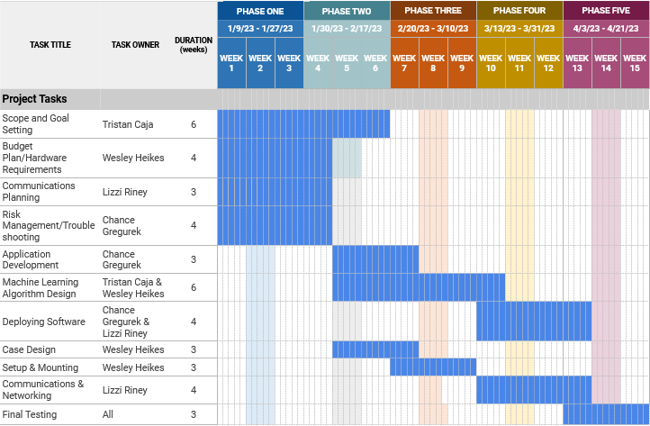
Gantt Chart
Notes:
Here we have our Gantt Chart displaying how work on this project will be allocated amongst members. Phases one and two include goal setting and software development while phases two and three include our setup and deployment. A final phase is used for testing and improvement.

Slide 22
References
[1] Distracted driving. NHTSA. (2021). Retrieved from https://www.nhtsa.gov/risky-driving/distracted-driving
[2] Taher Ujjainwala. (2019). Taher1322/RPI-bluetooth_app: Android Bluetooth app. GitHub. Retrieved from https://github.com/Taher1322/RPi-bluetooth_app
[3] ElectroFun. (2020). Control Raspberry Pi Gpio using Bluetooth | Android App | Bluetooth Interfacing. YouTube. Retrieved from https://www.youtube.com/watch?v=NddZnd95cyE.
[4] Eraqi, H. (2019). Distracted driver dataset. Hesham Eraqi - Personal website and blog of Hesham Eraqi. Retrieved from https://heshameraqi.github.io/distraction_detection
Notes:
We would like to thank Dr. Zeng for advising this project design. Data used for testing was provided courtesy of Dr. Eraqi at the American University at Cairo, Egypt.

