Slide 1
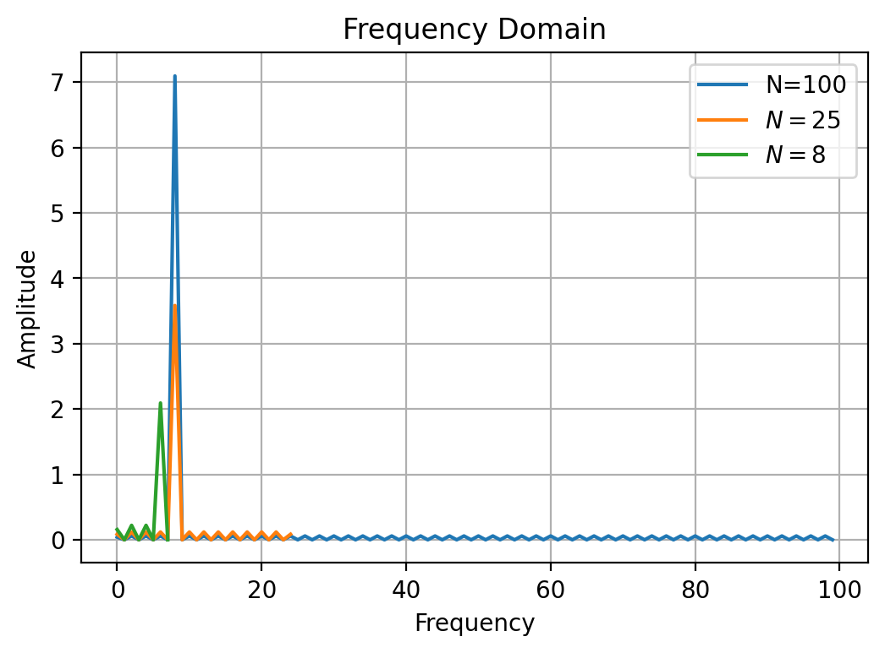
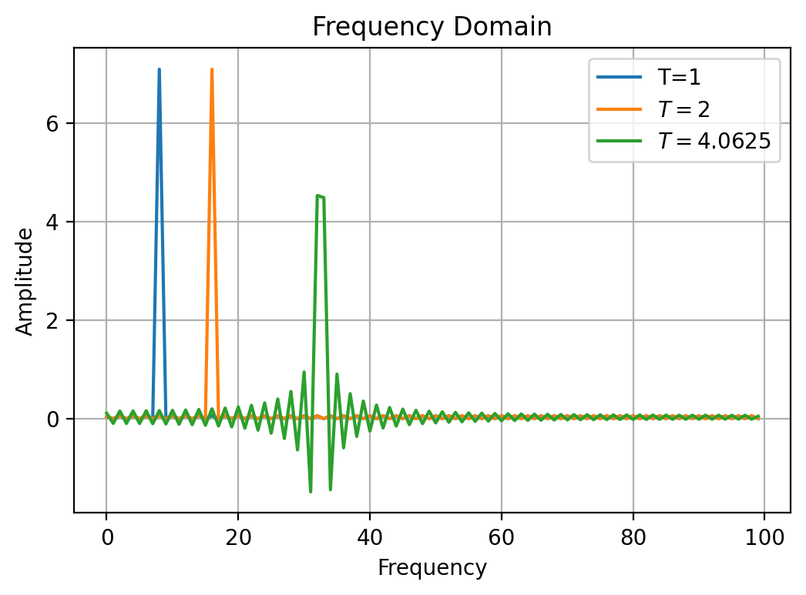
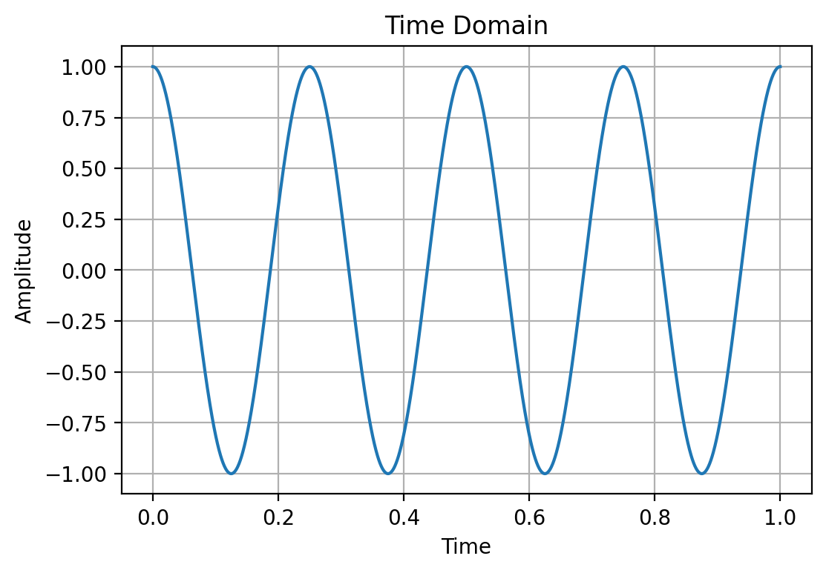
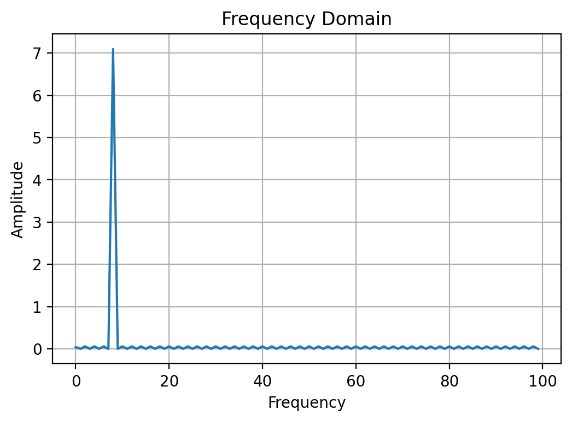
Analysis of the Discrete Cosine Transform Coefficients
Dillon McKinley
Background
Method
Findings
Although the math behind the Discrete Cosine Transform (DCT) is fairly unknown to most people, it is critical to the usefulness of many of our devices. The process of the DCT is to decompose signals so that they may be manipulated for compression and either shared between devices or allowing it to be stored more conveniently. The signals that are discussed here are very broad, ranging from audio files, texts, pictures, or even television. A common application for DCT’s specifically is with JPEG or MP3 files. However, a different method called the Discrete Wavelet Transform is used for more advanced usage as it is far faster and efficient. The reason why images online in the past could only load at one line at a time was because it was using the DCT, which is a slower process for computers.
Trying to compute the DCT by hand would require an immense amount of time as the largest DCT matrices involved in this project are 100 x 100. To process the DCT efficiently, I used Visual Studio Code to write programs that would quickly compute DCT’s. This application could also produce organized graphs that are also presented here. To learn the general information behind DFT’s and DCT’s, as well as techniques that would be helpful in analyzing them, I used the textbook Linear Algebra, Signal Processing, and Wavelets - A Unified Approach by Oyvind Rand.
When changing the amount of samples taken, it was examined how coefficients would appear from 100 samples, 25 samples, and 8 samples which can be seen in Fig. 2. When 100 samples are taken, we see the graph spike at frequency 8 while all the other points are negligible. At 25 samples, the graph spikes again at frequency 8, but not as high. There are also not as many of the negligible points. At 8 samples, the graph spikes before frequency 8 when an even lesser amplitude. In Fig. 3, while testing periods, we see that doubling the interval to $T=2$ causes the graph to spike at frequency 16 with equal amplitude. An interesting result is found by taking the interval at $T=4.0625$, the graph has two consecutive points with higher amplitude surrounded by non-negligible points.
Analysis
A technique within Linear Algebra, Signal Processing, and Wavelets - A Unified Approach that is important to DCT is called sampling theorem. It provides a method to take a number of evenly spaced samples over an interval. This way, the computer will not have to process every single point within a signal. Normally, we would use periodically repeating vectors $x$ for a function $f$ with period $T$ so that where the component of $x$ is $x_{k}=f(\frac{kT}{N})$ where $N$ is the number of samples taken. When using the DCT however, we double the period and the samples taken since we are analyzing the signal as if it was a symmetrically even function. In this project, only the type 1 DCT was used where the component of the vector is changed to $\breve{x}{=\{\frac{k2T}{2N}\}}_{k=0}^{2N−1}$. Throughout the project, the only function used for the input signal was $f\left(t\right)=cos⁡(8πt)$ on the interval $[0,1]$. Figure 1 demonstrates how the signal appears once the function has been transformed. To understand how these two graphs correlate, we will change the number of samples taken to see how many coefficients are needed for reconstruction, and then we will test various periods taken for the periodic extensions to see how it affects the coefficients that are outputted.
Research Purpose
The purpose of this study is to analyze the connection between the original signal being deconstructed and the DCT coefficients being outputted that are used to reconstruct the signal.
Fig. 2
Fig. 3
Discussion
What is the Discrete Cosine Transform
Each value of the frequency in the frequency-domain is a coefficient used in the cosine summation which can be used to reconstruct the input function. The absolute value of the amplitude can be considered the contribution that the select frequency has towards representing the input function. The function used throughout the project has a frequency of 8 which coincides with the findings. Taking 100 samples collects the necessary coefficients but includes many coefficients that to not contribute much to the function. At 25 samples, we can still see that frequency 8 is still contributing the most, but it does not need to compensate for an over abundance of negligible coefficients, making the amplitude smaller. Taking 8 samples does not collect enough of the necessary information for reconstruction. When changing the interval to double the initial amount, it also doubled the function’s frequency that is examined during the periodic extension. The reason why changing the period to 4.0625 alters where the graph spikes is that taking that period alters the sampling to not integer points so that frequency 32 cannot be directly taken. In response, two coefficients around frequency 32 increase in amplitude and other, lesser coefficients are used to balance out. This graph would spike normally if another type of DCT was used as they very in how the create the symmetry of the periodic extension.
To understand the DCT, it is important to know the concept of the Fourier Transform and Fourier Series. This is the concept that signals can be represented as summations of cosine terms which are real values, and sine terms which are imaginary values. The Fourier Transform takes an interval of the input signal and creates periodic extensions so that it can analyze it as if it is similar to a trigonometric function, changing the basis of the signal into the frequency domain and picking out the key frequencies that are needed for reconstruction. It becomes “discrete” because to process signals continuously would be to process an infinite amount of points on a graph, so we only take so many points of the sample, making it discrete as opposed to continuous. At this point, it is only the Discrete Fourier Transform. To go to the DCT, we change how we take the periodic extensions of the signal and make it symmetric at the beginning of the interval. This transforms the signal into an even function which eliminates all of the sine components in the summation with only the cosine terms remaining.
References
Ryan, Øyvind. Linear Algebra, Signal Processing, and Wavelets-- a Unified Approach. Springer, 2019.
Fig. 1

