Slide 1
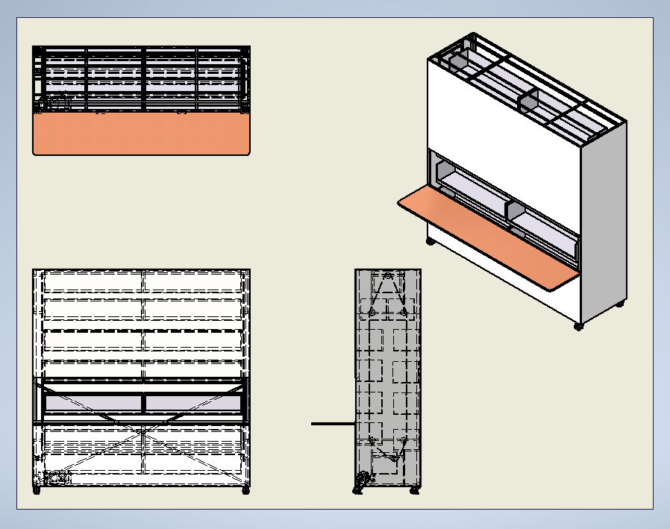
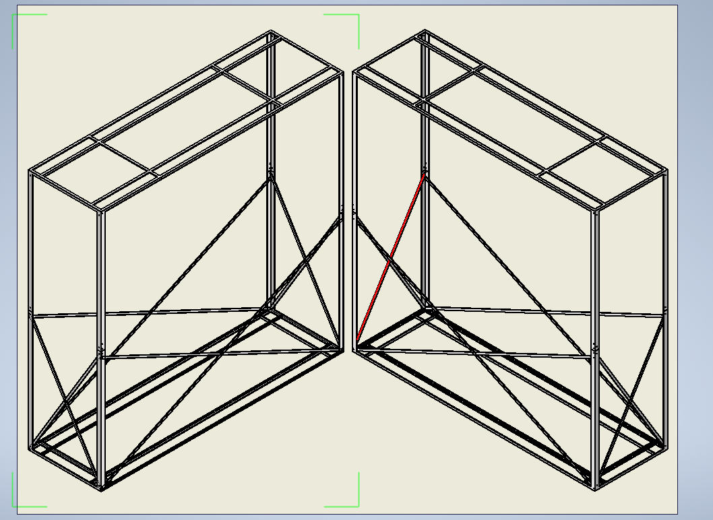
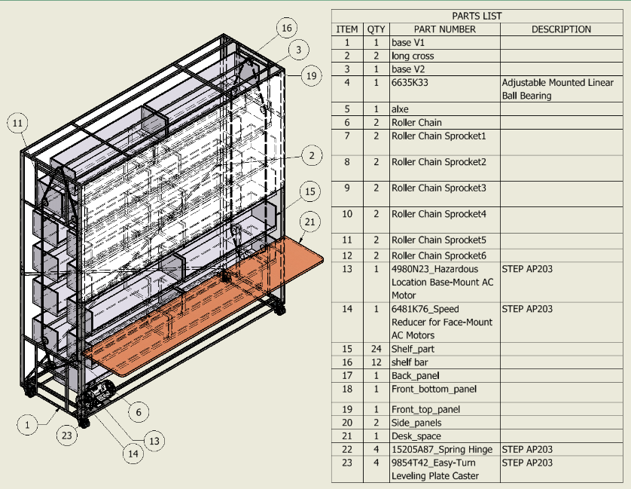
Functional Integrated Storage Housing
Christopher Dew, Noah Disheroon, Andrew Hilsdon, Vana Ducusin, Thomas Dobbs
And Alexander Holland
Introduction
Analysis
Discussion
With the space requirements, we 3-D modeled a design. First, we created the frame to be 10’x3’x10’. Due to the expected weight of the cargo, we had to add braces to the frame. From here, we determined how big the shelves should be and how they were to be connected to the chain that allowed the shelves to rotate freely about the chain as it moves around the track. After the shelves were designed, we designed a chain system and gear box. Once we were done with the internal components of the shelf, we moved to the design of the external features. We wanted the internal components concealed, so we designed panels that are easily assembled onto the shelf. We left 2 feet of open space on the front of the shelf for user accessibility. A safety door feature was added, to eliminate the risk of a user getting their hand caught in the rotating shelves in the open space. A foldable desk area was then added so the user can work on their projects directly in front of the desk, while not taking up much more of the space in the room. The material of each component plays a vital role in the affordability of the system, as well as the durability.
The shelf was designed to optimize the storage space available. While at first, this seems like it would be an easy task, there were several factors to consider. The system requires careful planning and design to ensure maximum efficiency and functionality. The weight of the shelves and the speed of movement can have a significant impact on the system's performance. The type of control mechanism used can affect the ease of use and safety of the system. Lastly, we wanted to make the shelf system to be easily assembled / disassembled. The conceptual design of our product was aligned with these factors in mind. The Mechanical engineers were tasked with designing the system, while the Electrical and Computer engineers oversaw the actual functionality of the system.
Our main problem we are studying is optimization of limited storage space in the robotics lab. There is only so much square footage in the lab, however there is upward space that is not used. An issue with building storage with increased height is accessibility. We wanted to create something that has height capabilities but can still be reached by the average person. Our moving shelf storage system, also known as FISH, is a space-saving storage solution that involves shelves that can rotate vertically, driven by a chain and gear system.
Findings/Results
Conclusion(s) / Implication(s)
Research Purpose and/or Question(s)
In conclusion, we discovered the process of taking an idea and specifications from a customer and create a feasible and affordable solution. With the mechanical design, we implemented our knowledge of mechanical systems into 3-D modeling and design.
The purpose of this study is to create a solution to the limited storage space available in the lab
Method / Data Source(s)
First, we were given specifications from Dr. Weidenfeller. We were allowed a 10’x3’x10’ space. Also, our goal is for the shelf to be able to hold over 1000 lbs and rotate at a safe and efficient speed. We decided to go with 3 rpm.
References
Budynas, Richard G., et al. Shigley's Mechanical Engineering Design. 11th ed., McGraw-Hill Education, 2021.
Haik, Y., Sivaloganathan, S., & Shahin, T. M. (2015). Engineering Design Process. Cengage Learning.
Special Thanks to our Project Sponsors:

