Slide 1
Utilizing VR Scenarios to Aid Student Empathy in Challenging Interactions
Presented by:
Peter Unwer, Candidate for Bachelor of Science in Hospitality Administration Arkansas Tech University
Faculty Mentor: Susan West, Associate Professor Arkansas Tech University

Slide 2
Background
December 2021 Awarded Teaching Technology Innovation Grant $25,000
Idea that sparked interest was a report from Federal Aviation Administration (FAA) from January to May 2021: 2500 reports of unruly passengers
Hilton partnered with Sweet Rush utilizing VR and noted an 87% change in behavior with staff members
Purchased ten VR headsets and Medtronic Harnesses to gauge heart rate and breathing rate, used pre and post test to determine stress level
Created VR scenario for three purposes

Slide 3
Method
65 undergraduate students enrolled in an accredited four-year university ranging from freshman to senior
Average age 20 years
Students were given harness, take pre-test, went through scenario once, taken out of simulation, asked questions and then placed back into situation followed by post-test

Slide 4
Method
Pre-test
Intermittent test
Post-test
Age
Experience with VR
Sit or stand
Current stress level
Stress level
Asked if beneficial
Checked on how they’re feeling
Checked on how they’re feeling
Reflection on their choices
Asked if helpful

Slide 5
Bio Harness Components
Internal Breathing Sensor
ECG sensors
Device housing
Built-in electrical contacts

Slide 6
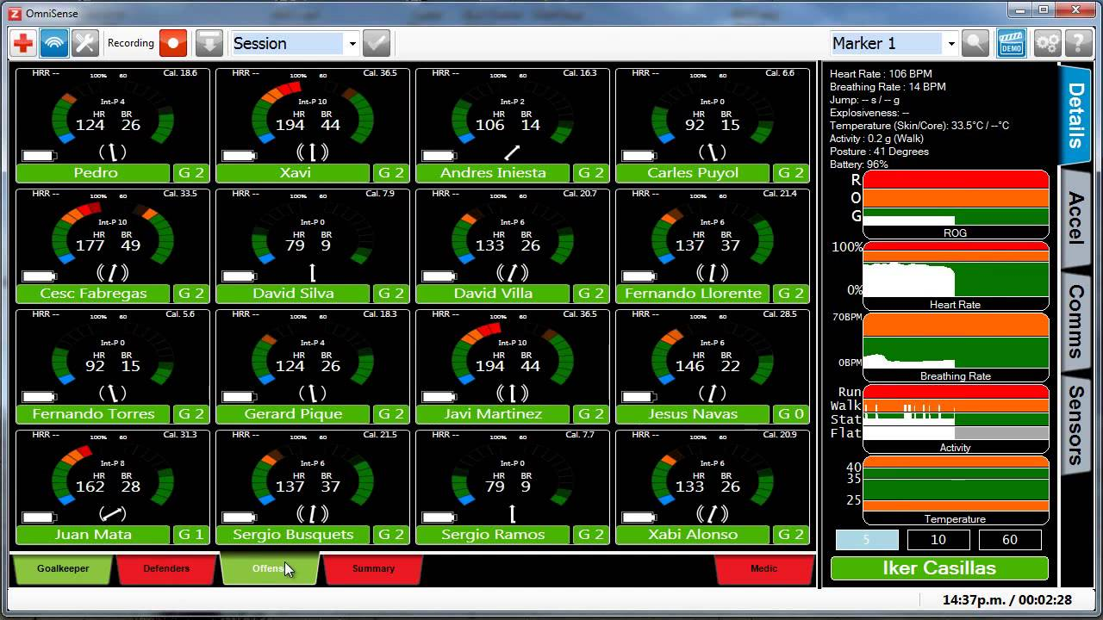

Slide 7
Case Scenarios
Video taped in 360 degree with a Go-Pro and used a decision-based branching program.
This allowed users to make a decision and based on the choices they make; they could see the consequences of their actions.

Slide 8
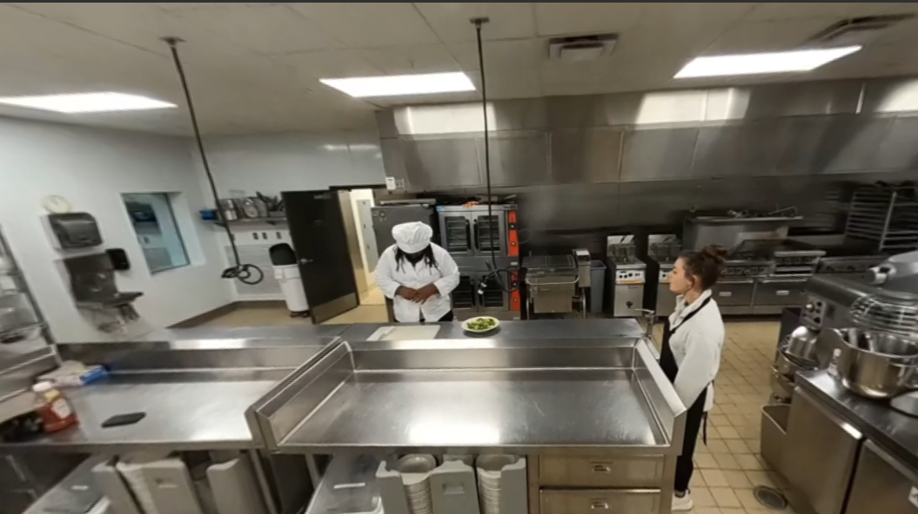

Slide 9
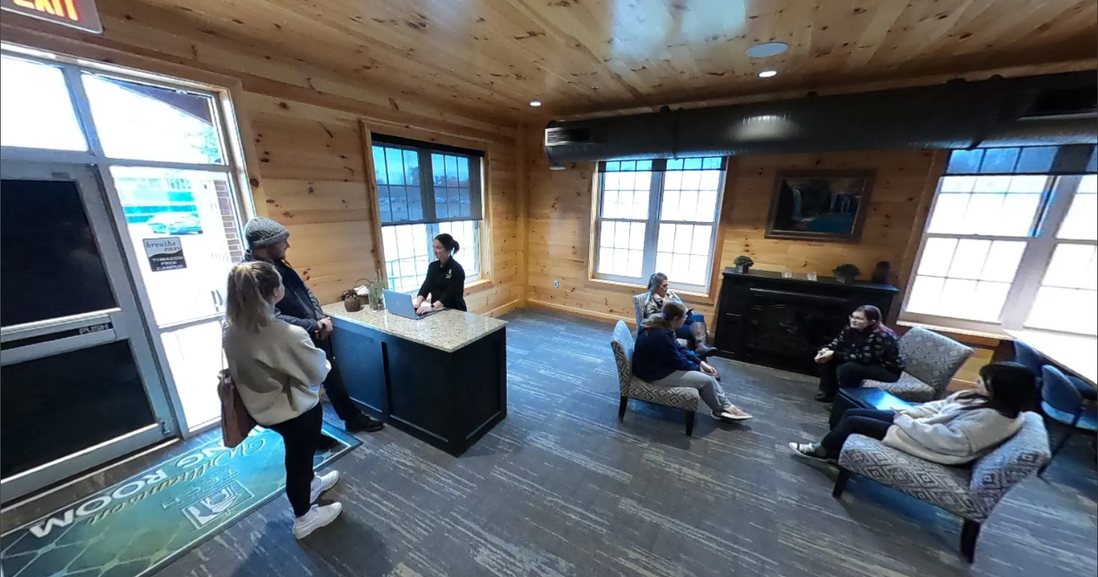

Slide 10
VR Experience
Scenario 1:
20 said yes, 11 said no
Scenario 2:
12 said yes, 21 said no

Slide 11
Goal One: Meaningful Training
Scenario 1:
28 said yes, 3 said maybe,1 said no
Scenario 2:
29 said yes, 4 said maybe, 0 said no

Slide 12
Goal Two: Assist the student in how best to handle guest relations
Scenario 1:
7 said yes, 24 said no
Scenario 2:
8 said yes, 25 said no

Slide 13
Goal Three: Immerse student in an environment that is safe and provide growth
On a scale of 1-5 with 5 being the most stressed, participants were asked to rate their stress​
Scenario 1:
The pre test averaged 2.19
The post test averaged 1.93
This suggest a 5.2% decrease in stress

Slide 14
Goal Three: Immerse student in an environment that is safe and provide growth
Scenario 2:
The pre test averaged 2.12
The post test averaged 1.94
This suggest a 3.6% decrease in stress

Slide 15
Goal Three: Immerse student in an environment that is safe and provide growth
Total averages for stress benchmark
The pre test averaged 2.16
The post test averaged 1.79
This suggest a 7.4% decrease in stress

Slide 16
Participant’s overall perception
Scenario 1:
32 said yes, 0 said maybe, 0 said no
Scenario 2:
32 said yes, 1 said maybe, 0 said no
98.46% of students would like to see more VR scenarios

Slide 17
Conclusions
For the industry, VR training seems needed, necessary and viable
Students/staff will be better equipped when faced with real-life situations
This research needs to be expanded

Slide 19
References
Egger, R. (2018, March 23). Mission 828 - An inspiration for touristic destinations. Virtual
Reality in Tourism. http://www.virtual-reality-in-tourism.com/mission/
Evaluation of a Wearable Physiological Status Monitor During Simulated Fire Fighting
Activities. (2019, May 21). Taylor & Francis. Retrieved October 20, 2021, fromhttps://www.tandfonline.com/doi/abs/10.1080/15459624.2013.875184
NPR Cookie Consent and Choices. (2021, May 28). NPR. Retrieved October 20, 2021, from
https://choice.npr.org/index.html?origin=https://www.npr.org/2021/05/28/1001385922/thefaa-
has-seen-a-significantly-higher-number-of-unruly-passenger-reports-in-20
VIVE PRO. (2021, January 1). VIVE Pro 2 Headset - Google zoeken. Retrieved October 21,
2021, from https://www.google.com/search?q=VIVE+Pro+2+Headset&ie=utf-8&oe=utf-
8&client=firefox-b-1
XR Today. (2020, November 23). Hilton Hotels and How VR is Changing Hospitality.
https://www.xrtoday.com/virtual-reality/hilton-hotels-and-how-vr-is-changing-hospitality/
XR Today. (2021, October 4). Valve Developing Standalone VR Headset, Report Says.
https://www.xrtoday.com/virtual-reality/valve-developing-standalone-vr-headset-report-says/
Cleveland Clinic accessed for normal heart rate and normal breathing rate

