Slide 1
HR Revision
By: John Modica, Dalton George, Brayan Bonilla, and Angelina Das

Slide 2
Introduction
Human Resources use a software to create, delete, sort, and search for employee records.
To specify, HR workers have to switch through numerous tabs more than 10 clicks per report.
This is overly complicated and tedious when they have to do this for 15 to 20 times a day.
After hearing about this, we decided to put our efforts into reworking how the software manages employee records.

Slide 3
Planning : Phase 1
Arranged a meeting with HR to see obstacles with their software.
Met with the OIS to overlook the software and backend of the application.
Get the OIS approval and request access to the backend and database to work on the system.

Slide 4
Planning : Phase 2
Until we got the access from OIS, we started to work on making an application (Front-end UI).
We also started learning new technologies *
After meeting with HR and OIS, we had to get approval from our professors to move forward with it.

Slide 5
Planning : Phase 3
After meeting with the OIS again, we were able to get access on their system (Argos System).
We decided to build a proof-of-concept web application as well as one using the Argos Systems to build an application that HR will actually use.

Slide 6
Requirements
Be able to add new, search, manage, and remove records.
To give it user friendly and smooth functions, HR needs to search records by first name, last name or T Number.
For Verification of Employment, they wanted to find Employee status, job position and salary, Hire date, and birthdate in one tab.

Slide 7
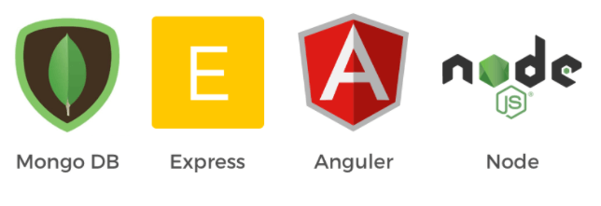
Technologies
HR Project
Evisions Argos System
Concept Project
MEAN Stack
MongoDB
Express.js
Angular.js
Node.js

Slide 8
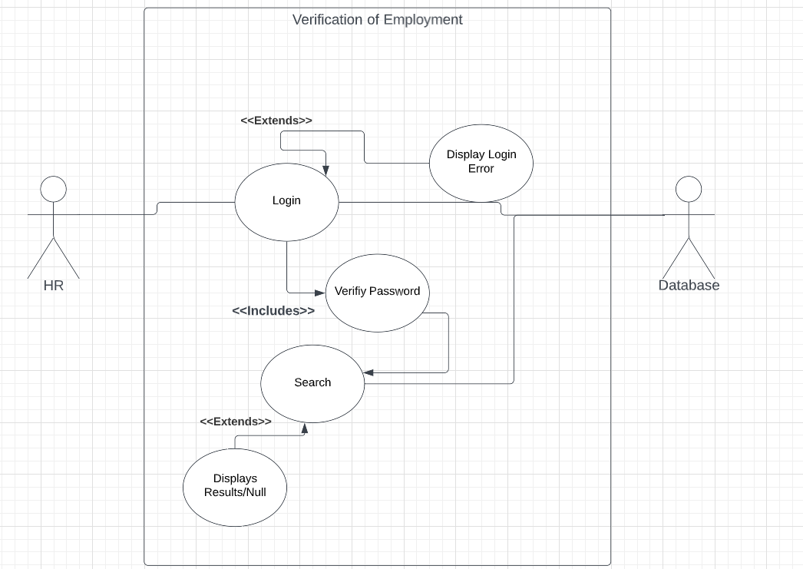
Use Case UML

Slide 9
Data Flow Diagram

Slide 10
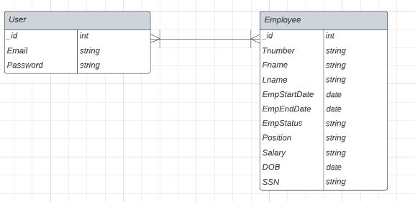
ER Diagram

Slide 11
Ethical And legal Considerations
Only authorized individuals can access the system
Signed a Person Of Special Trust Form with OIS
Ensured proper use of resources throughout the duration of the project.

Slide 12
Security
Only login page can be reached
Passwords are hashed using bcrypt
Vulnerable employee data was masked through the argos system

Slide 13
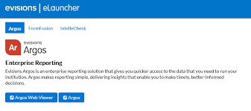
Evisions Argos System
Evisions Argos is a system that allows the building of reports that could query from existing databases to form reports and queries to gain analytical data in a simplified and well-organized manner.
This information could also be collected in a customized manner.

Slide 14
Demonstration of the Argos System Finished Results
Template Example
Filled Example

Slide 15
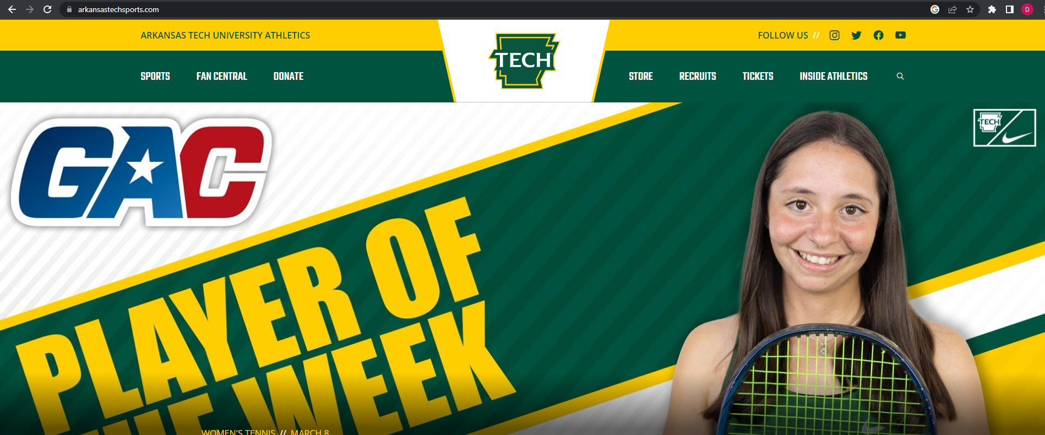
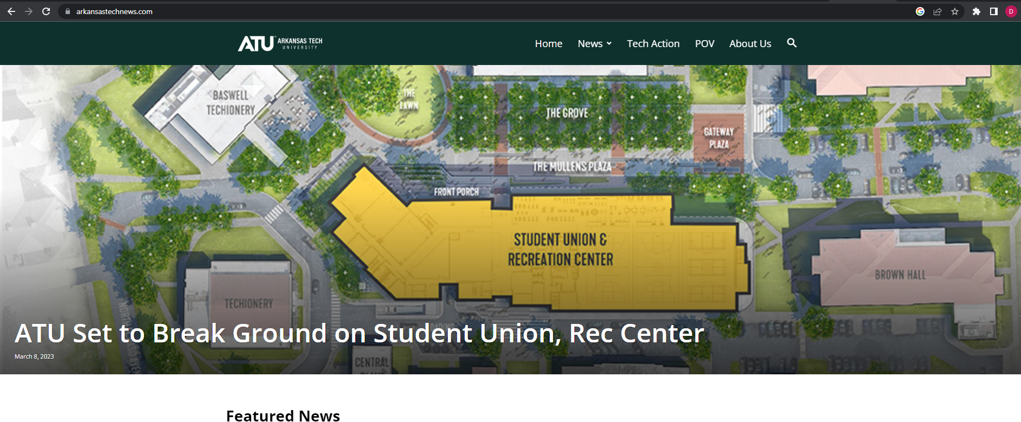
Design Choice

Slide 16
DEMONSTRATION

