Slide 1
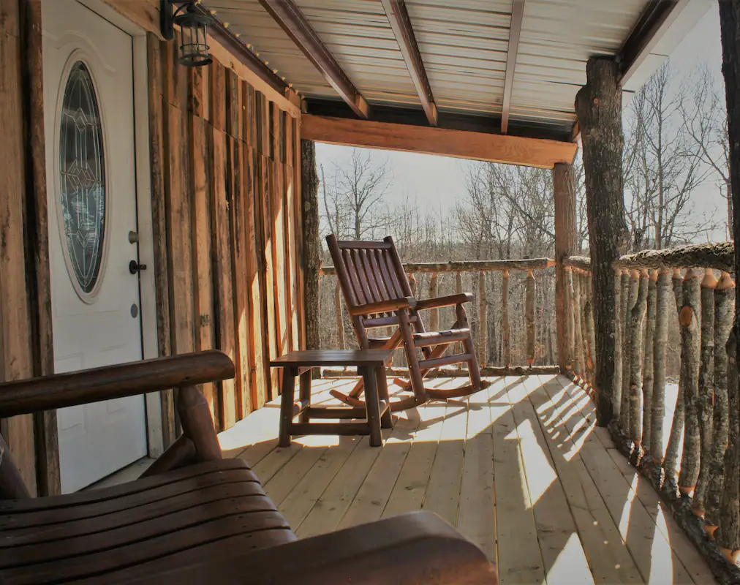
The Ozark Getaway
Team Air BoysNBusiness
Houston Barber
Tony Gasca
Evan Matlock
Avery Harrah

Slide 2
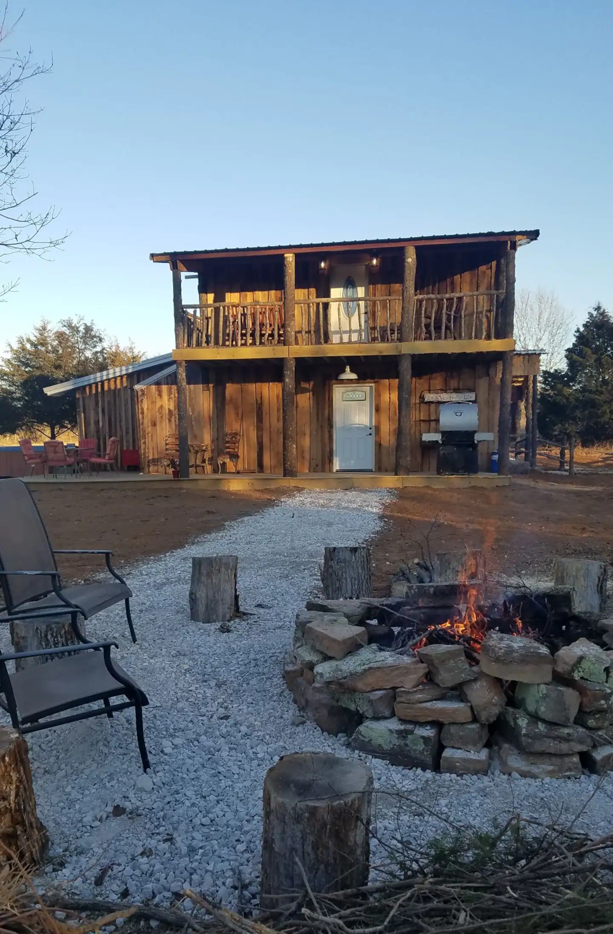
Intro to Business
The Ozark Getaways are a series of bed and breakfasts located in Huntsville, Arkansas.
It is a family business owned by a mother and daughter.
They currently own two BnBs with plans to add more in the future.
Each location offers a quiet retreat with plenty of land to explore.
Notes:
Avery

Slide 3
Problem Statement
Issues with Airbnb
High charges ($86/stay)
Can’t display enough pictures
Can’t display all BnBs together
Less flexible cancellation
No cash payment option
Notes:
Houston

Slide 4
Intro to Application
We are creating an Ozark Getaway business website that will solve all these issues. The website features include:
A homepage describing the business
Separate pages displaying each BnB with a large gallery size
A calendar that displays available dates and communicates with the availability calendar on Airbnb
A payment portal for online payment
Contact information for customers who want to do direct cash transactions
A database containing rental history and BnB info
Notes:
Evan

Slide 5
Planning
Phase 1
Determine Requirements
Speak with client about desires for the website
Determine potential ways to implement what they want
Confirm our ideas with client and make changes as requested
Phase 2
Determine Software
Research software implementation options
Propose implementation ideas to client
Get software accounts set up
Phase 3
Split Workload
Determine who will work on each task
Hold weekly meetings to make sure tasks are complete
Rebalance workload when necessary
Notes:
Tony

Slide 6
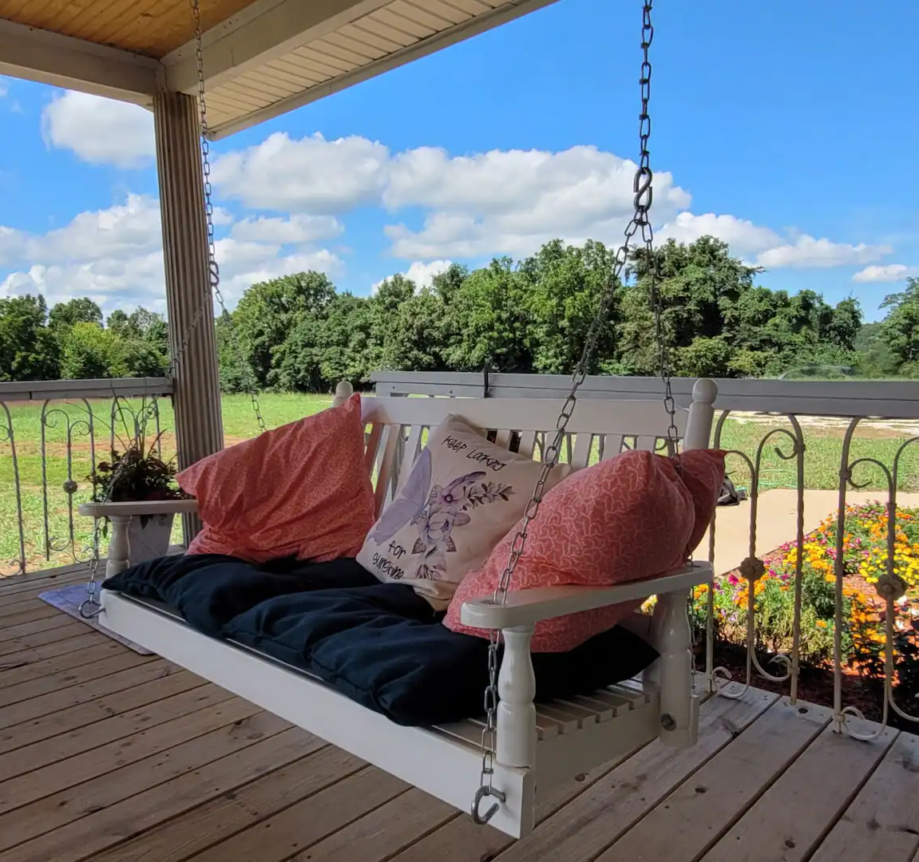
Requirements Determination Process
Receive desires from client
The ability to easily switch between BnBs
A gallery to display a large number of images
Calendar functionality that integrates with the calendar on Airbnb
Determine potential implementations
Create a UI wireframe
Research options for calendar integration
Research payment portal options
Confirm ideas with client
Client gave approval on UI decisions
Client made all final decisions that required monetary transactions
Notes:
Avery

Slide 7
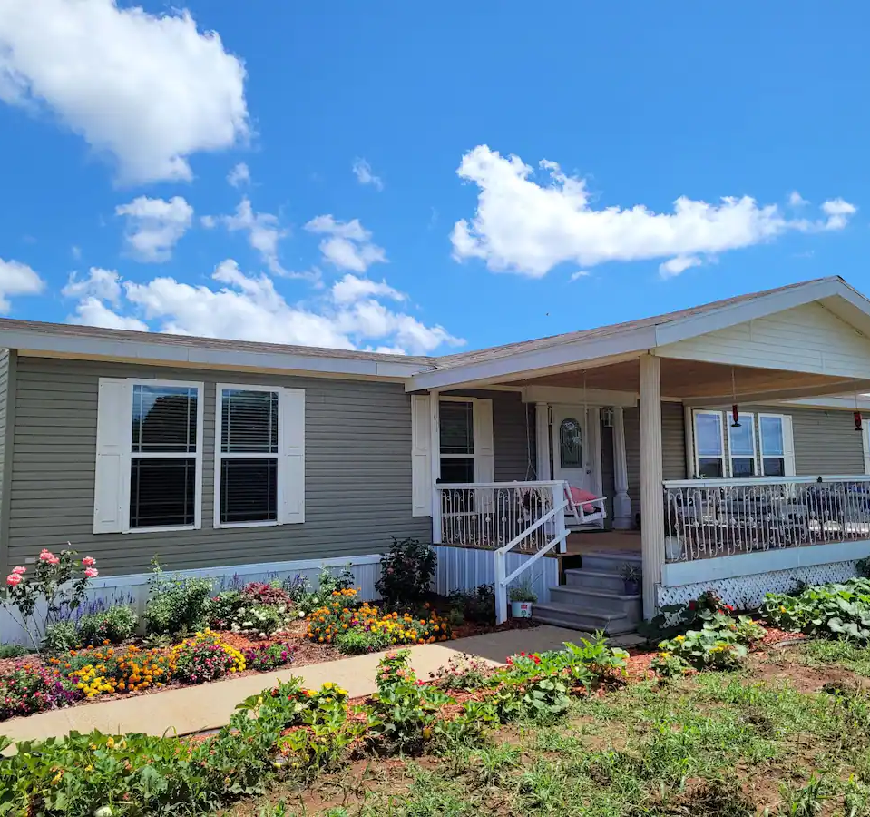
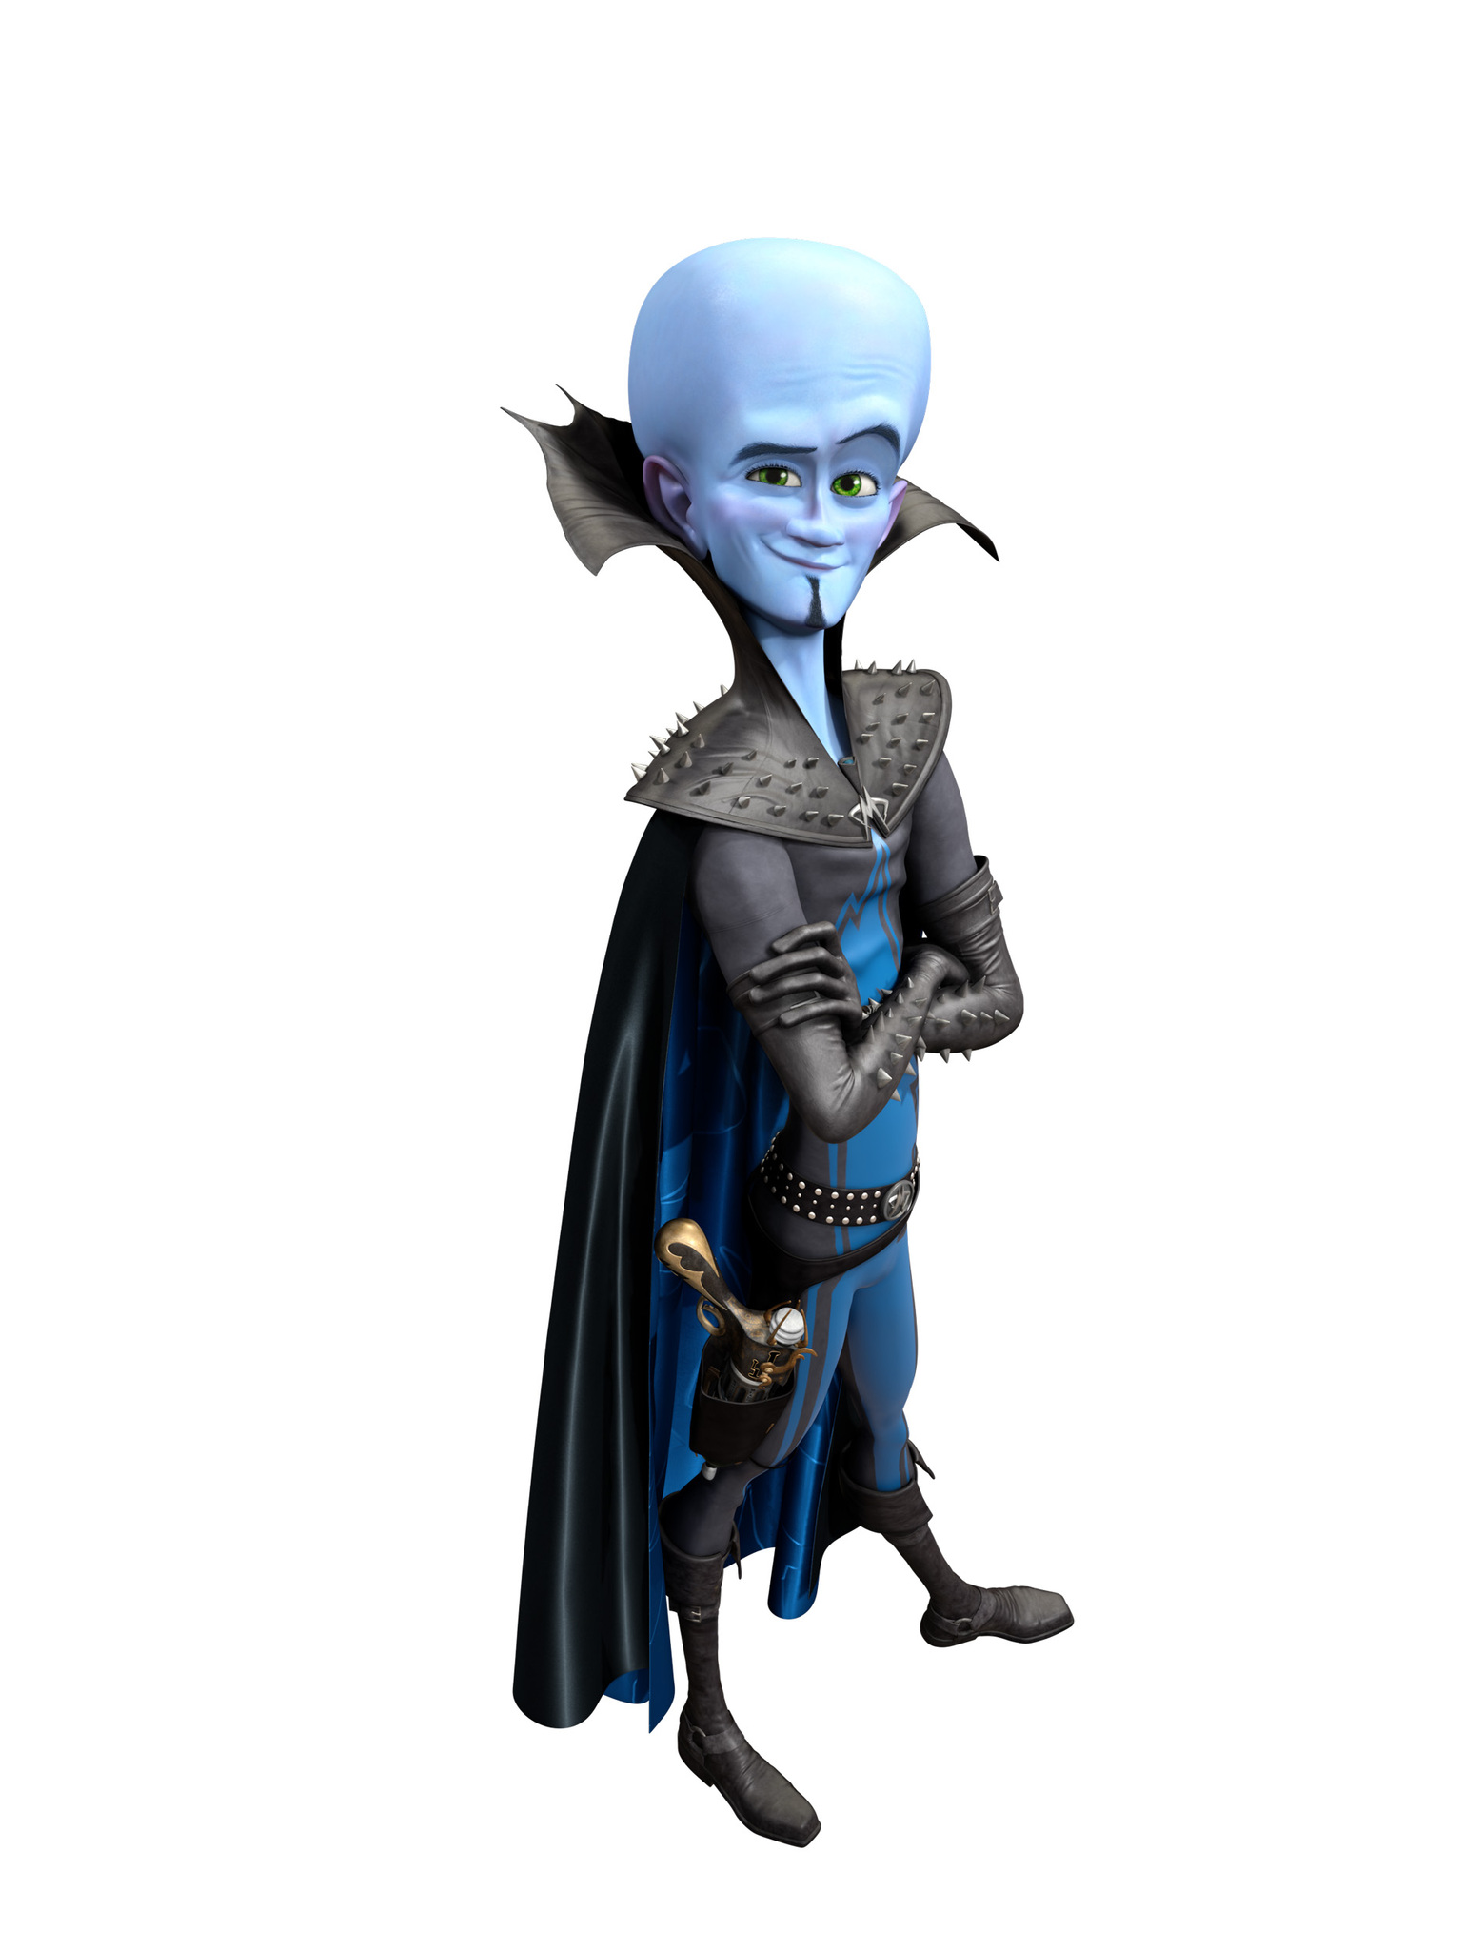
Implementations
Programming: HTML and CSS
Calendar: Google Calendar with Google API
Web Hosting: HostGator
Payment Portal: Stripe
Database: Stripe
Database Querying: SQL
Notes:
Avery

Slide 8
Workload Balance
Evan Matlock
Avery Harrah
U.I. designer
Stripe payment portal manager
Calendar integration
Client contact
Houston Barber
Tony Gasca
Main programmer #1
House pages
Main programmer #2
Home and contact pages
Notes:
Errybody

Slide 9
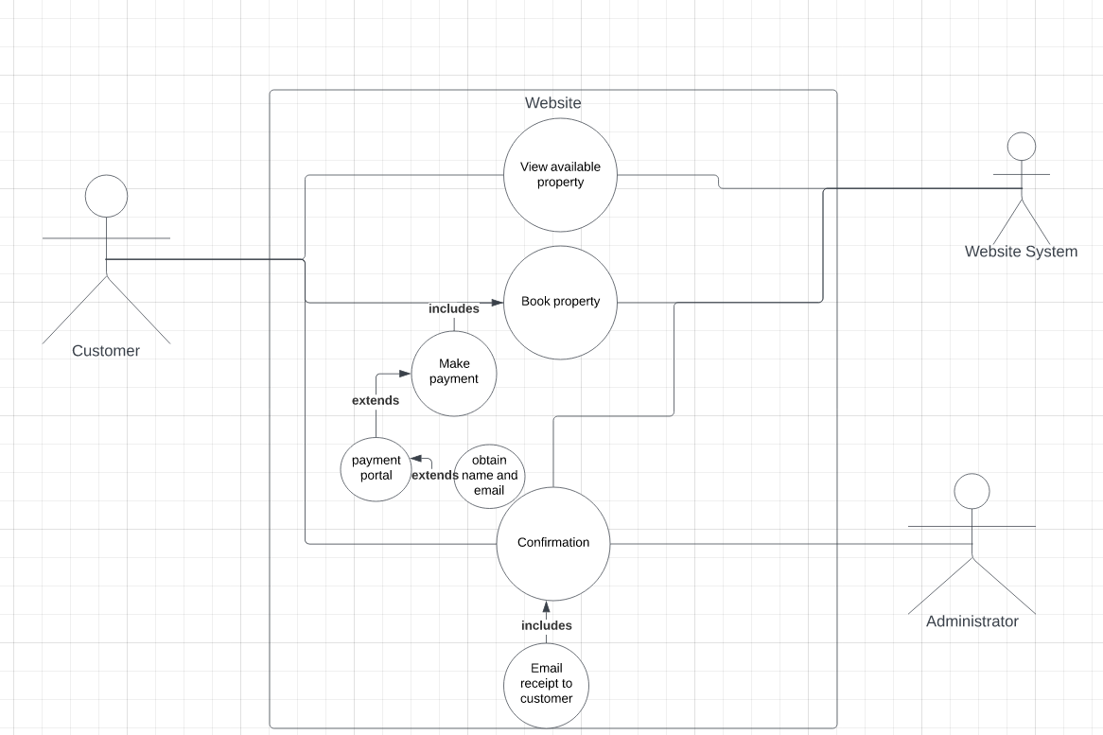
Usecase
Notes:
Tony

Slide 10
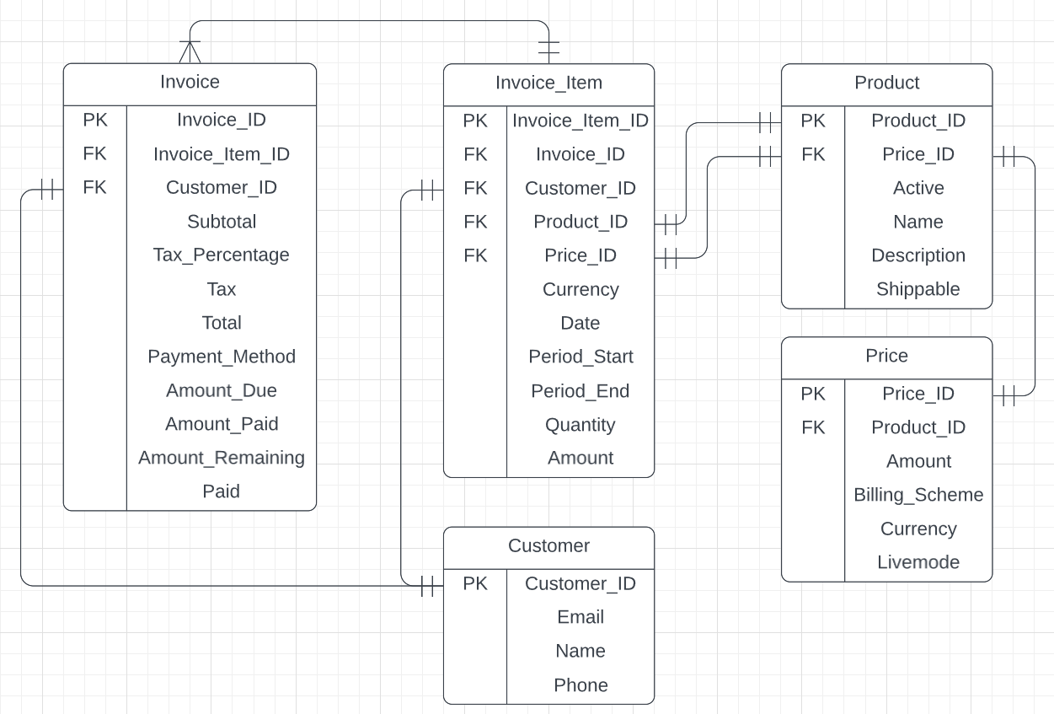
Entity Relationship Diagram
Notes:
Avery

Slide 11
Context-Level DFD
Notes:
Evan

Slide 12
Level 0 DFD
Notes:
Evan

Slide 13
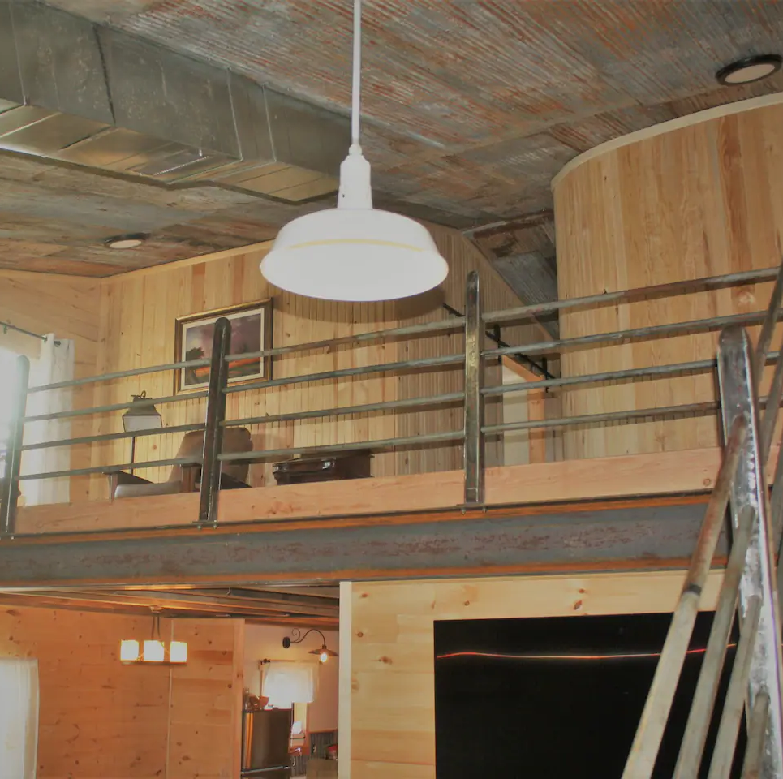
Learning Experiences
Major challenges getting website hosted
Better communication and asking the right questions early
Utilize templates for early prototype designs
When working across multiple forms of software, research integrations early
Notes:
Houston

Slide 14
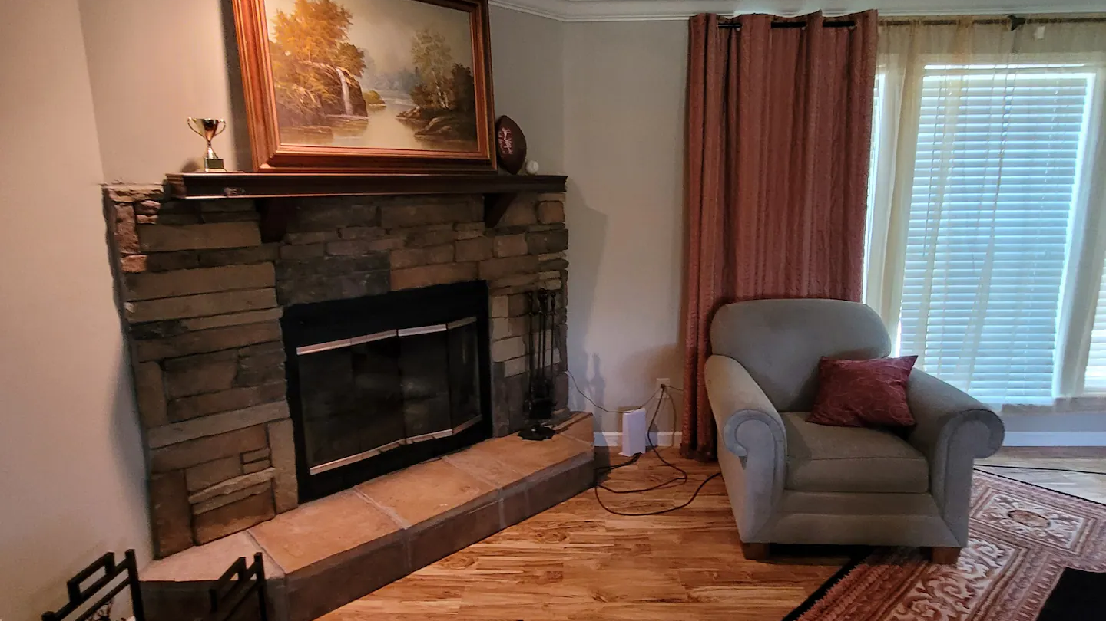
Legal Considerations
Storing login and payment info
All taken care of securely by Stripe
Refunds and Changes
Stripe has generous refund policy
Client has full control over their personal refund policies
Multiple pathways for contact
Notes:
Tony

Slide 15
Website Demo
www.theozarkgetaway.com

