Slide 1
A Study of Deep Neural Networks in the Application of Distracted Driving Detection.
By Wesley Heikes

Slide 2
Introduction

Slide 3
The Problem
The proportion of distracted driving accidents is growing.
Phone Usage, Make-up, and changing the radio station are among many behaviors that are contributing to these accidents.
Cell phone usage while driving accounts for 29,999 crashes in 2020.
Distracted Driving Accidents
Year | Percentage of Total Accidents
2018 | 7.77%
2020 | 14%

Slide 4
Objectives
Potential Solution:
Convolutional Neural Networks are capable to differentiating safe and distracted driving.
Objectives:
Research CNN’s
Research CNN application in distracted driving
Find suitable architecture and tune algorithm for distracted driving using State Farm Dataset.

Slide 5
Literature Review

Slide 6
Architectures
Alex Net | 10 layers, pioneered the concept of dropout
GoogLeNet | 22 layers, used sparse structures and small filters
VGG | Cascaded convolutional layers for efficiency
ResNet | Pioneered the use of skip-connections to minimize vanishing gradient problem (residuals)
MobileNet | Used inverted residuals and linear bottlenecks to minimize complexity for more mobile applications
DenseNet | Pioneered Dense Blocks (entire layers can be dropped)
Auto-Keras | Automatically constructs architecture and tunes hyperparameters based on input data.
EfficientNet | Automated Network that scales network complexity to data set.

Slide 7
Distracted Driving Literature
Detection of Distracted Driver using Convolutional Neural Network | VGG-16 and 1x1 convolutions instead of fully connected layers
Driver Distraction Identification with an Ensemble of Convolutional Neural | Ensemble of different types of neural networks including: AlexNet, Inception V3, ResNet, and VGG-16
Driver Fatigue Detection Based on Convolutional Neural Networks using EM-CNN | 3 cascaded CNN’s two of which used object detection to measure facial features of driver.
Driving Posture recognition by Convolutional Neural Networks | Used CNN to detect gaze, head posture, facial cues, and driver’s body language.
In Distracted Driving Detection with Machine Learning Methods by CNN based Feature Extraction | Used CNN to extract features to pass through KNN, SVM, and RF in parallel
Weight Initialization of Deep Neural Networks(DNN’s) using Data Statistics | Proposed alternative mathematical method for initializing weights to reduce vanishing gradient and improve accuracy
“Texting & Driving” Detection Using Deep Convolutional Neural Networks | Inception V3 model with region of interest tracking hands of driver.
Driver Behavior Analysis via Two-Stream Deep Convolutional Neural Network | 2 CNN’s in parallel to process spatial and temporal data from images.
Real-time detection of distracted driving based on deep learning | Tested 4 Algorithms on artificial driving setup

Slide 8
Method

Slide 9
State Farm Dataset

Slide 10
Auto-Keras
What does it do?
Tests different Neural Network Architectures
Tunes hyperparameters
Displays the resulting
Adjusts for overfitting and underfitting
How does it work?
Framework on top of Keras
Feed in preprocessed Data
Auto-Keras trains and tunes the model

Slide 11
Results

Slide 12
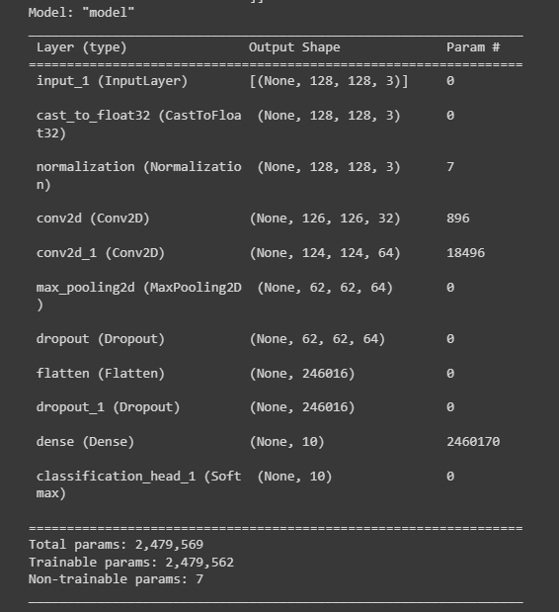
Resulting Architecture:

Slide 13
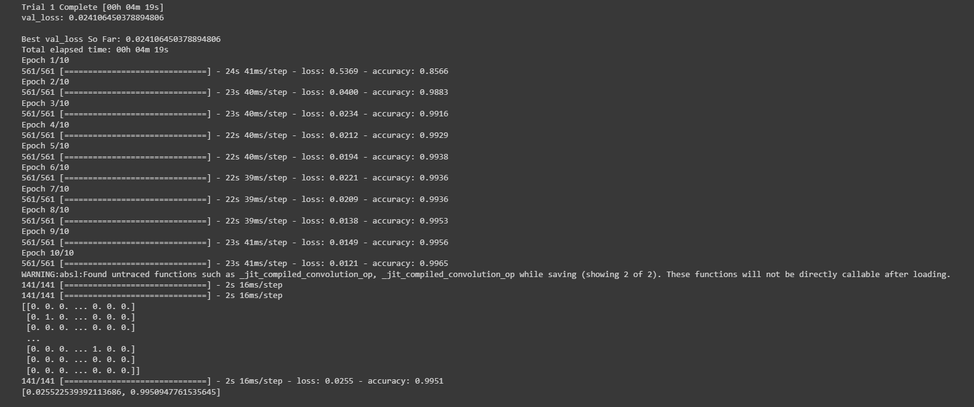
Resulting Accuracy:
Validation Loss: 2.55% Validation Accuracy 99.5%

Slide 14
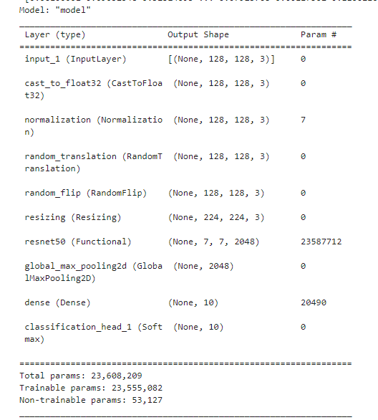
Alternate Architecture
Result of 44 Trials
Accuracy = 86%

Slide 15
Conclusion
Distracted driving is a growing problem
Convolutional Neural Networks are capable of detecting distracted driving
Auto-Keras is an automated framework that creates and tunes neural networks.
Weaknesses:
Research limited by Keras/Tensorflow bugs
Additional Validation could be done by further testing the Auto-Keras results

Slide 16
References
[1] Distracted driving. NHTSA. (2021). Retrieved from https://www.nhtsa.gov/risky-driving/
[2] Anna Montoya, W.. (2016). State Farm Distracted Driver Detection.
Hesham M. Eraqi, Yehya Abouelnaga, Mohamed H. Saad, Mohamed N. Moustafa, "Driver Distraction Identification with an Ensemble of Convolutional Neural Networks", Journal of Advanced Transportation, vol. 2019, Article ID 4125865, 12 pages, 2019. https://doi.org/10.1155/2019/4125865
[3] Alex Krizhevsky, Ilya Sutskever, and Geoffrey E. Hinton. 2017. ImageNet classification with deep convolutional neural networks. Commun. ACM 60, 6 (June 2017), 84–90. https://doi.org/10.1145/3065386
[4] Szegedy, C., Liu, W., Jia, Y., Sermanet, P., Reed, S., Anguelov, D., Erhan, D., Vanhoucke, V., & Rabinovich, A. (2015). Going Deeper With Convolutions. In Proceedings of the IEEE Conference on Computer Vision and Pattern Recognition (CVPR).
[5] Simonyan, K., & Zisserman, A.. Very Deep Convolutional Networks for Large-Scale Image Recognition.
[6] He, K., Zhang, X., Ren, S., & Sun, J. (2016). Deep Residual Learning for Image Recognition. In Proceedings of the IEEE Conference on Computer Vision and Pattern Recognition (CVPR).
[7] Sandler, M., Howard, A., Zhu, M., Zhmoginov, A., & Chen, L.C. (2018). MobileNetV2: Inverted Residuals and Linear Bottlenecks. In Proceedings of the IEEE Conference on Computer Vision and Pattern Recognition (CVPR).
[8] Huang, G., Liu, Z., Maaten, L., & Weinberger, K. (2017). Densely Connected Convolutional Networks. In Proceedings of the IEEE Conference on Computer Vision and Pattern Recognition (CVPR).
[9] Haifeng Jin, Qingquan Song, and Xia Hu. 2019. Auto-Keras: An Efficient Neural Architecture Search System. In Proceedings of the 25th ACM SIGKDD International Conference on Knowledge Discovery & Data Mining (KDD '19). Association for Computing Machinery, New York, NY, USA, 1946–1956. https://doi.org/10.1145/3292500.3330648

Slide 17
References
[10] Tan, M., & Le, Q. (2019). EfficientNet: Rethinking Model Scaling for Convolutional Neural Networks. In Proceedings of the 36th International Conference on Machine Learning (pp. 6105–6114). PMLR.
[11] Baheti, B., Gajre, S., & Talbar, S. (2018). Detection of Distracted Driver Using Convolutional Neural Network. In Proceedings of the IEEE Conference on Computer Vision and Pattern Recognition (CVPR) Workshops.
[12] Hesham M. Eraqi, Yehya Abouelnaga, Mohamed H. Saad, Mohamed N. Moustafa, "Driver Distraction Identification with an Ensemble of Convolutional Neural Networks", Journal of Advanced Transportation, vol. 2019, Article ID 4125865, 12 pages, 2019. https://doi.org/10.1155/2019/4125865
[13] Zuopeng Zhao, Nana Zhou, Lan Zhang, Hualin Yan, Yi Xu, Zhongxin Zhang, "Driver Fatigue Detection Based on Convolutional Neural Networks Using EM-CNN", Computational Intelligence and Neuroscience, vol. 2020, Article ID 7251280, 11 pages, 2020. https://doi.org/10.1155/2020/7251280
[14] Yan, Chao & Zhang, Bailing & Coenen, Frans. (2015). Driving posture recognition by convolutional neural networks. IET Computer Vision. 10. 10.1049/iet-cvi.2015.0175.
[15] S. K. S. Al-doorı , Y. S. Taspınar and M. Koklu , "Distracted Driving Detection with Machine Learning Methods by CNN Based Feature Extraction", International Journal of Applied Mathematics Electronics and Computers, vol. 9, no. 4, pp. 116-121, Dec. 2021, doi:10.18100/ijamec.1035749
[16] Saiprasad Koturwar, & Shabbir Merchant (2017). Weight Initialization of Deep Neural Networks(DNNs) using Data Statistics. CoRR, abs/1710.10570.
[17] J. M. Celaya-Padilla et al., “‘Texting &amp; Driving’ Detection Using Deep Convolutional Neural Networks,” Applied Sciences, vol. 9, no. 15, p. 2962, Jul. 2019, doi: 10.3390/app9152962.
[18] J.-C. Chen, C.-Y. Lee, P.-Y. Huang, and C.-R. Lin, “Driver Behavior Analysis via Two-Stream Deep Convolutional Neural Network,” Applied Sciences, vol. 10, no. 6, p. 1908, Mar. 2020, doi: 10.3390/app10061908.
[19] Tran, D., Manh Do, H., Sheng, W., Bai, H. and Chowdhary, G. (2018), Real-time detection of distracted driving based on deep learning. IET Intell. Transp. Syst., 12: 1210-1219. https://doi.org/10.1049/iet-its.2018.5172

