Slide 1
ArkaValley Liquor: Simplifying Restaurant Alcohol Orders

Slide 2
ArkaValley Liquor Overview
ArkaValley is a local liquor store based out of Blackwell, Arkansas and was opened in 1996.
ArkaValley provides alcohol to many customers including restaurants and businesses.
These restaurants usually purchase in bulk and currently make these orders through email.

Slide 3
Problem Statement
With the lack of a formal order system, orders are currently done via email.
This is a very unorganized and time-consuming process.
There is no easy way to access all order data made by restaurants.
Notes:
Isaiah

Slide 4
Business Needs
Due to the informal way of ordering, a new ordering system is needed to keep up with competition.
Also, keeping all order data stored in a single, easily accessible place is needed.
A modernized ordering system would automate the ordering process while also giving customers insight to the entire inventory.

Slide 5
Ordering system

Slide 6
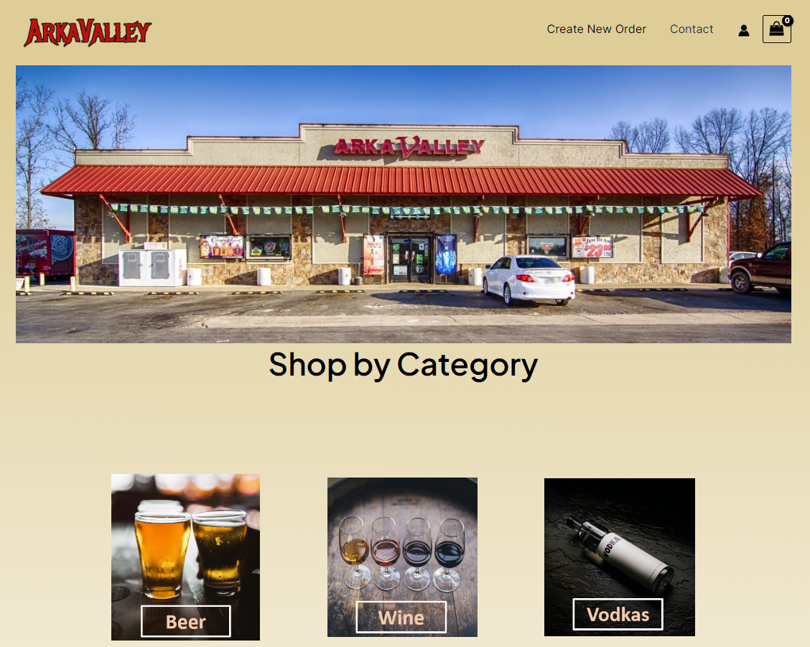
Ordering System
The system is web based and will be accessible by computers, cell phones, or tablets.
Restaurants can access the store’s inventory, while also creating an order that will be ready for pick up.

Slide 7
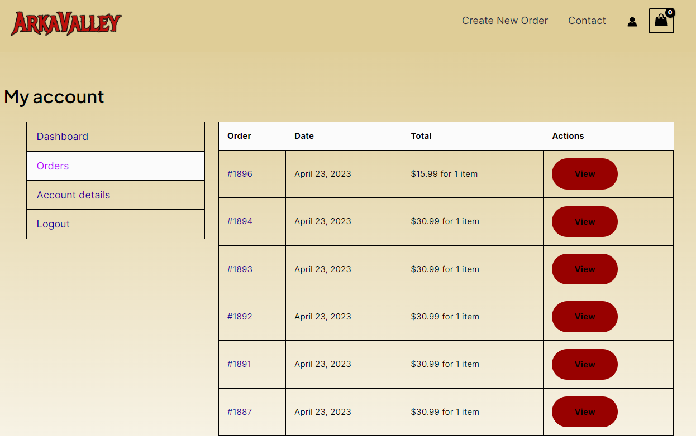
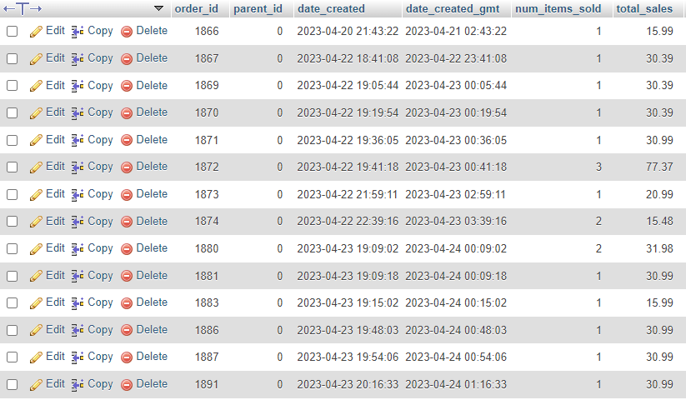
Ordering System
Restaurants can keep track of their previous orders.
ArkaValley keeps all order data stored in one place.

Slide 8
Task Management
We adopted an agile development style while creating this project.
Agile development is a collaborative approach to software development where tasks are broken down into sprints.
It relies heavily on communication with the customer to receive feedback on what is good and what needs change.
Notes:
isaiah

Slide 9
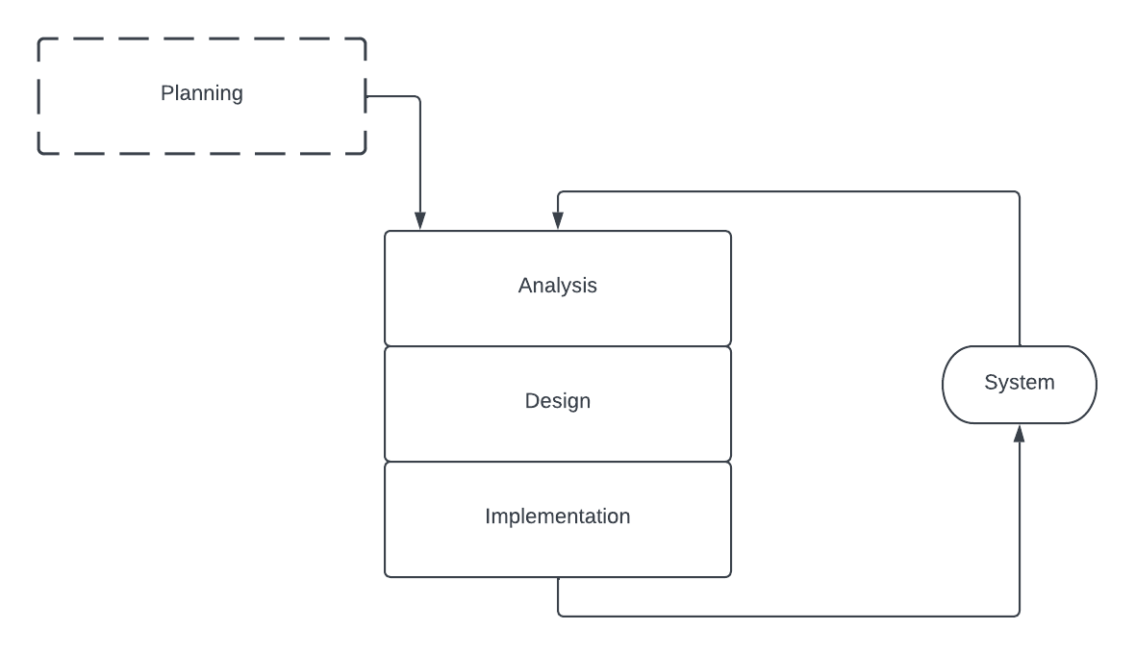
Task Management
We worked in 2-week sprints. Every two weeks we’d have a certain part of the project that we wanted done.
The main task would be broken down into smaller tasks and distribute them to each other.
At the end of the two weeks, we’d take what we had done and talk with the customer to get feedback.

Slide 10
Building Analysis Models
To make the Analysis Models we started by asking questions such as:
Do you currently have a Database?
How do customers currently place their orders?
How would you like the process of ordering items to be performed?
Where would you want the invoice to be sent to?
What information do you want displayed to the end users that are placing an order?
Once these base questions were answered we could start on making the base designs of the analysis models.

Slide 11
Context Level DFD

Slide 12
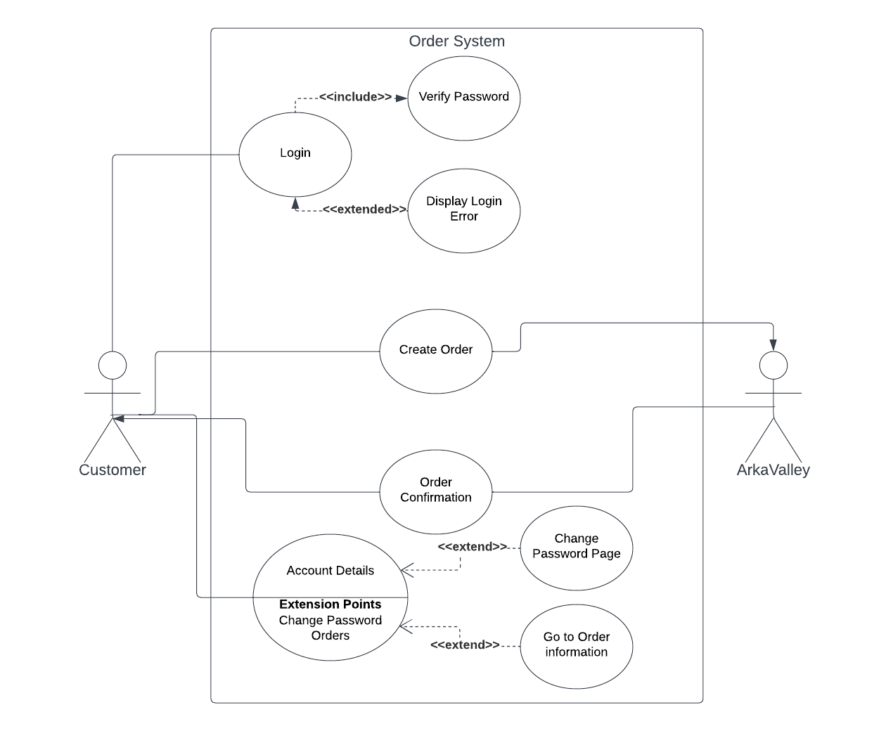
Use Case
Notes:
Isaiah

Slide 13
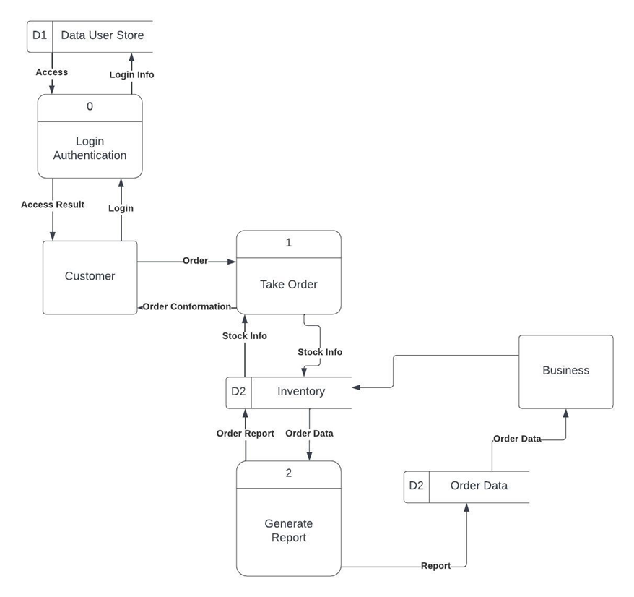
Level 0 DFD

Slide 14
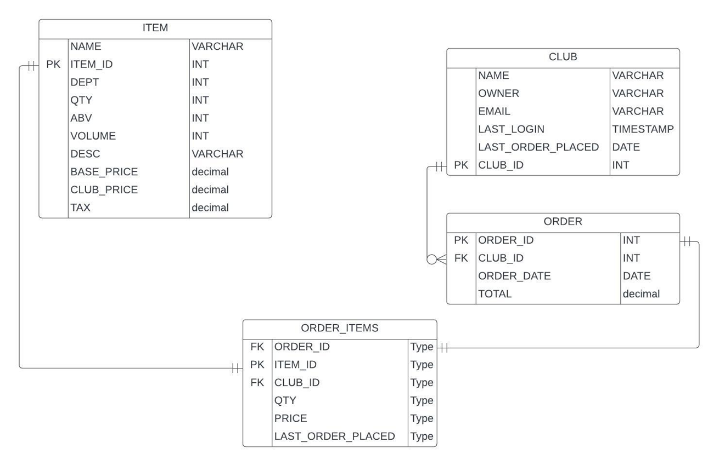
ER Model

Slide 15
Learning Experiences
WordPress, PHP, SQL, HTML, and CSS were some of the main technical skills that were acquired while working on this project.
Another significant aspect of our learning experience was collaborating with our teammates and the client. With a project like this, working effectively with others, communicating clearly, delegating tasks, and solving problems as a team is key.
Project/time management also played a big part in our project. Planning and setting goals are great aspects but being able to achieve those goals takes plenty of time management as well.
The ability to adapt to unforeseen issues was a crucial skill that we learned during this project. We faced several unexpected challenges, and being able to adjust to the unexpected was essential for our success.

Slide 16
Ethical and Legal Considerations
Password Protection: All user passwords will be secured using a hashing algorithm called bcrypt. This creates a “salt” value, which is a randomly generated string of characters added to the password before it is hashed.
Before hashing: Tech2023
After hashing:
$P$BtrivT0et3O68zEX8yKAQOgfA1csDA/
Notes:
Isaiah

Slide 17
Ethical and Legal Considerations
Age Verification:
If it is the first time someone is visiting the site, a message asking if they are 21 will pop up. If they click “Yes” access is granted. If they click “No” access is revoked.
Also, anyone wanting access to our site has to login first. All our users must be verified before they are given an account.

Slide 18
Demo
http://arkavalleyliquor.space/

Slide 19
THANKS!
Any questions?

