Slide 1
Functional Integrated Storage Housing
Thomas Dodds, Andrew Hilsdon, Alexander Holland, Vana Ducusin, Noah Disheroon, Parker Dew

Slide 2
Overview
The Corley lab director asked us to design and build a shelf for the robotics lab to help store parts and help organize the lab. The group decided on an electronic vertical rotating shelf design consisting of groups of bins on shelves. The unit is able to store and sort through thousands of pounds of parts and keep track of them using an computerized inventory system to streamline the operator’s workflow and improve efficiency. A motorized chain drive system is the backbone of the design allowing shelf movement. The group’s mechanical engineering section is working on a 3D design of the shelf using Autodesk Inventor.
Things to consider:
Sturdiness
Affordability
User friendliness
Capacity
Efficiency
Safety

Slide 3
Sturdiness
Materials used for design:
Steel
Wood
Plexiglass
Rubber
The unit may end up holding thousands of pounds of parts at full capacity, so material choice is a key aspect.
Steel would be used for the majority of the project because of its high strength.
Wood would be used in sections that do not bear high weight.
A plexiglass safety shield on the front of the unit is required for operator safety.
Rubber would be used to dampen vibrations of the motor to the floor, helping reduce the volume of the unit in operation.

Slide 4
Affordability
The shelf needs to be made of good quality materials and be quality build without breaking the bank. The budget for this project is $400.
Ways to cut down on cost:
Use wood for the non-weight bearing places
3D print as much as possible including the trays and bins
Build as many materials in house as possible
Where to not cut down on the cost:
Motor
Chassis (Frame)
Drive system
Bars that hold the bins

Slide 5
User Friendliness
The system - particularly the user interface - must be easy to use and intuitive, where anyone could simply operate the unit.
Features:
Manual Up and Down
Search Feature
Information of current shelf
Safety lockouts

Slide 6
Capacity
The shelf has to be able to hold a lot of parts so that all of the parts needed are in one place and easily accessible. The idea that we had for this was a modular system of bins that would fit into one big tray. These would be for holding various smaller items and if big item needed to be stored then the bins could be removed and the tray could be used.

Slide 7
Efficiency
This system has to be efficient in order for the people using it to get the most out of it. The motor has to be efficient so that it can smoothly rotate the shelves without making too much noise. The user interface also has to be efficient to navigate through, the buttons can not have a delay to them or that is just wasted time. The raspberry pi also had to be efficient in navigating the inventory system.

Slide 8
Safety
Heavy, high-torque electrical application: dismemberment is feasible, electrocution possible. These risks can be mitigated:
No internals should be easily accessible without intent (e.g. chain drive is protected by a side panel, can’t stick fingers/limbs back into mechanical areas, etc.)
No electrical wiring is exposed to the operator
Additional active safety features:
Plexiglass safety shield must be in place for the shelves to index
At least one obvious emergency shutoff switch within arm’s reach of the operator to shut off the shelf and the workbench power
Warning labels (e.g. “this equipment starts and stops automatically”, “risk of electric shock” etc.) placed visibly on all sides of unit

Slide 9
Mechanical Design
Folding workspace area
Electrical outlets
Motor/gearboxes in lower base
Chain drive to move shelves
Castor wheels to move easily
Plexiglass shield to protect users
Assembled in parts for easy transport
Unit dimensions: 10ft x 3ft x 10ft

Slide 10
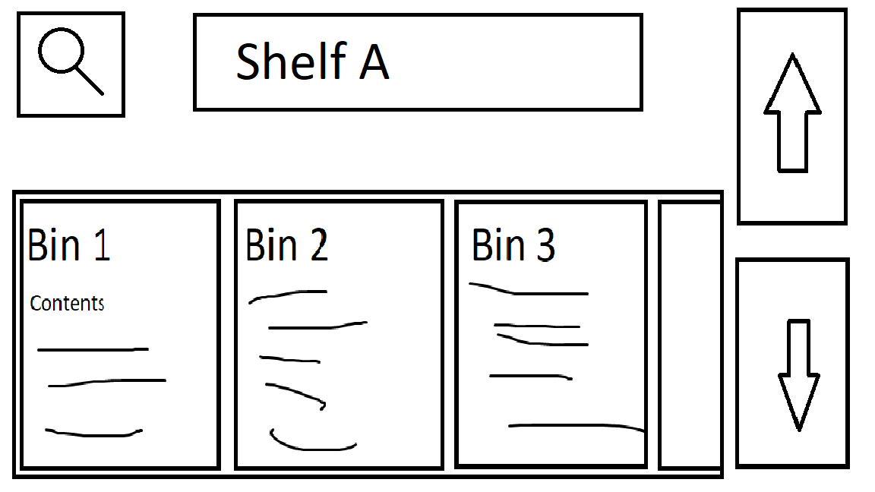
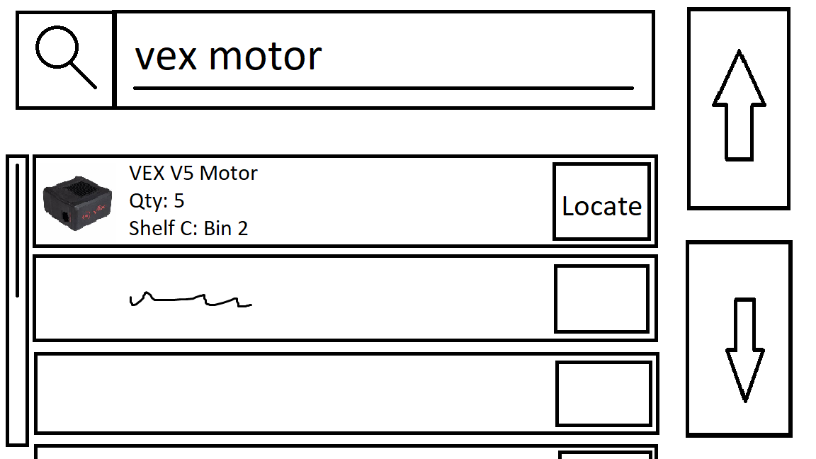
Interface Design
Home screen
Current shelf info/contents
Search bar to search parts
Access to settings
Search function
Quickly search storage content by keyword or short descriptive phrase
List the most relevant results
Allow operator to one-touch “go-to” the shelf containing a search result
Part database modifiable from settings
Persistent up/down buttons - always able to manually index shelves
Top: “Home screen” mockup. Bottom: “Search screen” mockup.

Slide 11
Drive Motors: DC vs AC
Both AC and DC motors are multipurpose machines with a wide range of usability and adaptability. Either type of motor would fit the design case.
Factors to consider:
Usability
Ability to implement
Cost

Slide 12
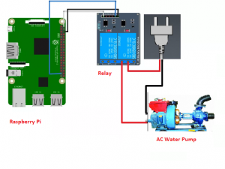
AC Motor Implementation
With an AC Motor, we would need a Relay Module to work in tandem with our Raspberry Pi.
This Relay would function as a switch to change which direction our motor turns, allowing more accessibility and ease of access for the shelf.
Relay
Raspberry Pi
AC Motor

Slide 13
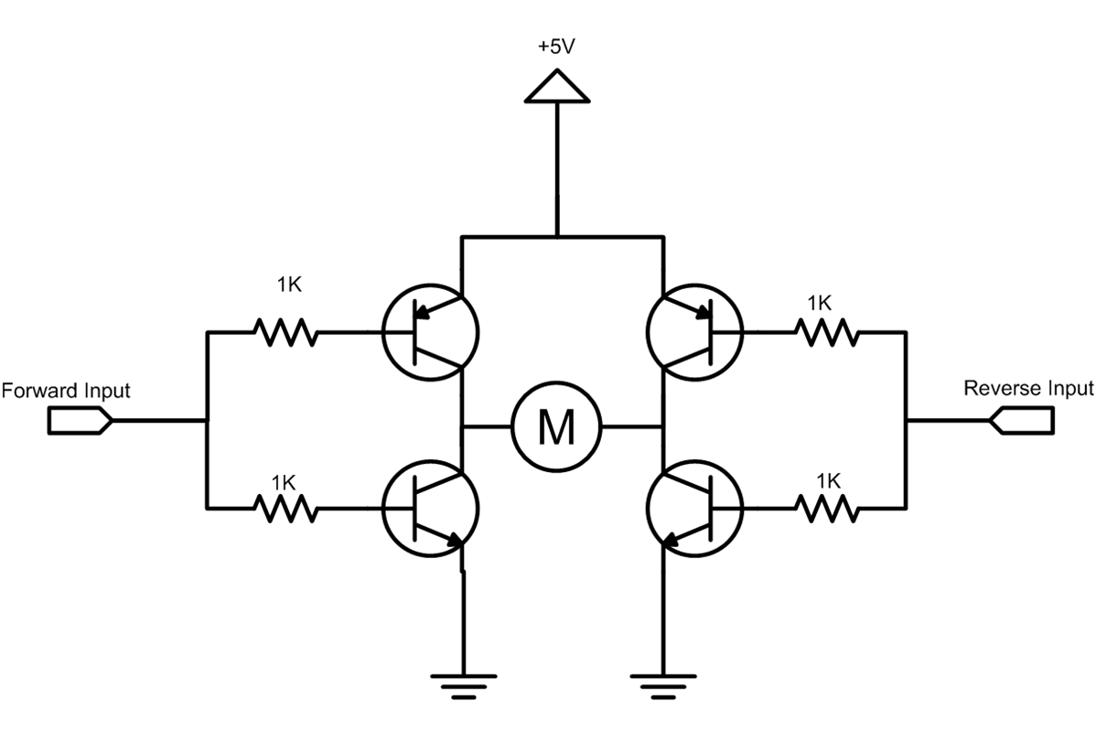
DC Motor Implementation
DC Motors have a little more to them. A H-Bridge design would be required in order to control the direction of the motor.
A H-Bridge allows for more fine tuned control over the current and voltage supplied to the motor. It can also be designed with Basic lab equipment.

Slide 14
Electrical Cost
For the amount of torque needed to rotate the shelf, a motor with at least 1/4 horsepower is needed.
For both types of motors, the average cost would be roughly the same at around $200-$250.
A relay for an AC motor costs no more than $5 to $10. An H-Bridge implementation will cost a similar amount.

Slide 15
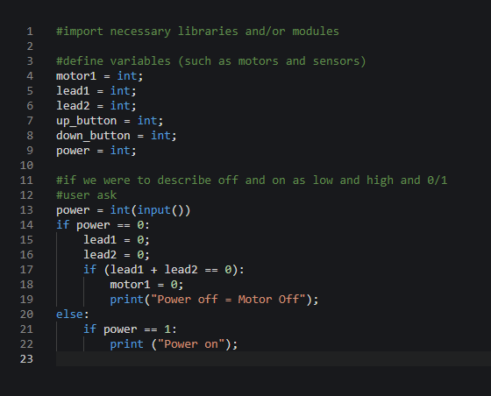
Electrical Interface
Pseudocode: Power control
Motor Control Logic (x = doesn’t matter)
Power | Lead1(M) | Lead2(M) | (M) MotorResult
0 | x | x | Power off
1 | 0 | 0 | No movement
1 | 0 | 1 | Shelves move up
1 | 1 | 0 | Shelves move down
1 | 1 | 1 | Not movement

