Slide 1
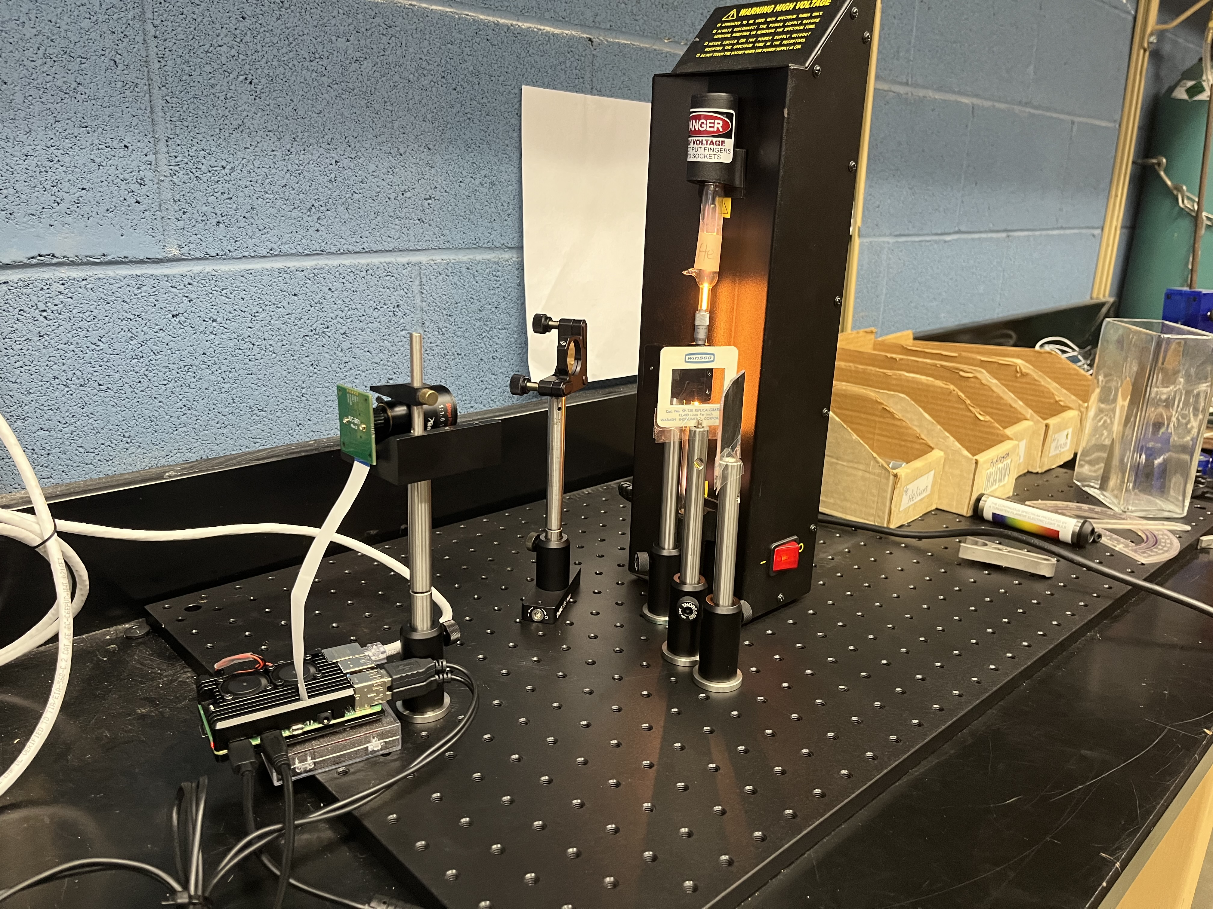
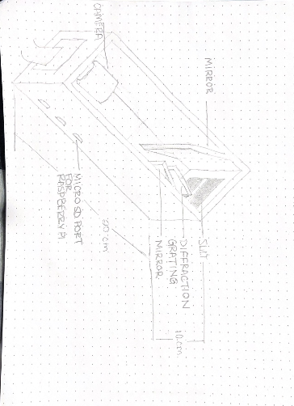
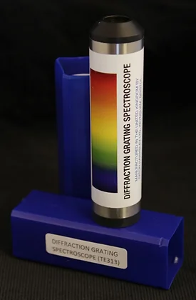
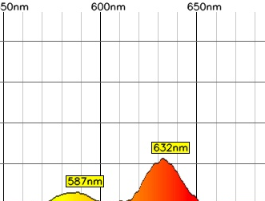
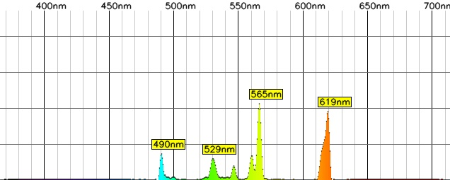
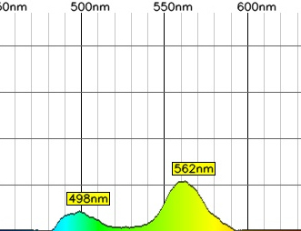
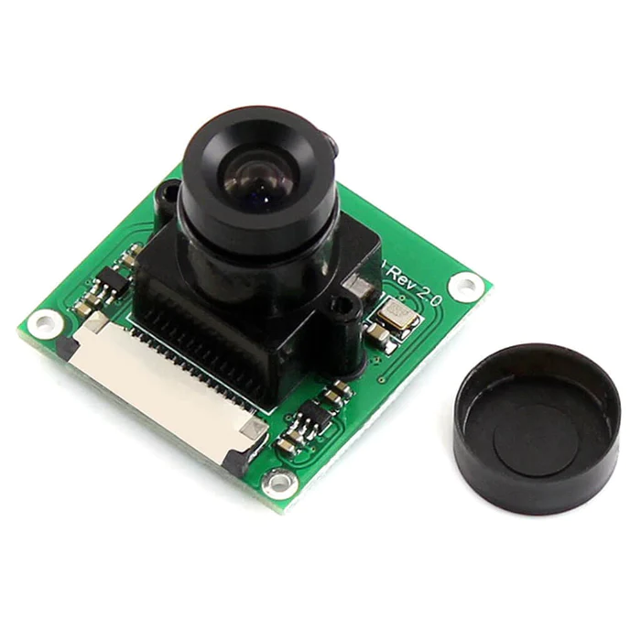
Process of Building and Designing a Spectrometer
Tori Freeman, Jessica Young, Matthew Young
Analysis
Discussion
Introduction
The thin lens maker equation was used to determine the appropriate lens size and focal length for the design.
$\frac{1}{f}=(μ−1)(\frac{1}{R_{1}}−\frac{1}{R_{2}})$ µ = refractive index
$R_{1}, R_{2}$ = curvature of lens surfaces
Using a desired focal length of 10 cm and the refractive index for glass, 5 cm lens was selected for the final design.
The design was able to capture the spectrum of various elements and display them in a readable graph. However, there are potential areas of improvement. This was done using an open-source code for the graphical interface. In the future, the interface design can be improved by writing our own code.
The design of the spectroscope is not contained into a singular table top unit which was a main goal of the design project. Future projects should aim to rectify this.
Spectroscopy is the study and measure of electromagnetic spectra resulting from electromagnetic radiation interacting with matter. Each element when excited emits a unique spectrum containing light of various wavelengths. The identity of the element can then be determined by examining the spectra. A spectrometer is a scientific instrument that utilizes optics, mirrors, and lens to capture and examine spectra.
A classroom spectrometer is potentially useful in the demonstration of numerous physics principles such as diffraction, reflection, ray optics, etc.
Our design included the use of:
2 mirrors
5 cm focal length thin lens
13400 lines/in diffraction film
Slit
Waveshare Camera Board for Raspberry Pi
Raspberry Pi Model B with PoE+ HAT
Computer monitor
Future Work
Research Purpose and/or Question(s)
Figure 3: Tabletop Spectrometer Layout/Design
The purpose of this project is to build and design a small table top spectrometer for educational and demonstrational purposes.
Figure 7: Drawing of Potential Spectrometer Container
Future Improvements
3D printing a “container” to hold the individual parts of the spectrometer
Coding our own user interface for examining the emitted spectra
Modify the design to contain fewer parts of better quality
Method / Data Source(s)
The Paton Hawksley Spectroscope was utilized. This spectroscope has a 600 lines/mm diffraction grating. Our design sought to utilize a similar diffraction grating and overall size.
The program interface used to capture Figures 4-6 was written using an open source Python code.
Findings/Results
References
Figure 1: Paton Hawksley Pocket Spectroscope
Figure 4: Spectra for Krypton
Figure 5: Spectra for Helium
Figure 6: Spectra for Mercury
Benchtop Spectroscope. PHEL Laboratories. (n.d.). Retrieved April 24, 2023, from https://www.patonhawksley.com/product-page/benchtop-spectroscope
leswright1977. (n.d.). LESWRIGHT1977/PySpectrometer: Raspberry Pi Spectrometer. GitHub. Retrieved April 24, 2023, from https://github.com/leswright1977/PySpectrometer
A camera specifically for use with a raspberry pi was selected. This camera is 32mm x 32mm and has a focal length of 6 mm. Pictured right.
We were successful in designing our own spectrometer. Pictured above in Figures 4-6 are the spectrums of several elements. The elements are contained within electrode tubes and energized using electromagnetic radiation (light). The emitted spectrum was focused, filtered, and captured using the designed spectroscope.
Figure 2: Waveshare Camera Board for Raspberry Pi
Special Thanks to our Project Sponsors:

