Slide 1
Premium Retail
By: Dakota Burkhart, Andrew Clark, Garrett Kenney, and Brandon Monroe

Slide 2
Business Introduction
Premium Retail Services
Third party phone sales specialist
Assist with selling and setup of phones
Currently only assist in store customers
Business needs to have information shown out of stor
Business needs sales pipeline to increase sales conversion rate

Slide 3
Problem Statement
Customers are unable to view inventory outside of store.
Associates don't receive information until customers come into the store.

Slide 4
Planning
Without existing inventory database system we have to implement our own database.
1
Appointment selection system paired with inventory system assists with sales conversion rates
2
The web design needs to fit with Premiums existing design scheme.
3

Slide 5
Application Information
Account system – Login, Account Creation
Appointment system – Customers will be able to set a time/date and meet with a Premium Wireless sales rep at their desired location.
Inventory system – Set up a system where customers can view phone inventory.
Administrator View - An admin can look at the appointment schedule and reschedule and communicate with customers as needed.

Slide 6
Team Management
Two teams consisting of a research team and a development team.
Research team focused on product research and finding solutions to best fit our project
Development team did front-end and back-end development

Slide 7
Functional Requirements
Processes
Register for account.
Allow customers to set and review appointments.
View available inventory.

Slide 8
Functional Requirements
Information
System must include inventories for all available locations
System must allow employees to view upcoming appointment history
System must allow customers to set an appointment with desired phone

Slide 9
Non-functional Requirements
Operational
System will run on mobile devices
System should run on any web browser
Responsive design and form fitting for all resolution types

Slide 10
Non-functional Requirements
Performance
Any interaction between the user and the system should not exceed 2 seconds
The system should support 250 users 24/7 365 days a year
System will be available all day every day, all year

Slide 11
Non-functional Requirements
Security
Personnel are not allowed to view customer information with exception of for an appointment
System safe guards against all malicious code/intent
Passwords are hashed and inputs are sanitized
Personnel cannot view information about other stores

Slide 12
Technologies Being Used.
Implemented with the LAMP stack on a Digital Ocean Droplet (Cloud Server)
Linux (Ubuntu 20.04 LTS) (Operating Layer)
Apache2 (Web Server Layer)
MYSQL (Database Layer)
PHP (Back-end Layer)

Slide 13
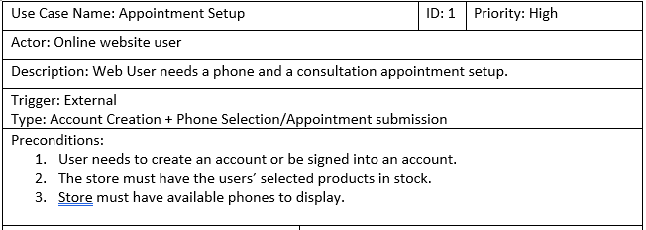
Use Case

Slide 14
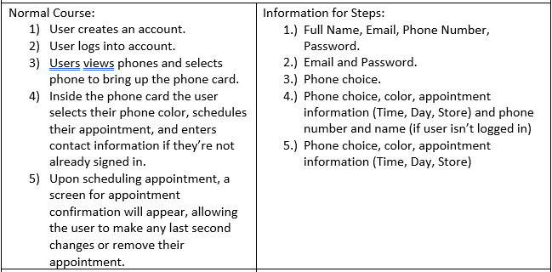
Use Case pt.2

Slide 15
Use Case pt.3

Slide 16
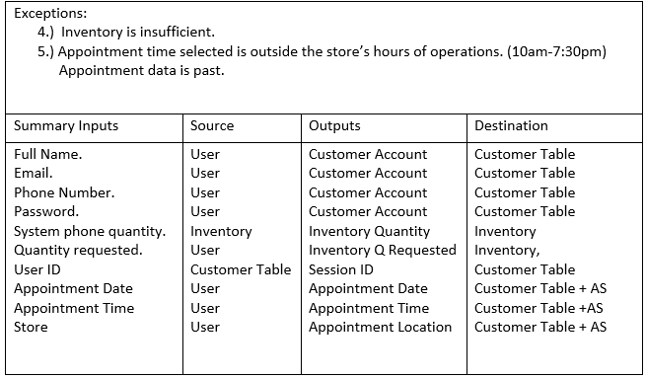
Use Case pt.4

Slide 17
Legal/Ethical Considerations
Client information must be stored and managed securely.
Data threats must be monitored, and damage must be mitigated immediately.
To clarify Liability Premium Wireless must create their Privacy Policy and Terms of Use Agreements upon the transfer of ownership.

Slide 18
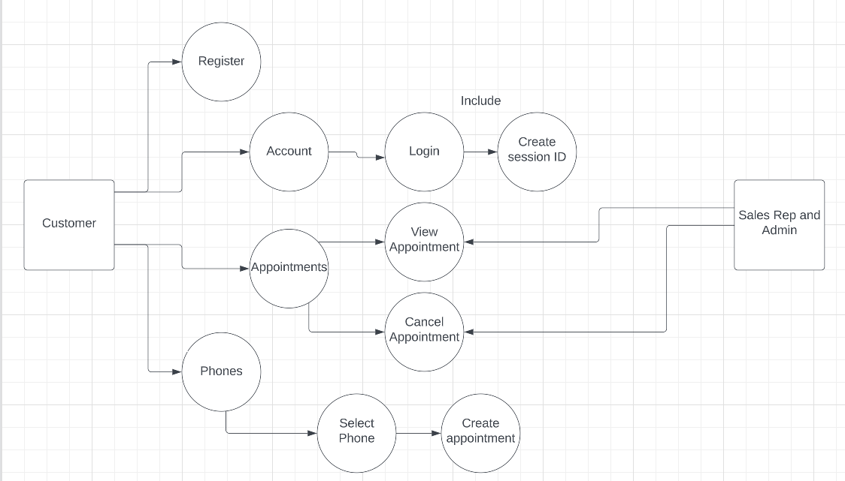
Use Case Diagram

Slide 19
ER Model

Slide 20
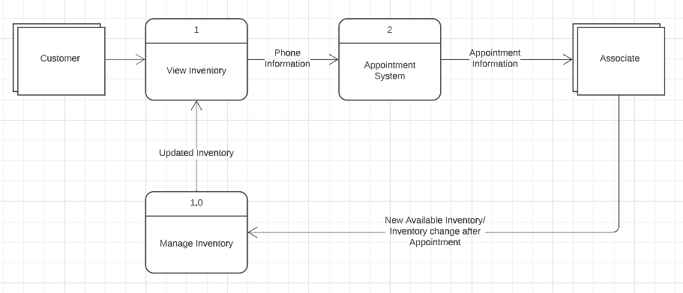
DFDs Model

Slide 21
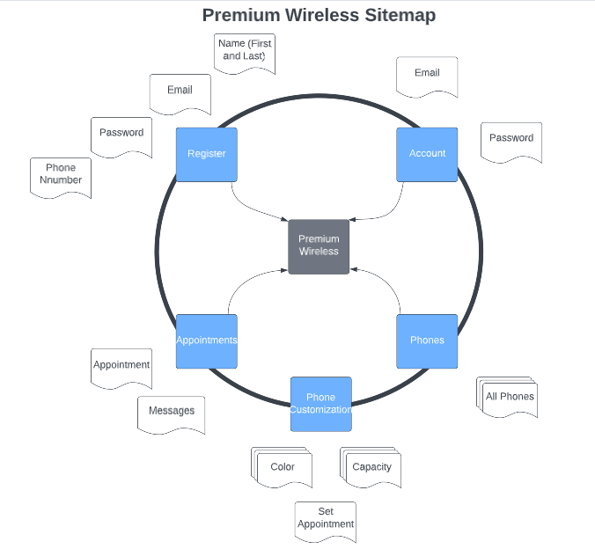
Sitemap

Slide 22
Customer View Home Page

Slide 23
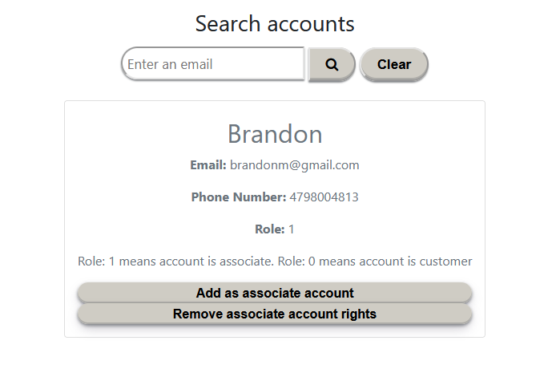
Admin View Add/Change Account Roles

Slide 24
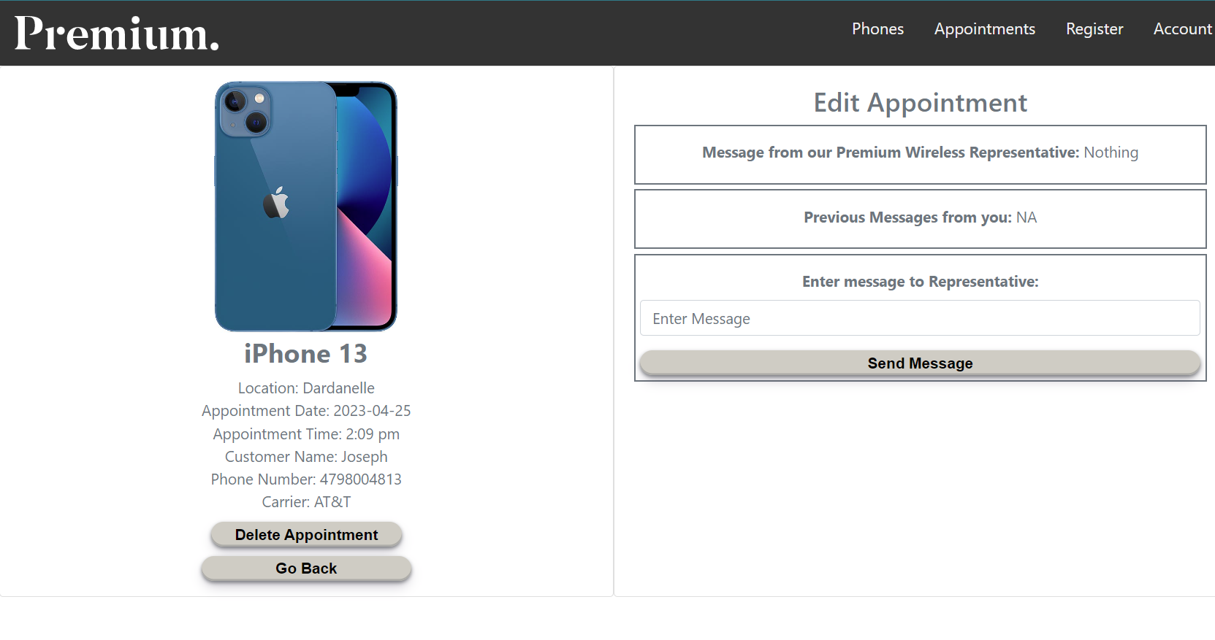
Customer Appointment View

Slide 25
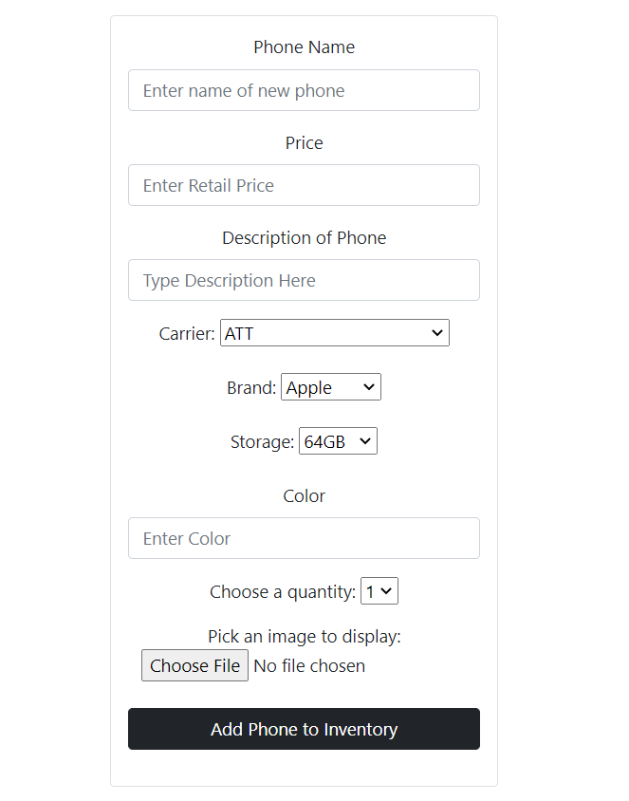
Adding Phones to Inventory

Slide 26
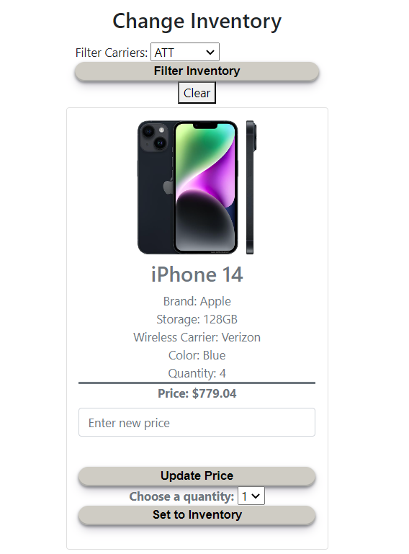
Filtering Inventory by Carrier

Slide 27
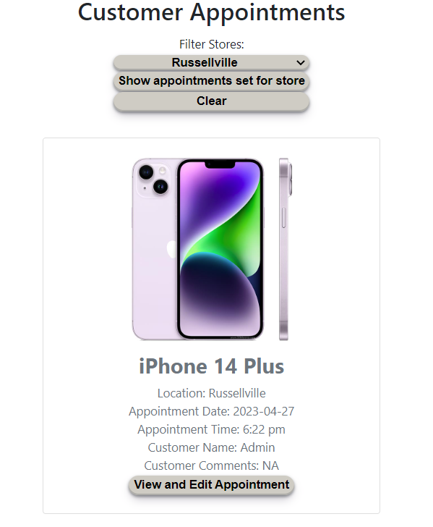
Customer Appointments by Store

Slide 28
Database

Slide 29
Post Development Features
Filter for brand and carrier on All Phones page
Live calendar API
Dedicated timeslots for appointments(30-minute intervals?)
Customer appointment reminders with emails
Asynchronous chat with employee

Slide 30
Learning Experiences
Database Management
Securely storing and using user data
Full-stack website development
Managing a secure server
Domain and SSL setup for website

Slide 31
Demo
Premium Wireless

Slide 32
Q&A

