Slide 1
The Synergistic Effect of Loganetin and 5-fluorouracil on the Carcinogenesis of Glioblastoma Cancer Cells
By: Jonathan Wollenberg
Assisted by: Dr. Mariusz Gajewski and Dr. Steven Barger

Slide 2
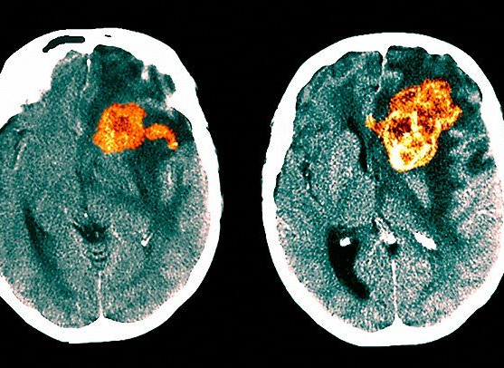
Background
5-fluorouracil is a drug used in various cancer treatments
Loganetin synergizes 5-fluorouracil
Synergistic relationship shown in gastric cancer
Glioblastomas are most common and lethal primary brain tumor
5.6% 5-year survivability rate
Surgical removal is difficult

Slide 3
Purpose
Analyze synergistic effect of Loganetin and 5-fluorouracil on glioblastomas.
Why?
Severity of glioblastomas
Prevalence of chemoresistance
Previous success on gastric cancer
Unmet medical need
Hypothesis
The extract will synergize 5-fluorouracil to further inhibit glioblastomas

Slide 4
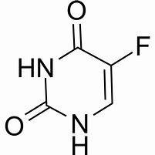
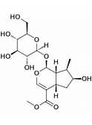
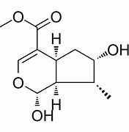
An Overview of Loganetin and 5-fluorouracil
5-fluorouracil
Loganetin
Aglycone moiety of Loganin
Naturally occurring
Biologically active compound
5-fluorouracil
Chemotherapeutic agent
Toxicity
An essential medicine
Loganin
Loganetin

Slide 5
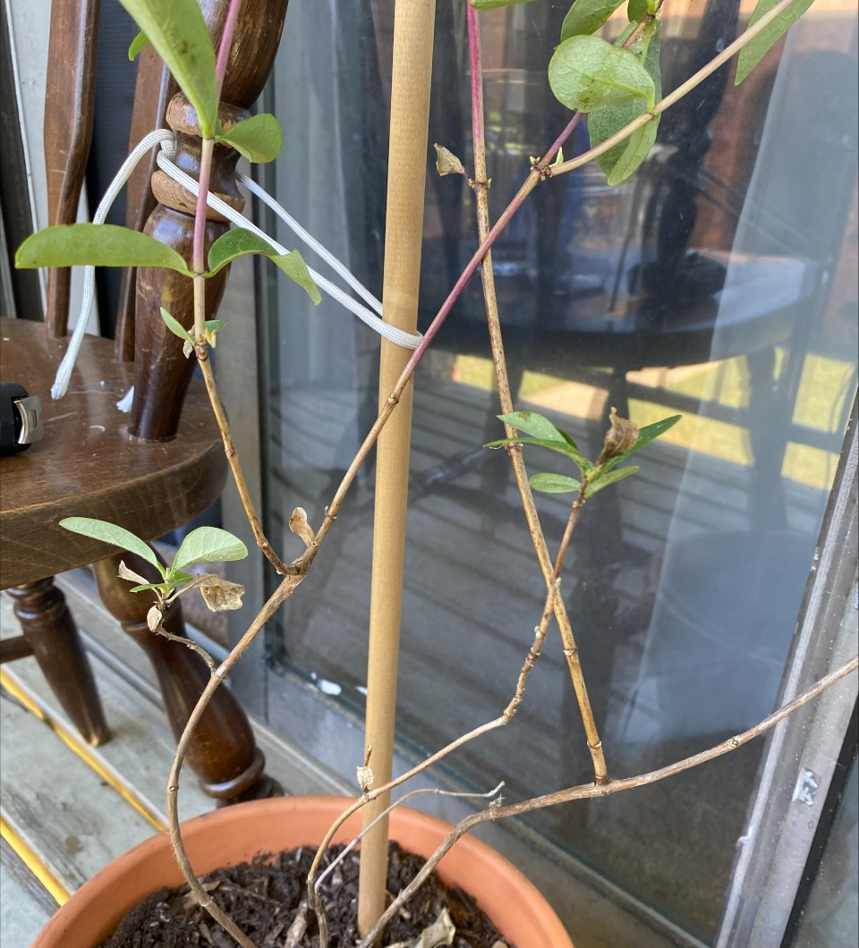
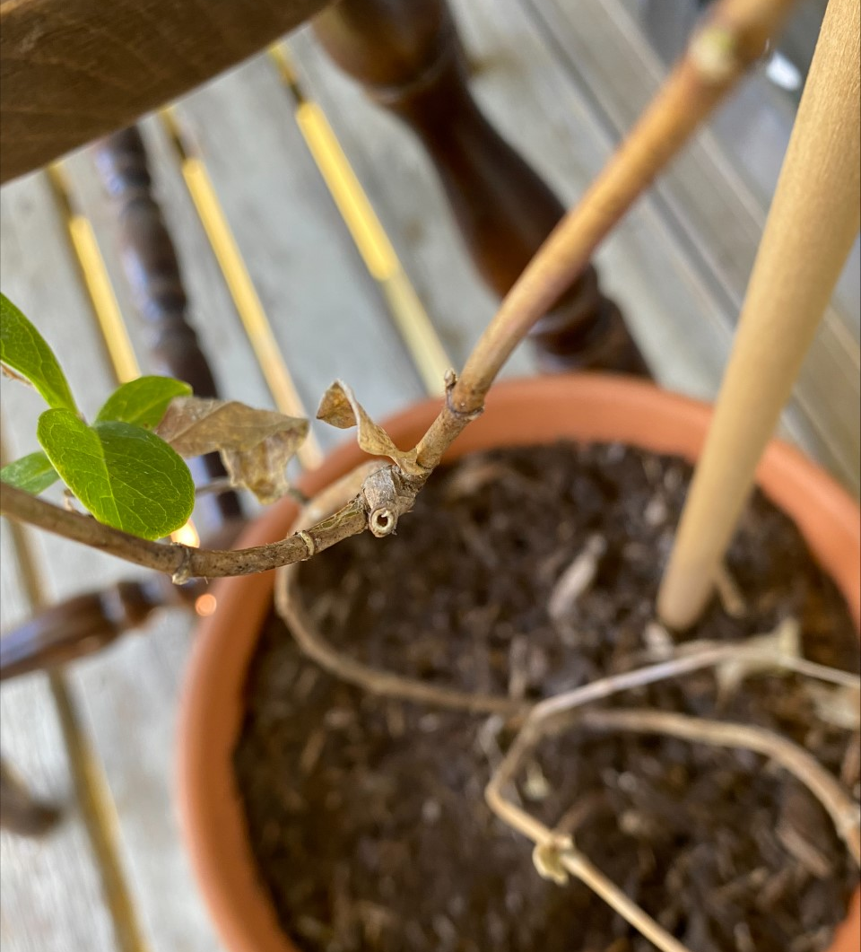
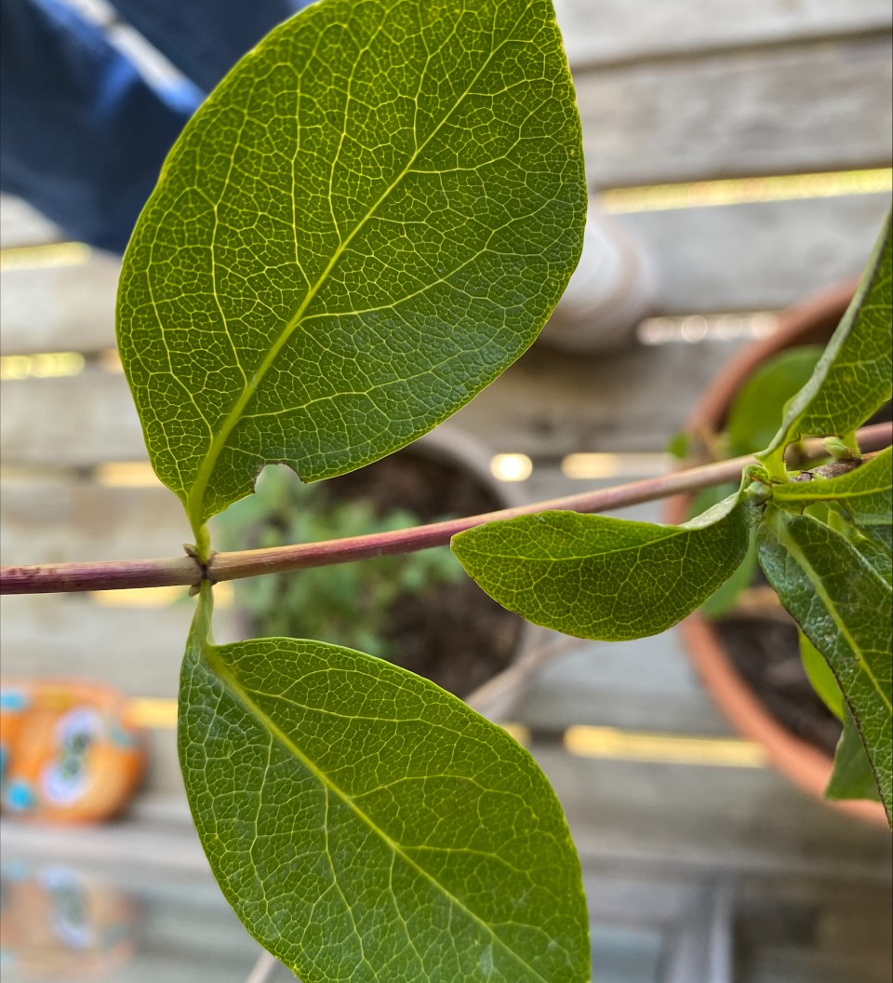
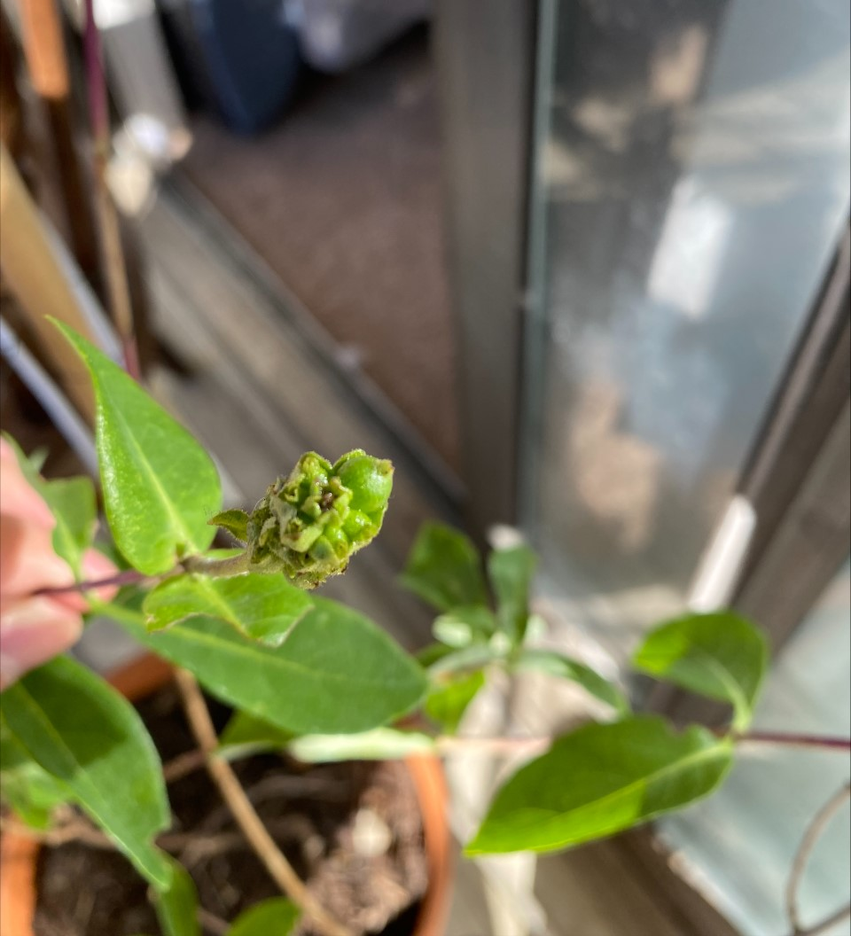
Lonicera etrusca
Species of honeysuckle
Native to Southern Europe, Western Asia and North Africa
Plant purchased online from Stanwood, Washington
Shown to contain Loganetin

Slide 6
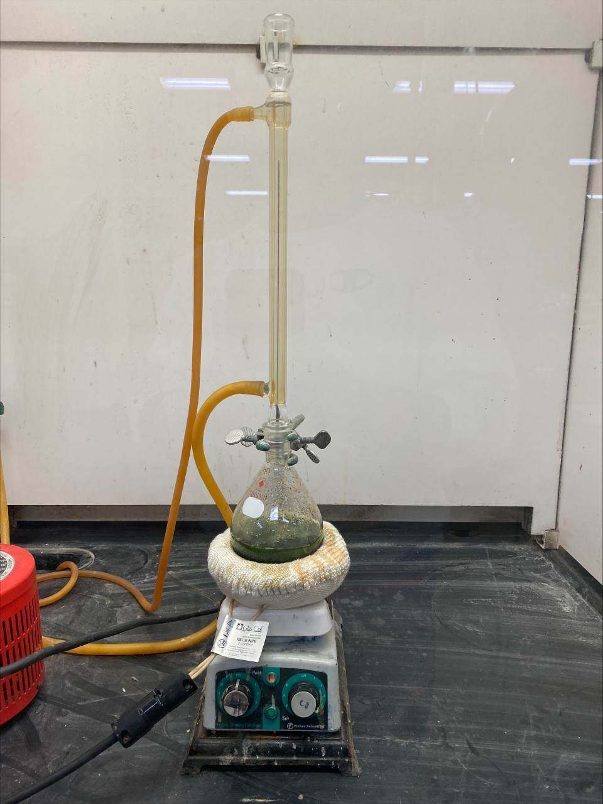
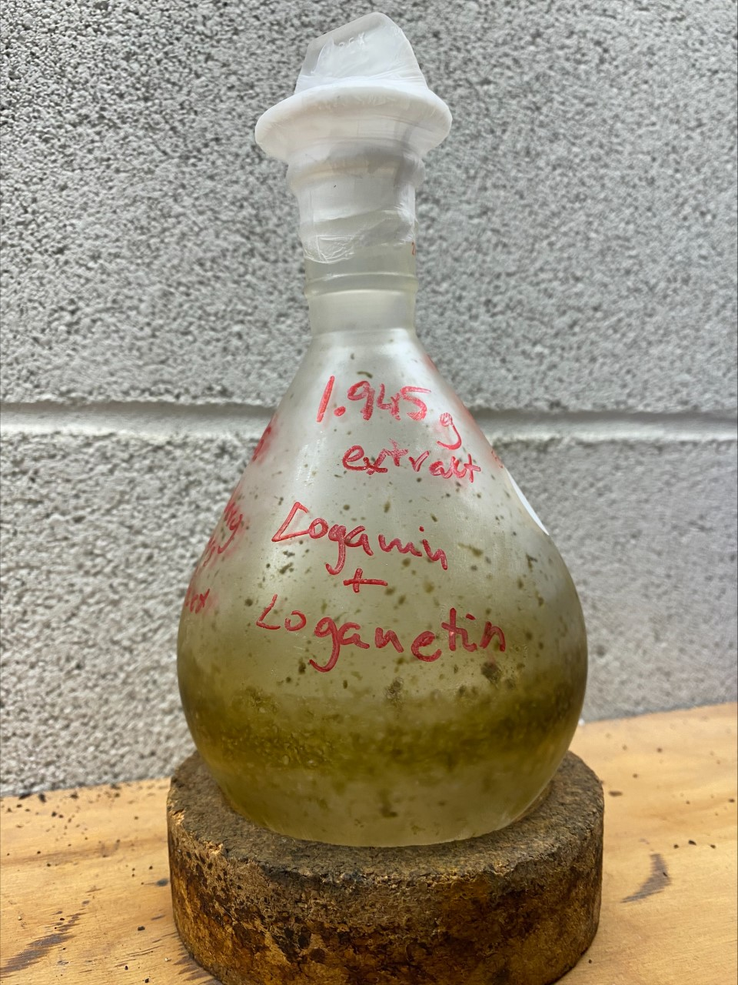
Extraction Method
Cut plant material into small pieces
Air dried for 10 days (until mass stabilized)
Ground in coffee grinder
Extracted with methanol under reflux
Extract evaporated under vacuum and reconstituted in water
Removed oils and lipids by extraction with hexane
Filtered the aqueous solution through plug of Celite and evaporated under vacuum
Sample dried azeotropically with toluene
1.945 grams of crude semi-solid extract obtained

Slide 7
Plate Preparation and Cell Treatment
Extract dissolved to make 300 mg/mL stock solution
Dilution series of extract created the following concentrations
1000 ug/mL, 333 ug/mL, 100 ug/mL, and 33.3 ug/mL
Second dilution series concentrations
10,000 ug/mL, 3000 ug/mL, 1000 ug/mL, 300 ug/mL, and 100 ug/mL
Dilution series of 5FU using 50 mM stock solution created the following concentrations
15 uM, 5 uM, 1.5 uM

Slide 8
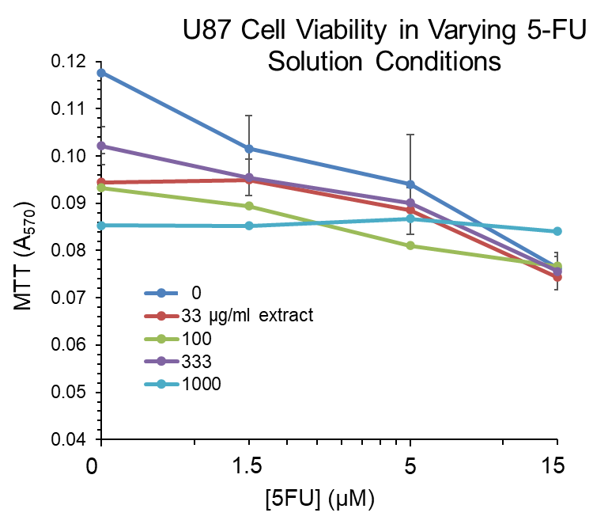
U87 Glioblastoma MTT Assay Results 11/22/22

Slide 9
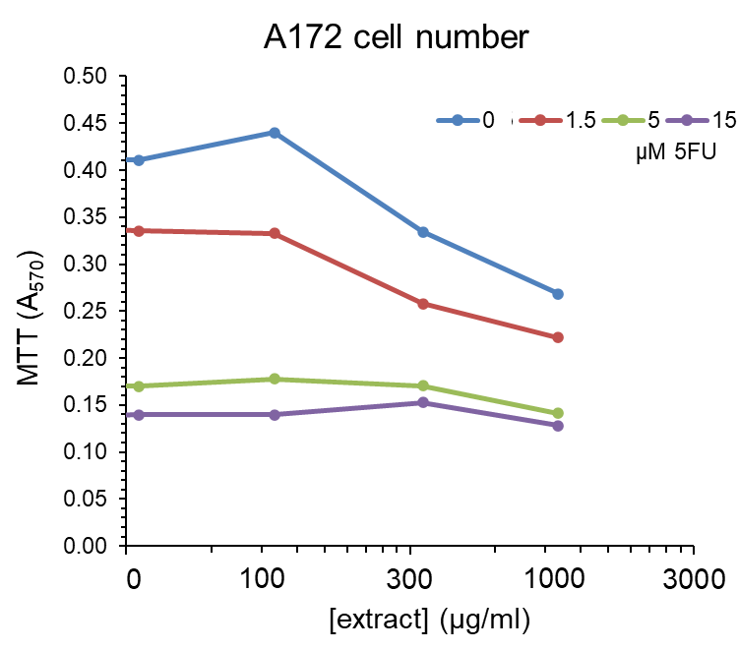
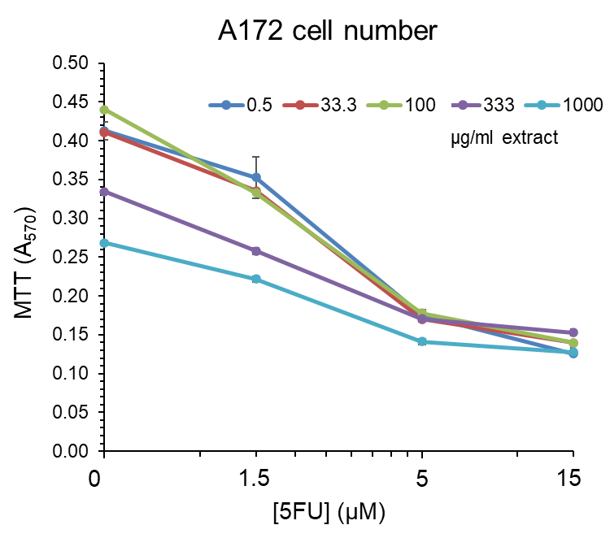
A172 Glioblastoma MTT Assay Results 01/14/23

Slide 10
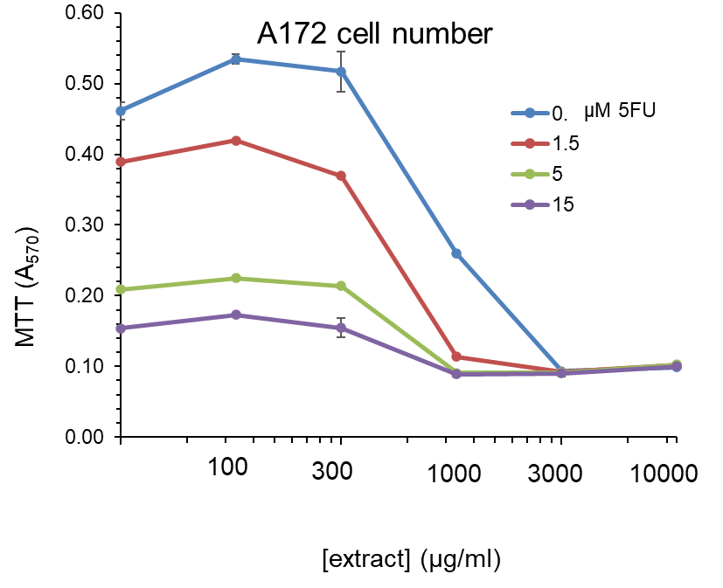
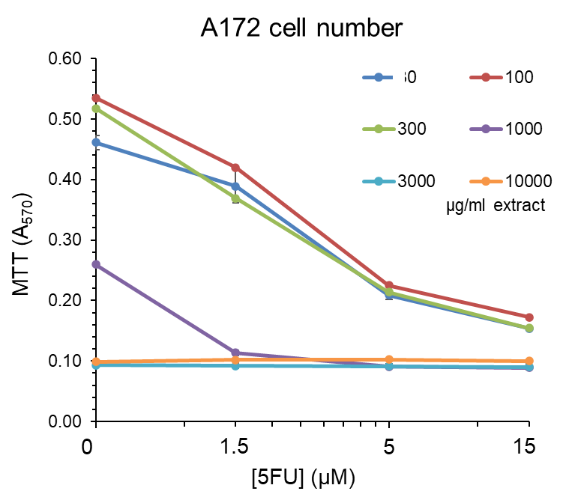
A172 Glioblastoma MTT Assay Results 02/28/23

Slide 11
Summary
The extract and 5FU synergistically inhibit glioblastomas
Extract shows anticancer properties
The anticancer properties of the lower concentrations of 5FU increased by higher concentrations of extract
The 3000 ug/mL extract concentration is the minimum level needed to achieve maximum inhibition

Slide 12
Future Research
Comparison studies of pure Loganetin vs. extract
Mechanism of action
Investigation of susceptibility of other cancer cell lines to this therapeutic approach

Slide 13
Thank you!
Dr. Mariusz Gajewski
Dr. Steven Barger

Slide 14
References
Dr. R. Lustig. (2018, November 5). “What Are the Most Common Types of Brain Tumors?” [Blog post]. Retrieved from: https://www.pennmedicine.org/updates/blogs/neuroscience-blog/2018/november/what-are-the-most-common-types-of-brain-tumors
Chen, W., Xu, X. K., Li, J. L., Kong, K. K., Li, H., Chen, C., He, J., Wang, F., Li, P., Ge, X. S., & Li, F. C. (2017). MALAT1 is a prognostic factor in glioblastoma multiforme and induces chemoresistance to temozolomide through suppressing miR-203 and promoting thymidylate synthase expression. Oncotarget, 8(14), 22783–22799. https://doi.org/10.18632/oncotarget.15199
Zhou, H., Hu, X., Li, N., Li, G., Sun, X., Ge, F., Jiang, J., Yao, J., Huang, D., & Yang, L. (2020). Loganetin and 5-fluorouracil synergistically inhibit the carcinogenesis of gastric cancer cells via down-regulation of the Wnt/β-catenin pathway. Journal of cellular and molecular medicine, 24(23), 13715–13726. https://doi.org/10.1111/jcmm.15932
Pestalozzi, B. C., McGinn, C. J., Kinsella, T. J., Drake, J. C., Glennon, M. C., Allegra, C. J., & Johnston, P. G. (1995). Increased thymidylate synthase protein levels are principally associated with proliferation but not cell cycle phase in asynchronous human cancer cells. British journal of cancer, 71(6), 1151–1157. https://doi.org/10.1038/bjc.1995.225
Z. Guvenalp, H. Ozbek, A. Kuruuzum-Uz, C. Kazaz, O. Demirezer. (2012) Chemical Constituents of Lonicera etrusca. Chemistry of Natural Compounds, Vol. 48, No. 4. https://link.springer.com/article/10.1007/s10600-012-0353-7
C. Poeaknapo, J. Schmidt, M. Brandsch, B. Dräger, M. H. Zenek. (2004) Endogenous formation of morphine in human cells. PNAS 101 (39) 14091-14096. https://www.pnas.org/doi/abs/10.1073/pnas.0405430101
Mayo Clinic Staff. (2020, April 4). Glioblastoma - Overview - Mayo Clinic. https://www.mayoclinic.org/diseases-conditions/glioblastoma/cdc-20350148
D. Longley, D. Harkin, P. Johnston. (2003) 5-fluorouracil: mechanisms of action and clinical strategies. Nat Rev Cancer 3, 330–338 (2003). https://doi.org/10.1038/nrc1074

Slide 15
Questions?
Thank you for listening!

