Slide 1
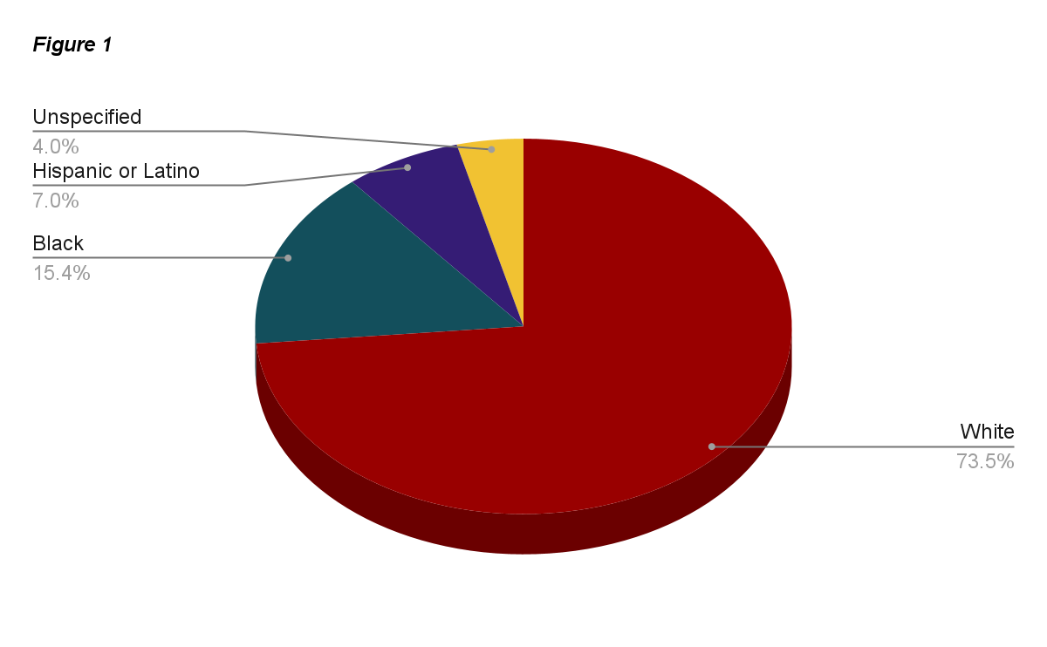
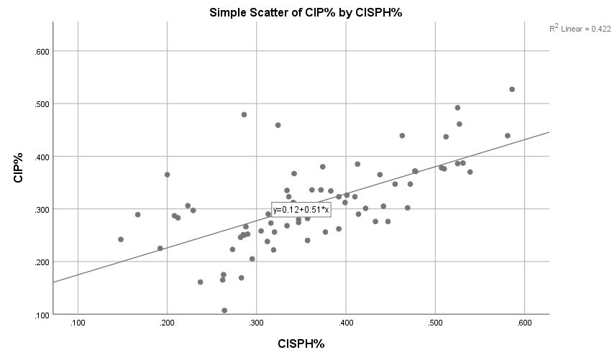
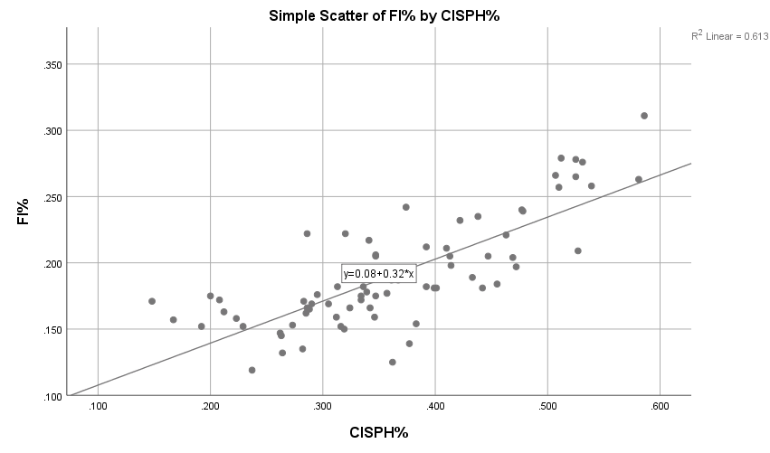
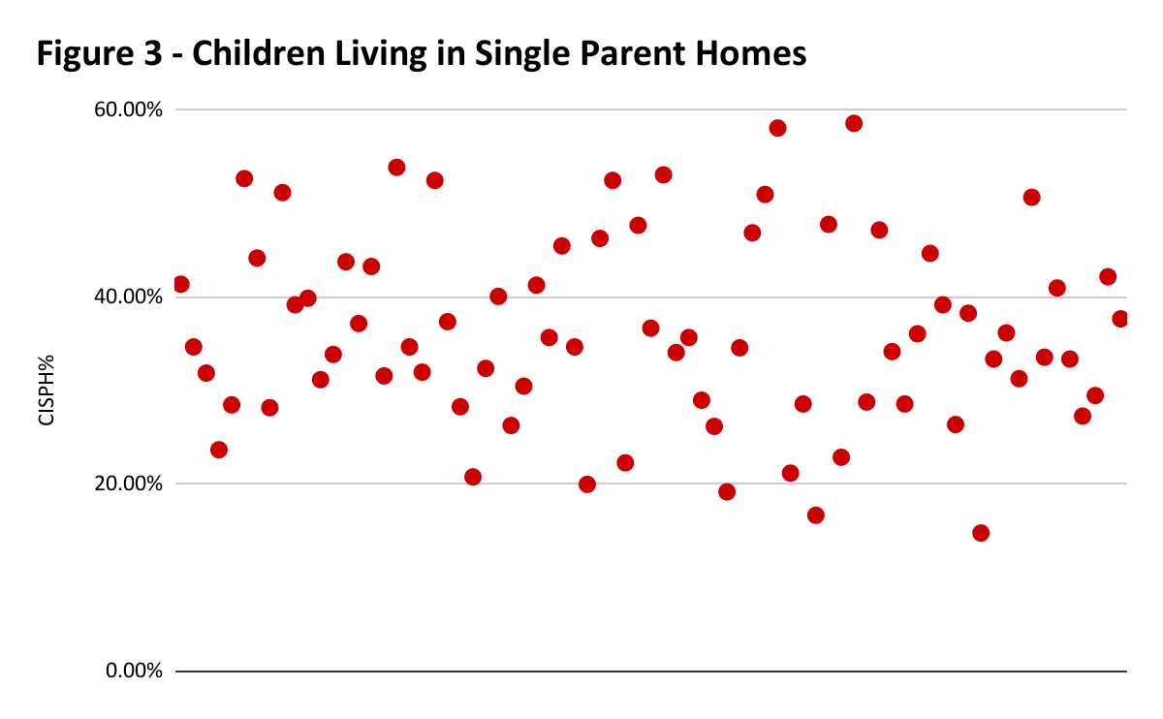
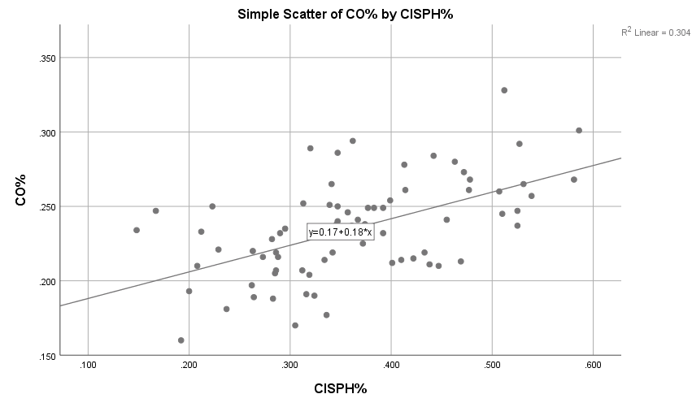
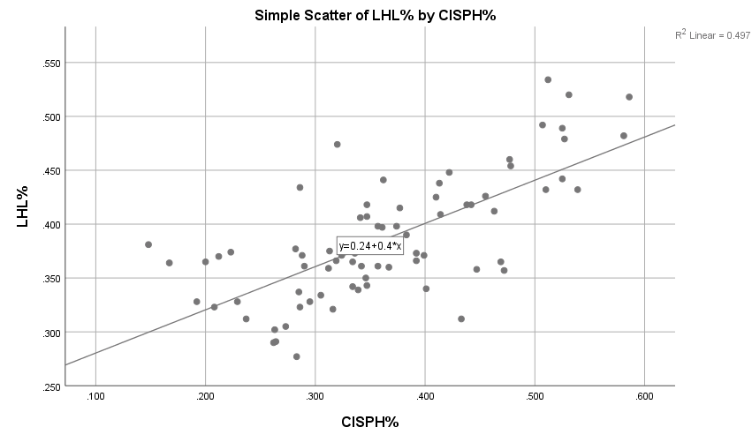
Societal Structure and Stability in Low-Income Families in Arkansas
Kristen Brown, Vivian M. Young, and Bryr Bruton
Introduction
Methods
Conclusion
Societal structure is not built to support a single-parent household positively. This can be shown by research measuring children’s development in poverty, the median household income of single parents, and food insecurities and obesity of children in poverty. The first goal of this research is to investigate the patterns of struggle that single-parent families experience in low-income households. The second goal is to investigate the policies in place to help single-parent families and why they are inefficient in assisting them.
Using SPSS, we will be testing the correlation between single-parent households and children in poverty, obesity in youth, food insecurity, and low health literacy. We will be running a bivariate correlation analysis. The test will be run for the percentages, as well as the raw numbers for each variable. The test will examine if there is a correlation between our independent variable and our dependent variables, as well as exhibit the strength of the correlation.
Our findings for this research study suggest that in-depth studies can be made on a specific variable subject, like food insecurity and low health literacy. Our findings also suggest that because there is a positive correlation between the variables, it shows there are multiple factors that affect the raising of children in poverty, who live in single-parent households. This could mean a creative solution for children who face the inability to gain a better understanding of their health, like what it means to feel and be healthy. The limitations of this project could be the data collected. Updated data could give a better visual on where to begin creating a solution for the problem. The solution to this limitation or problem would be to collect that raw data or find more recently collected data. Look specifically at children who are obese or even underweight, would contribute well to new research on the perspective of not having the information to be healthy.
Ethnic Demographics in Arkansas
Results
Children in Poverty (CIP) in correlation to children in Single-parent household (CISPH) is a scatter plot of children in single-parent households (x-axis) and children in poverty (y-axis).
Discussion
One of the takeaways that came from this project would be the clear observation that there is an ongoing epidemic in Arkansas regarding the factors mentioned in our research and there needs to be a change. Arkansas must take responsibility for children who live in single-parent household, who have the highest rates of childhood obesity. This takeaway is what will fuel future research on this topic or similar. There are many factors that contribute to the ongoing epidemic in Arkansas, and with action and more research a solution can be found for the children and low-income households who need it. If we could conduct this study again, we would investigate other states in comparison to our current research. We would conduct similar statistics to measure if the data in Arkansas reflects in other states in the United States. We would also use a population breach instead of the individual counties and numbers, to create a smoother comparison without the many variables. ​
This pie chart represents the total population within the seventy-five and the ethnic demographics within that population.
Food Insecurity (FI) in correlation to children in Single-parent household (CISPH) is a scatter plot of children in single-parent households (x-axis) and food insecurity (y-axis).
Hypothesis
We hypothesize that counties in Arkansas with higher percentages of children living in single-parent households will contain higher percentages of children living in poverty, followed by higher percentages of food insecurity, obesity in their youth, and low health literacy.
Related Policies in Arkansas
Childhood obesity (CO) in correlation to children in Single-parent households (CISPH) is a scatter plot of children in single-parent households (x-axis) and obesity in youth (y-axis).
Temporary Assistance for Needy Families (TANF)
Provides grants to provide financial assistance, childcare, job preparation, and work assistance.
Act 1220
Focuses on providing healthy choices and activities in the school environment (e.g., P.E. requirement)
Supplemental Nutrition Assistance Program (SNAP)
Or Food stamps are in the form of an electronic card that is used to buy healthy foods.
Medicaid
Health insurance offered to low-income households
American Rescue Plan
Initiated to help those affected by the COVID pandemic and need healthcare
AR Kids First
Health insurance offered to children 18 years and younger
Low health literacy (LHL) in correlation to children in Single-parent households (CISPH) is a scatter plot of children in single-parent households (x-axis) and low health literacy (y-axis).
There are three counties that are below the 20% line, while majority are on or over the 20% line describing that 96% of counties in Arkansas have children living in poverty.
Contact Information
Bryr Bruton- email: bbruton1@atu.edu
Kristen Brown- email: kbrown102@atu.edu
Vivian Young- email: vyoung2@atu.edu
Special Thanks to our Project Sponsors:

