Slide 1
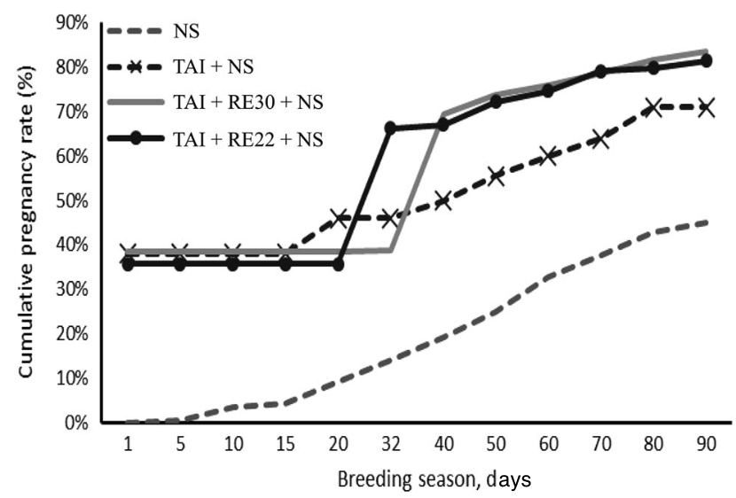
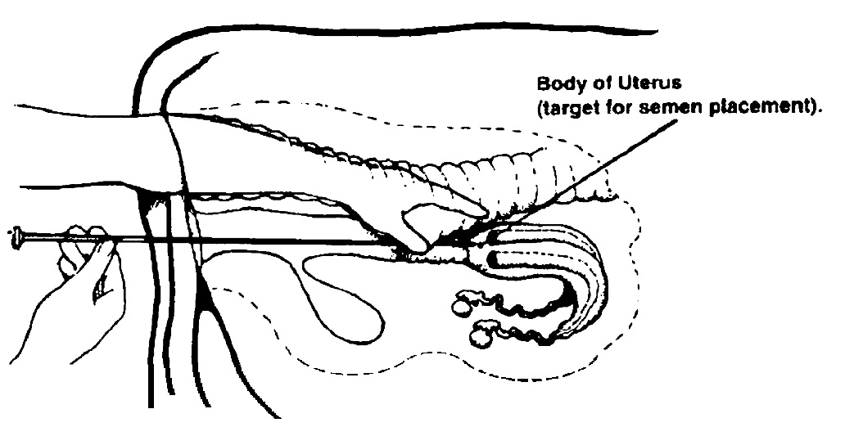
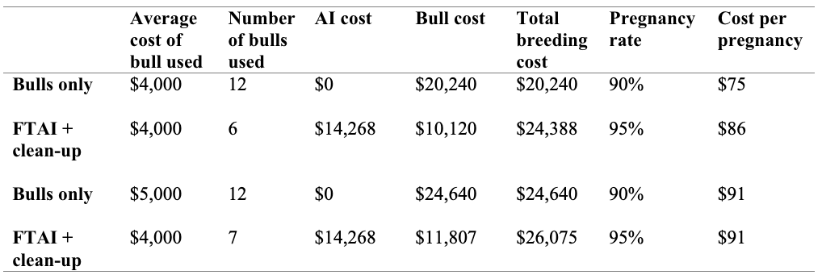
The Effects of Artificial Insemination on Beef Cattle in the United States
Allee Sweeten, Abby Shelnut, and Madison Dickey
Arkansas Tech University, Department of Agriculture & Tourism
Introduction
Results
Conclusion
Artificial insemination or otherwise known as AI, is a medical procedure of inserting semen into the vagina or uterus of an animal. It is a popular method of breeding among farmers, industry professionals, and mass production breeders. Comparing AI to natural breeding can come with some advantages and disadvantages. If not done properly, AI can come with infectious diseases that can impact the fertility of the animal and could even be life-threatening. AI can also come with expensive costs due to the need of well-trained individuals and the fact that it is a longer process than natural breeding.
Overall, artificial insemination is a reproductive procedure that is widely used through livestock industries. AI is used to increase pregnancy rates, give the ability to use specific bulls that may not be affordable, are able to shorten breeding season, etc. Though AI has advantages, it can be more expensive when compared to natural breeding. Artificial insemination requires training, equipment, and an investment of time and money. However, with the prices of bulls going up, AI could be a solution to livestock industries that saves the farmers money by requiring fewer bulls and producing a greater pregnancy rate.
AI in commercial cattle production has advantages for the cattle and the farmer but also has disadvantages that could prevent a producer from choosing it as their breeding method. AI is typically used for the reasons of increasing genetic variation within the herd, having accessibility to select certain beneficial genetics, managing fewer bulls, and being able to narrow the time frame of calving for the herd (Griffith, 2020). Artificial insemination for cattle production requires an investment of training and practice, time, and money.
(Baruselli, 2018)
References
Figure 2. During a 90-day breeding season, the cumulative pregnancy rate is compared between multiple reproductive procedures in beef cattle. The different procedures conducted were natural service (NS); timed artificial insemination (TAI) and NS; TAI with resynchronization 28-32 days after the previous AI (RE30) and NS; and TAI with resynchronization 22 days after the previous AI (RE22) and NS ².
¹Anderson, J. D., Rhinehart, J. D., & Parish, J. A. (2008, June 13). Economic impact of artificial
insemination vs. natural mating for beef cattle herds. Economic Impact of Artificial Insemination vs. Natural Mating for Beef Cattle Herds | The Beef Site. Retrieved April 2, 2023, from https://www.thebeefsite.com/articles/1453/economic-impact-of-artificial- insemination-vs-natural-mating-for-beef-cattle-herds
²Baruselli , P. S., et al. (2018). Review: Using artificial insemination v. natural service in beef herds. Redirecting. Retrieved April 10, 2023, from https://doi.org/10.1017/S175173111800054X
³Butcher, R. (2017) Artificial breeding in beef cattle. Department of primary industries and regional development
https://www.agric.wa.gov.au/genetics-selection/artificial-breeding-beef-cattle? page=0%2C0
⁴Drake, Daniel J. Artificial insemination for beef cattle-cost and benefits. Cesiskiyou.ucanr.edu. University of California Agriculture & Natural Resources. https://cesiskiyou.ucanr.edu/newsletters/Siskiyou_Stockman42251.pdf.
⁵Graves,W,M. Smith, R,C. (2017). Improving Artificial Insemination Techniques. UGA
⁶Griffith, Andrew, et al. (2020). Cost-Benefit Analysis of Timed A.I. and Natural Service in Beef Cattle. UT Extension Institute of Agriculture. https://extension.tennessee.edu/publications/Documents/W899.pdf.
⁷Grussing, Taylor. (2023) Cost of Implementing AI Technology This Breeding Season. Beef2Live. https://beef2live.com/story-cost-implementing-ai-technology-breeding-season-0-142475.
⁸Karisch, Brandi. (n.d.). Economic Impact of Artificial Insemination vs. Natural Mating For. Mississippi State University Extension Service. http://extension.msstate.edu/publications/economic-impact-artificial-insemination-vs-natural-mating-for-beef-cattle-herds#:~:text=The%20reduction%20in%20bull%20numbers,reduces%20revenue%20by%20%24567%20annually.
⁹Mochamad, S., et al. (2019). The influence of Artificial Insemination (AI) cost to profitability of beef cattle farming in Banjarnegara District, Central Java Province, Indonesia. IOP Conference Series: Earth and Environmental Science, 247.
¹⁰Mulu, M., Moges, N., & Adane, M. (2018). Review on process, advantages and disadvantages of artificial insemination in cattle. International Journal of Veterinary Sciences and Animal Husbandry, 8-13.
¹¹Selk,G. (2017). Artificial insemination for beef cattle. OSU
https://extension.okstate.edu/fact-sheets/artificial-insemination-for-beef-cattle.html
¹²Smith, Troy. (2020). Does AI Pay in a Commercial Herd? - American Hereford association. Hereford World
https://hereford.org/wp-content/uploads/2020/02/0220_DoesAIPay.pdf.
¹³Troxel, T. R. (n.d.). Artificial insemination - FSA3118 - University of Arkansas system ... Retrieved March 29, 2023, from https://www.uaex.uada.edu/publications/pdf/FSA-3118.pdf
In Figure 1, a variety of reproductive procedures are constructed and compared over a 90-day breeding season. You can see in the graph that the natural service breeding produced the lowest percentage of cumulative pregnancy amongst the heifers. In contradictory, the procedure including timed artificial insemination, resynchronization 28-32 days after the previous AI, and natural service for clean-up (TAI + RE30 + NS) produced the highest percentage of cumulative pregnancies². Resynchronization is used when cows are not pregnant after the TAI. These programs make it possible for potentially eliminating the need for clean-up bulls². It was supported that adding resynchronization to the TAI process during the procedure was beneficial in increasing the number of pregnancies in beef cattle by reducing the interval time between AI of each cow².
Table 1. Comparison between natural service and fixed time AI (FTAI) with clean-up bulls. The different average cost of bulls and number of bulls used were included in the comparison. The total bull cost was used to find the total breeding cost which then broke down into the cost per pregnancy¹².
(Selk, 2017)
Figure 1. Proper placement of insemination gun to deposit semen in the body of the uterus. ¹¹ https://extension.okstate.edu/fact-sheets/artificial-insemination-for-beef-cattle.html
Methods
(Smith, 2020)
Gathering information from reliable sources.
Search key words including, “artificial insemination”, “beef cattle”, and “United States”, as well as “cost association”, benefits”, and “supplies”
Organized into categories that included benefits of artificial insemination, cost associations, disadvantages of artificial insemination, estrus synchronization, etc.
Process of artificial insemination and estrus synchronization was reviewed including the methods and equipment needed
From Table 1, it is supported that AI does cost more than natural service, but AI does produce a higher pregnancy rate. As you can see in Table 1, the cost per pregnancy is calculated. The last two columns show comparison of a herd using AI and a herd using more expensive bulls in natural service. The cost per pregnancy between these are the exact same, but the herd with AI has a 5% more likely chance of the cattle becoming pregnant¹². Therefore, depending on the quality of bulls that you own, the cost per pregnancy between natural service and AI are either close or the exact same.

