Slide 1
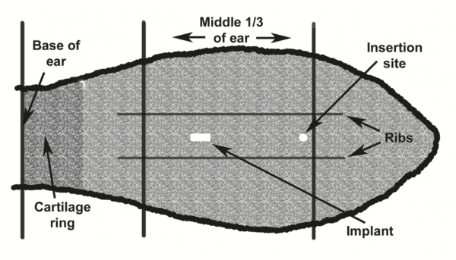
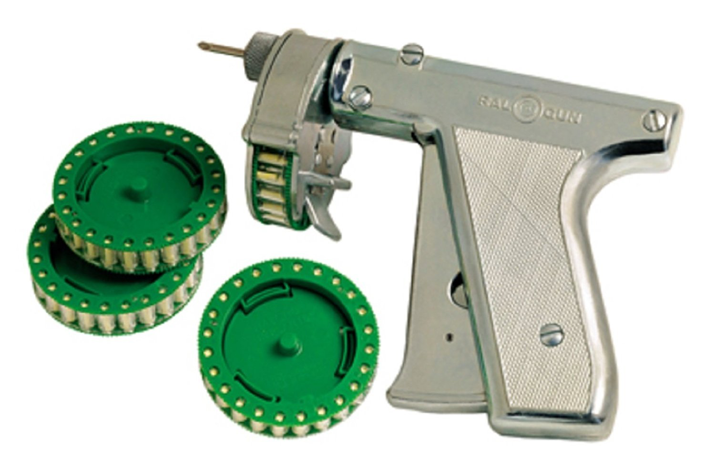
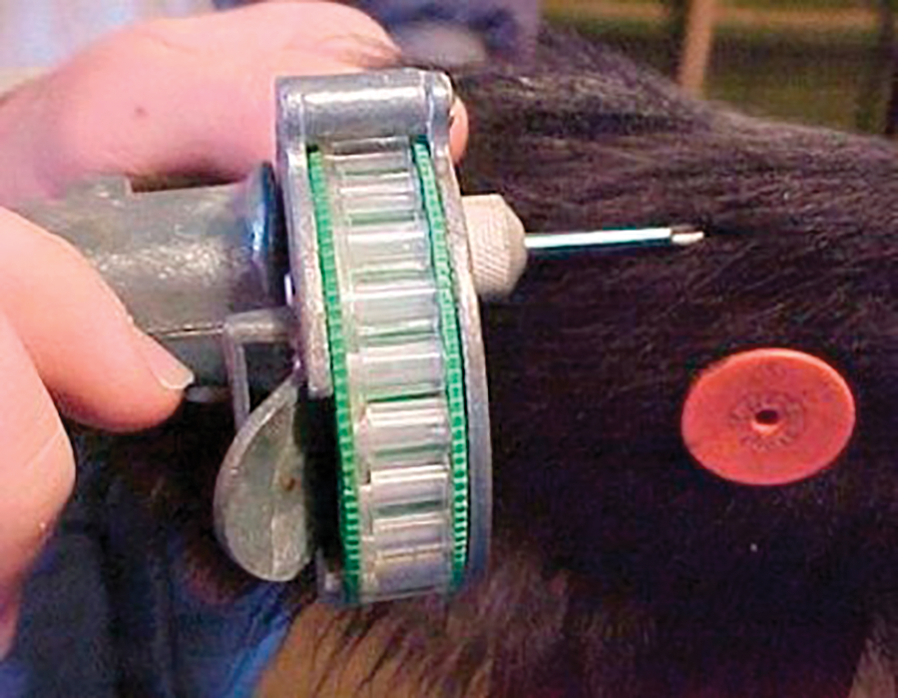
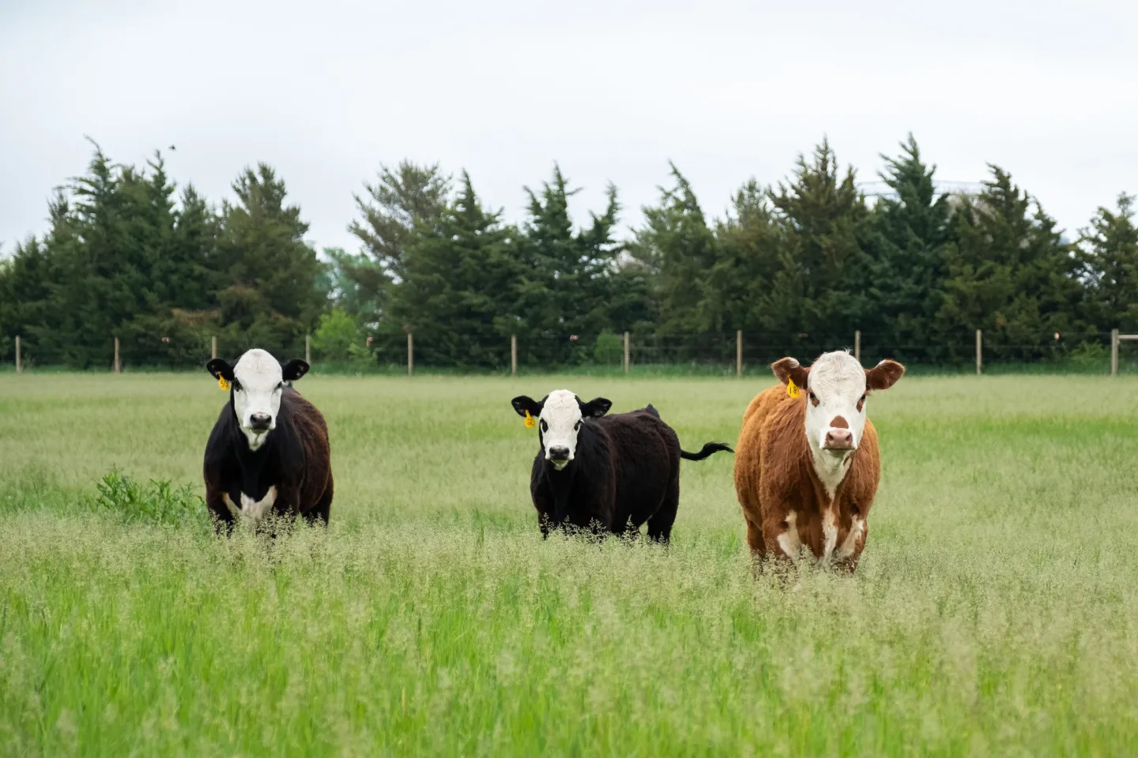
Benefits of Growth Hormone Implants in Beef Cattle
Brody Jones, Jaxsen Franco, and Riley Knight
Introduction
Analysis
Discussion
Beef cattle producers in the United States have seen a significant increase in input cost over the past 3 years, causing chance for high profits to become harder to attain. According to the USDA (2022) beef cattle feed prices had rose 16% between May 2021 and May 2022 also, noting corn, the main ingredient in cattle feed, is projected to hit $5.95 per bushel. This would be the highest season-average farm price since 2012/2013 marketing year. According to the American Farm Bureau Federation (AFBF, 2022) Iowa State University estimated that the total cost to finish out a 760 lb steer in March of 2022 would cost $1,802.58. They also mentioned with the rising costs of feed, corn, and hay among other things the break-even price was estimated to be $138.66 cwt, which is an increase of 12.8% from the year 2021. “These rising costs will make profitability an uphill battle” (AFBF, 2022).
In order to test the hypothesis which stated, “If growth hormone implants were used in the production of beef cattle, producers would see an increase in productivity through gains in feed efficiency and average daily gain.” Based on the research articles used, the findings were arranged in averages found from the results discussed in varying articles.
After the research it was found that there is a benefit in using a growth hormone implants
The findings displayed this method is cost effective and efficient
Based on the results concluded that producers using growth hormones benefit by:
Increased average daily gain
Increased weaning weights
Increased feed efficiency
There are still risks when using hormones
It is advised that you read all directions and make yourself aware of all cautions
Research Purpose and/or Question(s)
This study provides an insight into the benefit of using growth hormone implants in the production of beef cattle. The paper looks at the rising costs of input prices, cattle market supply in the US, and the effects these implants had on beef cattle of varying species and environments.
Findings/Results
Table 1
Effects of steroidal Implants on Feedlot Performance of Holstein Steers (Carvalho, et. al, 2019)
Non- Implanted Implanted
n, steers 35 35
Live weight, kg
Initial 274 276
84 Days 413 440
Final 542 598
ADG, kg/D
Days 1 to 84 1.65 1.96
Days 85 to 186 1.27 1.54
Days 1 to 186 1.44 1.73
Table 3
Daily gain response to use of an implant, energy supplement, and ionophore (Stewart, 2017)
Treatment Daily Gain Growth
Response, %
Control 1.22 -
Implant 1.39 13.9
Control 1.35 10.7
Supplement + ionophore 1.45 18.9
Implant, supplement, and ionophore 1.72 41.0
Method / Data Source(s)
Conclusion(s) / Implication(s)
Based on the data presented in the research paper and presented through the articles read, growth hormone implants are successful in increasing ADG and feed efficiency in beef cattle despite the environment in which they are raised. Depending on the operation producers may see small savings, or a significant increase in both savings and profit. The research found that more evidence could be conducted on the safety of the implants in beef cattle and if there are more risks and hazards than noted. More research could be conducted on how long a recommended withdrawal period should be for implanted cattle going to public markets. Moreover, while feedlots would see the most impactful benefits in using implants, producers of all kinds should find a way to implement this idea into their herd to help their operational sustainability and profits.
The research is based off previous studies conducted by different institutions and universities. In the beginning of the research the hypothesis that was tested was using growth hormone implants could serve as a great tool for cattle producers to combat rising inflation and input costs. The articles read and referenced throughout the essay served as a tool to gain a good understanding for the current economic situation cattle producers in the U.S. face while developing an understanding for how implants work and what they truly are.
References
1) Arias, R., Santa-Cruz, C., & Velásquez, A. (2019). Effect of high potency growth implants on average daily gain of grass-fattened steers. Animals, 9(9), 587. https://doi.org/10.3390/ani9090587
2) Beef cattle producers face higher input costs, with feed prices up 16 percent since 2021. USDA ERS - Chart Detail. (n.d.). Retrieved February 19, 2023, from https://www.ers.usda.gov/data-products/chart-gallery/gallery/chart-detail/?chartId=104424
3) Carvalho, P. H., Perry, G. A., & Felix, T. L. (2019). Effects of steroidal implants on feedlot performance, carcass characteristics, and serum and meat estradiol-17β concentrations of Holstein Steers. Translational Animal Science, 4(1), 206–213. https://doi.org/10.1093/tas/txz186
4) Cattle Supply and demand issues for the 2022 Marketing Year. American Farm Bureau Federation. (2022). Retrieved February 19, 2023, from https://www.fb.org/market-intel/cattle-supply-and-demand-issues-for-the-2022-marketing-year
5) Growth stimulants (implants). University of Missouri Extension. (n.d.). Retrieved February 19, 2023, from https://extension.missouri.edu/publications/g2090
6) Saha, U. K., Knight, C. H., & Segers, J. R. (2010, June 1). Implanting beef cattle. University of Georgia Extension. Retrieved February 19, 2023, from https://extension.uga.edu/publications/detail.html?number=B1302&title=implanting-beef-cattle
Special Thanks to our Project Sponsors:

