Slide 1
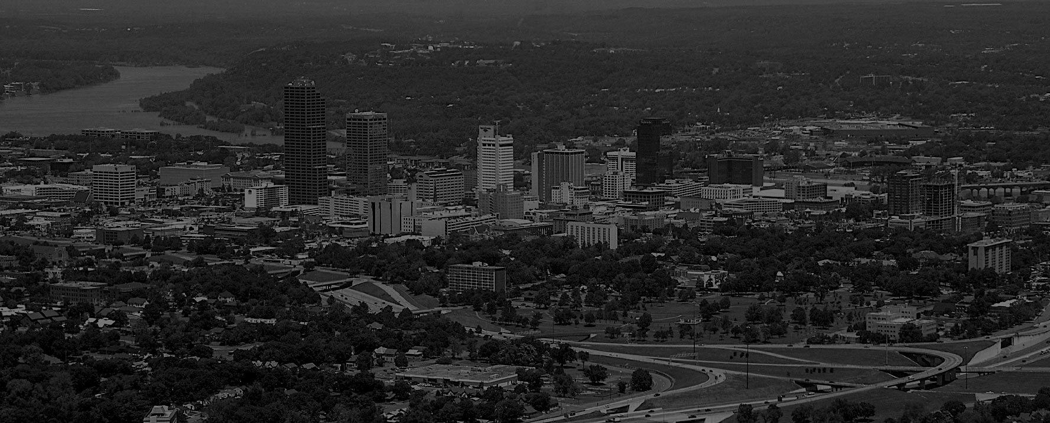
Crime Prediction Using Machine Learning:
The Case of The City of Little Rock
April 25, 2023
Authors:
Zurab Sabakhtarishvili
Sijan Panday
Clayton Jensen
Notes:
Slide 1: Title Slide
- Title: "Crime Prediction Using Machine Learning: The Case of The City of Little Rock"
- Authors: Zurab Sabakhtarishvili, Sijan Panday, Clayton Jensen, Dr. Robin Ghosh
- Date: April 25, 2023
- Background Image: A cityscape of Little Rock, Arkansas (faded)
- Arkansas Tech University logo

Slide 2
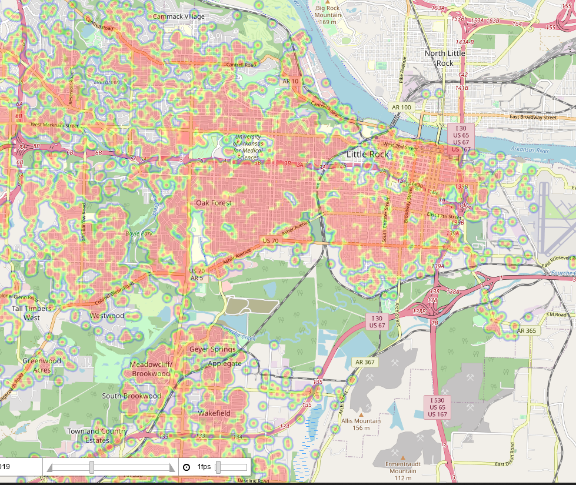
Understanding Crime in Little Rock
Little Rock ranks among top 15 of most dangerous cities
16,000 reported crimes in 2017
Traditional crime prevention approaches are costly and inefficient
Predictive policing may reveal solutions by:
Creating a Machine Learning model to identify high-risk areas
Providing insights into city regions
Providing real-time crime predictions
Allocating resources effectively and efficiently
Image 1. Map of Little-Rock showcasing crime hotspots for different years using Folium

Slide 3
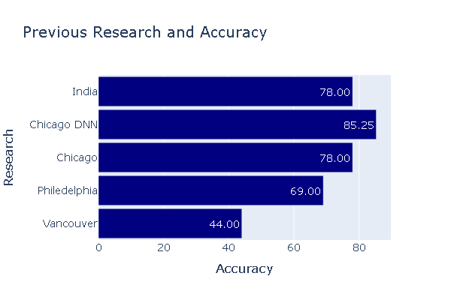
Previous Crime Prediction Studies & Techniques
Various machine learning techniques used in crime prediction
Different studies achieved accuracy levels ranging from 39% to 85.25%
Deep Learning techniques showed best performance, such as an 85.25% accuracy in Chicago
Potential for a "universal police officer" system to monitor hotspots & predict future crimes

Slide 4
Our Approach to Predicting Crime in Little Rock
1. Data Collection:
- Acquire crime data from Little Rock Police Department (2017-2023)
2. Data Preprocessing:
- Clean and prepare data for analysis
- Remove duplicates and handle missing values
- Convert data types as needed
- Classify crimes as violent or non-violent based on FBI's Uniform Crime Reporting (UCR) guidelines
- Determine crime severity (low-risk or high-risk)
3. Model Development:
- City-wide Prediction:
a. Facebook's Prophet: Time Series forecasting model
- Optimize hyperparameters such as seasonality and scale
b. Neural Prophet: Deep Learning-based Time Series forecasting model
- Optimize hyperparameters using HyperOpt library
- Zip-code level Prediction:
a. Neural Prophet: Optimized model for each unique zip code
- Use Ray Tune library and HyperOpt search algorithm for hyperparameter optimization
- Minimize Mean Absolute Error (MAE) during training
- Incorporate holiday information as an external regressor
- Capture unique crime trends and patterns within each region

Slide 5
Our Approach to Predicting Crime in Little Rock contd.
4. Model Evaluation:
- Evaluate model performance using metrics: RMSE, MSE, MAE, R2 score
- Compare city-wide predictions from Facebook's Prophet and Neural Prophet
- Assess zip-code level predictions using Neural Prophet
5. Results and Insights:
- Analyze and interpret model predictions
- Identify high-risk areas and crime patterns
- Provide actionable insights for law enforcement, policymakers, and business owners

Slide 6
Data Collection and Preprocessing
The Little Rock government provided the crime data for this study through the data.littlerock.gov website, specifically the Little Rock Police Department Statistics 2017 to year-to-date dataset.
Four goals were identified for data preprocessing:
Initial reading
Duplicate handling
Type conversion
Erroneous data handling
Duplicate rows were handled by keeping only the first instance, which resulted in dropping roughly 6% of the original data set
Incident dates typed from strings to date-time representations and by ensuring that zip, latitude, and longitude values were numeric.

Slide 7
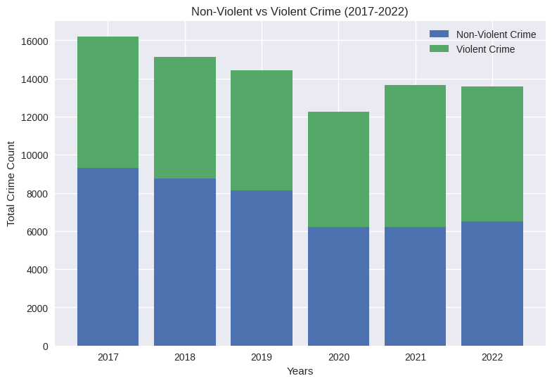
Crime Classification
The FBI's Uniform Crime Reporting (UCR) guidelines provide a framework for classifying the nature and severity of crimes.
The binary column created to classify severity into Violent or Non-violent (property crimes) can be useful for future projects and model training.
Crimes are further broken into risk types:
High risk for violent crimes and nonviolent crimes with weapons.
Low risk for nonviolent (property crimes) with no immediate threats.
Crime analysis using UCR guidelines can help to better understand crime patterns in a particular area.

Slide 8
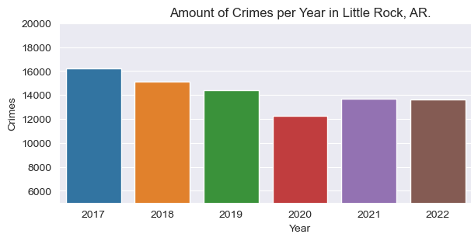
Visualizing Yearly Crimes

Slide 9
City-wide Crime Forecast: Model Comparison
Comparison of Facebook's Prophet & NeuralProphet
Both Facebook's Prophet and NeuralProphet models were used to predict crime in Little Rock.
Neural Prophet had better overall performance compared to Facebook's Prophet.
The Neural Prophet model provided more accurate crime predictions with fewer errors:
Neural Prophet error rate: 16.67%
Facebook's Prophet error rate: 19.63%
Preliminary model accuracy was 83.33%
Metric | Facebook Prophet | NeuralProphet
Root Mean-Squared Error | 9.50 | 8.17
Mean Squared Error | 90.30 | 66.78
Mean Accuracy Error | 7.62 | 6.47
R2 Score | -0.095 | 0.190
Error rate is a percentage of the average daily crime count (X).
Facebook's Prophet error rate % = (7.62 / X) * 100
Neural Prophet error rate % = (6.47 / X) * 100

Slide 10
Facebook Prophet
NeuralProphet

Slide 11
Targeted Predictions: Zip-code Level Analysis
Visualizing Offenses – Zip-code Offenses
To obtain insights on each zip-code and their unique crime we created the following visualizations:
Offense Counts for all zip-codes
Violent & Nonviolent crimes

Slide 12
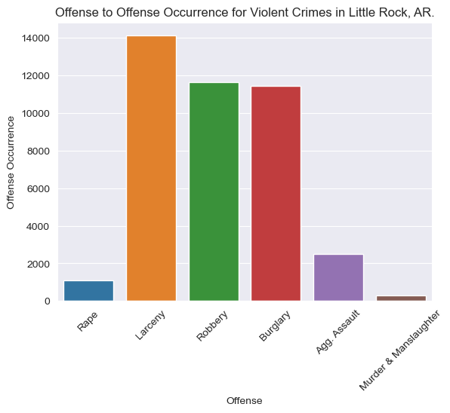
Targeted Predictions: Zip-code Level Analysis
Visualizing Offenses – Violent Crimes
Violent crimes spanning 2017-2023 show a trend in Larceny, Robbery, and Burglary.
Since these crimes are classified as violent, its concerning to see high amounts of these crimes.
Unfortunately, there are ~1,000 Rapes, another concerning statistic.

Slide 13
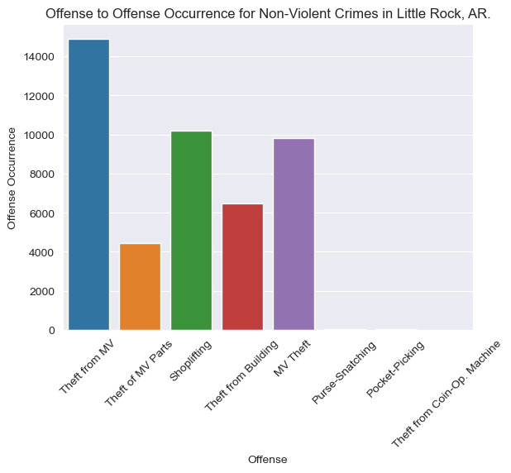
Targeted Predictions: Zip-code Level Analysis
Visualizing Offenses – Non-Violent Crimes
Non-Violent crimes spanning 2017-2023 show a trend in Theft from Motor Vehicles, Shoplifting, and Motor Vehicle Theft.
Although the crimes are non-violent, its concerning to see that Little Rock’s vehicles are vulnerable.
These statistics can provide valuable insights to businessowners.

Slide 14
Targeted Predictions: Zip-code Level Analysis
Neural Prophet Performance across Zip Codes
By training separate models for each unique zip code, we captured the distinct crime trends and patterns within each region of Little Rock.
The model performance varied across different zip codes, reflecting the unique characteristics and crime patterns in each area.
These zip code-level predictions provide more targeted insights for law enforcement, policymakers, and business owners, allowing them to address crime in specific areas more effectively.
Zip-code | RMSE | MSE | MAE | R2 Score
72212 | 0.830 | 0.688 | 0.663 | 0.063
72223 | 1.349 | 1.819 | 1.148 | 0.030
72205 | 2.293 | 5.259 | 1.892 | 0.048
72135 | 0.155 | 0.024 | 0.055 | 0.019
72103 | 1.250 | 1.562 | 0.902 | 0.000
72209 | 3.002 | 9.011 | 2.353 | -0.287

Slide 15
Perfecting The Imperfect, What Happens Next?
Finding a Model, Predicting Human Behavior
Our model scores represent the inability to predict humans, so how do we make educated crime predictions?
We can’t predict the who, the how, or the why. We can predict the when and where!
Our model focuses on predicting the when, a valuable forecast that helps to establish a basis of predicting humans.
Machine learning models are continually being improved and enhanced!
While we used Neural Prophet, there will be bigger and better models in the future that will simplify the task of predicting human behavior.
Our research provides a basis to making a Binary Classification model for predicting crimes.

Slide 16
Acknowledgements
Arkansas Tech University Undergraduate Research Scholarship
Dr. Robin Ghosh
Dept. Of Engineering & Computing Sciences
Mr. Randy Foshee, CTO City of Little Rock

Slide 17
References
Bharati, Alkesh and Dr. Sarvanaguru RA.K.
Crime Prediction and Analysis Using Machine Learning.
International Research Journal of Engineering and Technology (IRJET) (2018): 1037-1042
Federal Bureau of Investigation. FBI: UCR.
Gordon, Deb. MoneyGeek.
Kang, Hyeon-Woo and Hang-Bong Kang.
Prediction of crime occurrence from multi-modal data using deep learning. (PLOS ONE)
Little Rock Police Department. Little Rock's Data Hub
Martegiani, Gabriele and Loubna Berrada.
Crime Prediction Using Data Analytics: the Case of the City of Boston. (Academia)
Nguyen, Trung, Amartya Hatua and Andrew H. Sung.
Building a Learning Machine Classifier with Inadequate Data for Crime Prediction.
Ramdas, Shraddha Bandekar and C. Vijayalakshmi.
Design and Analysis of Machine Learning Algorithms for the reduction of crime rates in India.
The 9th World Engineering Education Forum (WEEF) (2019): 122-127

Slide 18
Questions?

Slide 19
Thank You!

