Slide 1
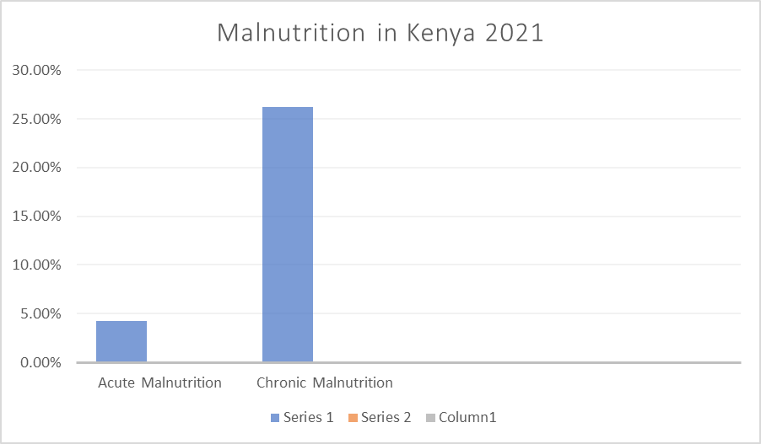
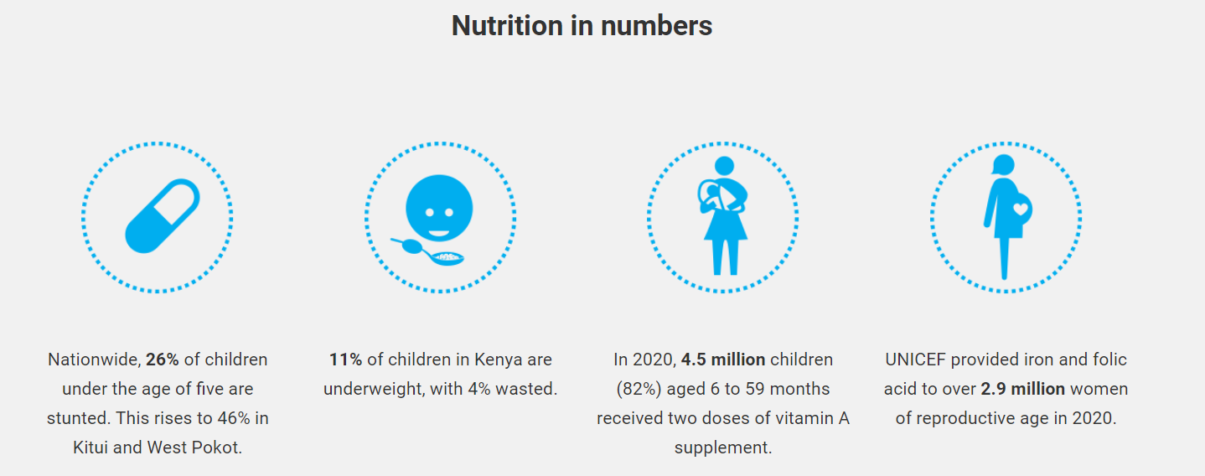
Fighting Malnutrition in Kenya
Jessica Payton, Tara Ross, Adalyne Nehus
Arkansas Tech University, Department of Agriculture and Tourism
Introduction
Analysis
Discussion
Malnutrition affects everyone differently, but a few major characteristics include severe weight loss, reduced muscle mass, swelling and inflammation, and an increased risk of disease or infection.​
There are multiple factors contributing to Kenya’s malnutrition issue, such as poverty, general lack of information, and political/economic conflicts, but we will be primarily focused on the severe drought that they are experiencing.​
A few methods of conversation that may aid in Kenya’s malnutrition problem are nutrient fortification/supplementation, improvements in agricultural systems and nutrient diversity, and community implementations to enforce the access to proper nutrition.
Malnutrition is a global health issue that severely affects many countries, Kenya being one of them. In fact, Kenya ranks within the top 20 countries in the world for malnutrition (Statista). Malnutrition affects everyone differently, but a few major characteristics include severe weight loss, reduced muscle mass, swelling and inflammation, and an increased risk of disease or infection. There are multiple factors contributing to Kenya’s malnutrition problem; such as poverty, general lack of information, and political/economic conflicts, but we will be primarily focused on the severe drought that they are experiencing. Throughout history droughts have been a leading factor in the rising rates of starvation in Kenya. We will be discussing the severity of Kenya’s malnutrition epidemic, and different things that could be implemented to reduce the malnutrition rates. A few ways to help aid in Kenya’s malnutrition problem are nutrient fortification/supplementation, improvements in agricultural systems and nutrient diversity, and community implementations to enforce the access to proper nutrition. Nutrient fortification is more cost-effective than nutrient supplementation, for example, iodizing salt can cost as little as 0.05 U.S. dollars and wheat fortified with iron only 0.12 U.S. dollars yearly. Kenya is implementing a new strategy to improve agricultural operations; their mission is to provide access to more nutritiously diverse foods and enhancing community production. Additionally, a group called Feed Africa is successfully using regenerative farming techniques to improve agriculture production. A few of these techniques include implementing grazing rotations to avoid depletion and educating locals on regenerative farming.
Figure 2 Source: https://www.statista.com/statistics/1236226/prevalence-of-malnutrition-among-children-in-kenya
Different degrees of malnutrition exist in Kenya, chronic malnutrition is defined as a form of growth failure that causes both physical and cognitive delays in growth and development. While acute malnutrition is a nutritional deficiency resulting from either inadequate energy or protein intake.
Findings/Results
FARM AFRICA is improving agricultural production in rural arid areas of Kenya. Between the years of 2022 and 2025, they plans to scale up on regenerative agriculture by training 50,000 smallholder farms. A few practices they are implementing in Kenya include cover cropping, minimum tillage, and intercropping maize and high yield/nitrogen fixing crops. These practices were found to contribute to reduced moisture loss and improved soil fertility. Farmers reported a 20% increase in harvest, thus escaping total crop failure following reduced rainfall in 2021.​
Micronutrient food fortification, provides substance and adds vital nutrients to the food. Fortification is also relativity more low-cost, and tastes better. Depending on the food and the specific vitamins and minerals added, fortification costs only $0.05 to $0.25 per person per year, fortification costs $347 million a year, whereas micronutrient supplementation costs $700 million per year.​
Through the governmental program, KNAP, Kenya was able to decrease the number of malnourished citizens. From 2018 to the current day the government has been working on producing and perfecting ways to officially end this issue for their people, and numbers have finally started to decrease. By providing better care, and quality of food, as well as making these resources affordable and readily available, the people of Kenya's quality of life will also increase. (KNAP, 2018)
Conclusion(s) / Implication(s)
Research Purpose and/or Question(s)
In conclusion, programs like KNAP and FARM ARICA, are providing long-term solutions to improve agricultural production in rural arid areas of Kenya, they are also working to increase agriculture output by educating them on how to improve their crop production and raise livestock. They work primarily in communities severely affected by drought and water accessibility. ​
Another possibility for aiding malnutrition rates in Kenya is micronutrient fortification, food fortification is a good option because it provides substance and adds vital nutrients/vitamins to the food. Fortification is also relativity more low-cost, and tastes better than supplementation.
The purpose of our research is to find out what major factors are causing Kenya’s high malnutrition rates, then figure out effective, long-term solutions that will aid in decreasing the number of malnourished individuals in Kenya.
Method / Data Source(s)
Our primary method of research involved reviewing credible research articles and pulling valuable information from them. In addition, we researched numerous nonprofits and charities that are already actively trying to fight Kenya's malnutrition problem, seeing what methods these groups are currently using to analyze the relationship between nutritional status and overall health/infections.
References
Das, J. K et al. (2013) “Micronutrient Fortification of Food and Its Impact on Woman and Child Health: A Systematic Review.” Systematic Reviews,2, 67, 1-24. https://www.ncbi.nlm.nih.gov/pmc/articles/PMC3765883/.​
Vita, M. V. (2019). BioMed Central. Retrieved from Malnutrition, morbidity and infection in the informal settlements of Nairobi, Kenya: an epidemiological study: https://ijponline.biomedcentral.com/​
Kamer, l. (2021). Prevalence of malnutrition among children in Kenya 2021. Retrieved from www.statista.com: https://www.statista.com/statistics/1236226/prevalence-of-malnutrition-among-children-in-kenya​
AFRICA, F. (2020). Our Work in Kenya. Retrieved from FARM AFRICA: https://www.farmafrica.org/us/kenya/kenya​
Muriuki, T. M. (2021). Demographic and Social-Economic Determinants of Malnutrition. Retrieved from International Journal of Child Health and Nutrition: https://www.researchgate.net/​
Unknown. (2020). New Drive to reduce malnutrition, boost immunity and improve the economy. UNICEF. Retrieved from: https://www.unicef.org/kenya/press-releases/new-drive-to-reduce-malnutrition​
Figure 1 Source: https://www.unicef.org/kenya/
Special Thanks to our Project Sponsors:

