Slide 1
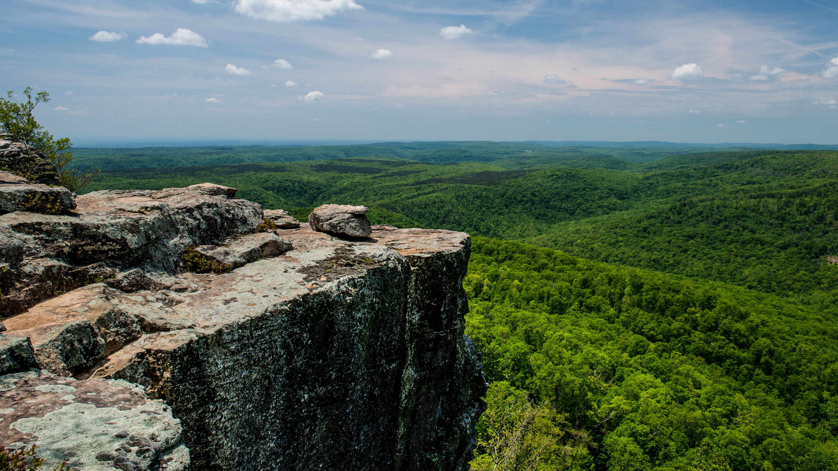
Environmental Factors Affecting Coleoptera Biomass in the Ozark Mountain Range in Arkansas
Hayley Springsteen
Arkansas Tech University
2023 ATU Research Symposium

Slide 2
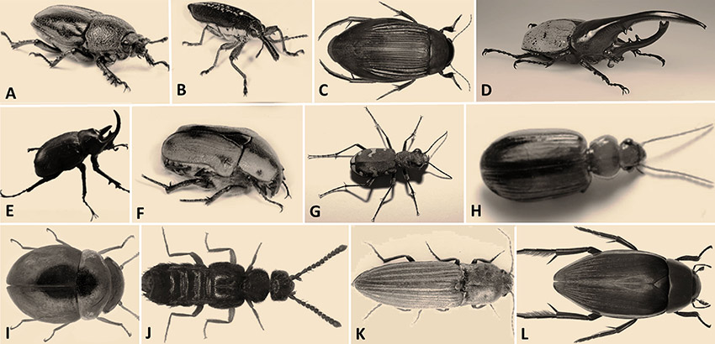
Purpose of Study
Contribute to the knowledge of how environmental factors and different management practices are affecting beetle assemblages
Further assist ecologists in improving management techniques in the future
Contribute to a larger project studying ecology of Ozark Big-Eared Bat

Slide 3
Objectives
Identify which climatic factors may increase the susceptibility of beetles being caught in traps
Explain why these factors might have increased that likelihood
Identify how different forest management practices are affecting beetle biomass
Explain why these practices may have an effect on beetle abundance

Slide 4
Importance and General Info
Bioindicator and play a role in many ecosystem services
Soil formation and fertility, pollination, decomposition and nutrient turnover, population regulation of other organisms through predation
Make up diet for mammal species like Ozark Big-Eared Bat

Slide 5
Introduction
High humidity levels (above 73%) are correlated with increased beetle flight
Beetles tend to reside in areas with high humidity
Insects lose water content in their bodies through both transpiration and excretion
Expect increased biomass on nights with higher relative humidity

Slide 6
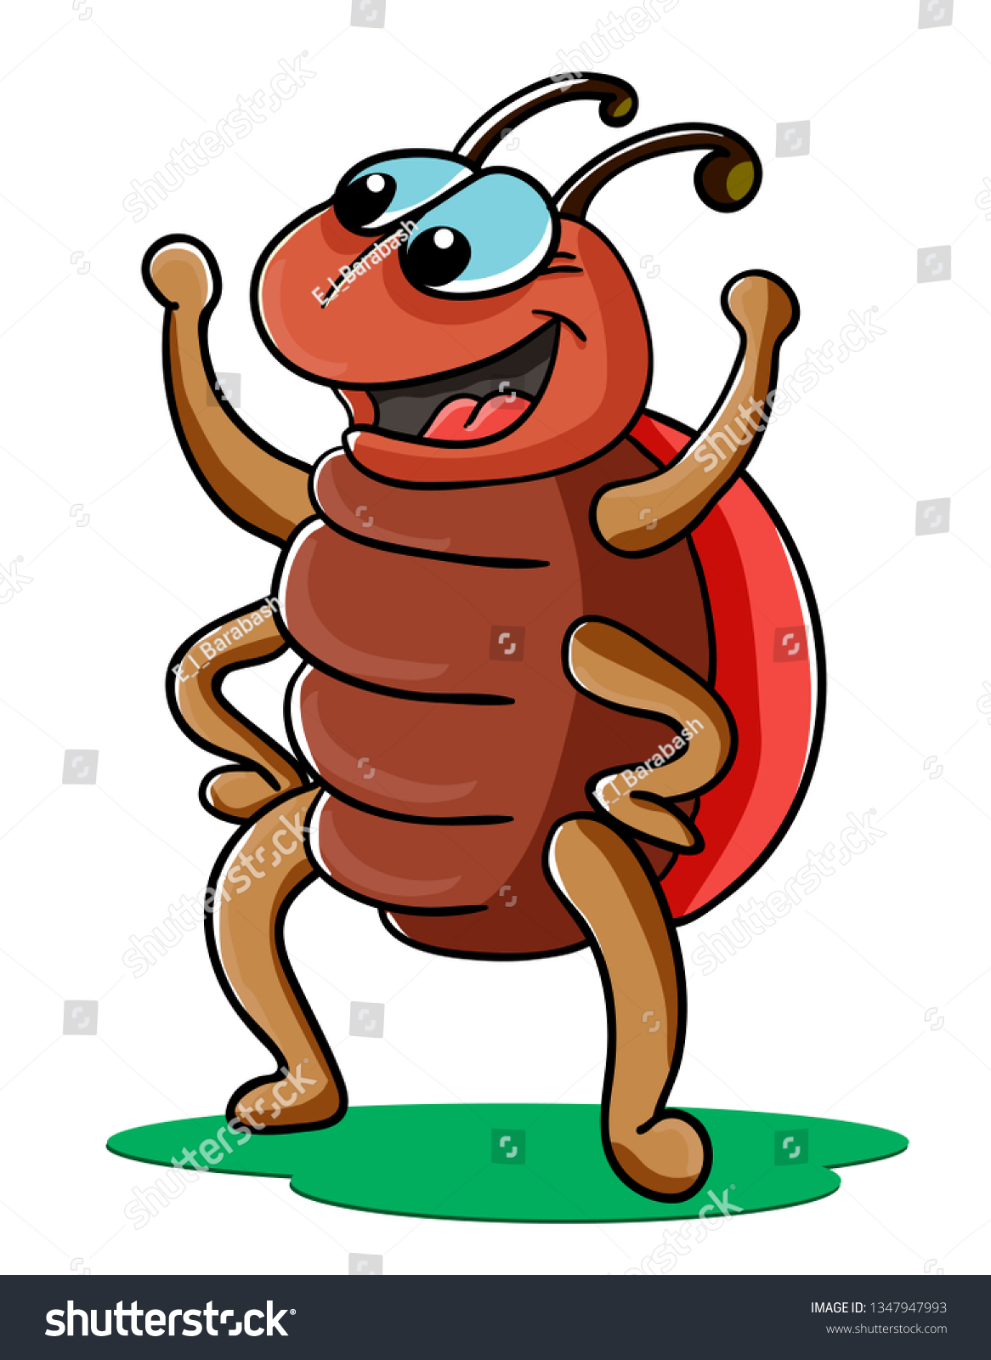
Introduction
Temperature has a strong effect on metabolism and movements of insects
Temperature is one of the most influential factors in flight
Studies found migration and distance flight both increased with increase in temp.
Expect to see higher biomass from traps set on warmer nights

Slide 7
Introduction
Burning has a short-term negative affect on abundance
Thinning and burning increases the number of forbs in an area
Previous studies show an increase in biomass in areas that were previously burned
Expect to see an increase in biomass in areas that have been thinned or burned and an increase at sites that have a higher percentage of grass/forbs

Slide 8
Methods (Study Sites and Insect Collection)
White Rock Mountain area
Universal Black Light Traps
Ethyl-Acetate to kill insects that inter the traps
Total of 61 sites
ArcGIS used to randomly select trap sites in suitable areas
After collection, insects moved to a drying oven before identification

Slide 9
Methods (Microhabitat Assessment and Vegetation Survey)
Temperature, humidity, wind speed, atmospheric pressure
Fire, regenerative harvest commercial thinning, and understory thinning
Canopy Cover, DBH (>10cm), density board and vegetation plot for plant composition
All climatic factors came from the nearest remote weather station

Slide 10
Results
Analysis was done by generalized linear model (R studio)
Total biomass from 61 sites 488.133g.
Greater biomass at sites where humidity was higher (t59=2.53 ± 0.06, p=0.01)
Greater biomass at sites where temperature was higher (t59= 2.94 ± 0.19, p=<0.01)
Greater biomass at sites that were commercially thinned when compared to sites that had a combination of management types (t54=2.12 ± 2.62, p=0.04)

Slide 11
Results
Fig 1. Shows total coleoptera biomass compared to humidity where there is a positive relationship between biomass and humidity (t59=2.53 ± 0.06, p=0.01).

Slide 12
Results
Fig 2. Shows the relationship between total coleoptera biomass and temperature which presents a positive response of biomass with increasing humidity (t59= 2.94 ± 0.19, p=<0.01).

Slide 13
Results

Slide 14
Results
Fig 3. Shows coleoptera biomass in areas that have been thinned when compared to a combination of management practices. Thinning areas had significantly more biomass than combination areas (t54=2.12 ± 2.62, p=0.04).

Slide 15
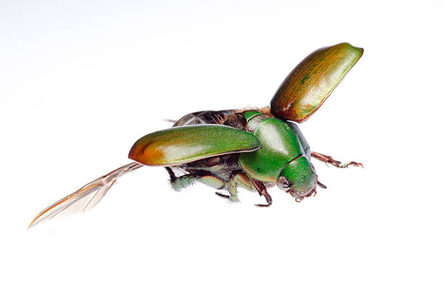
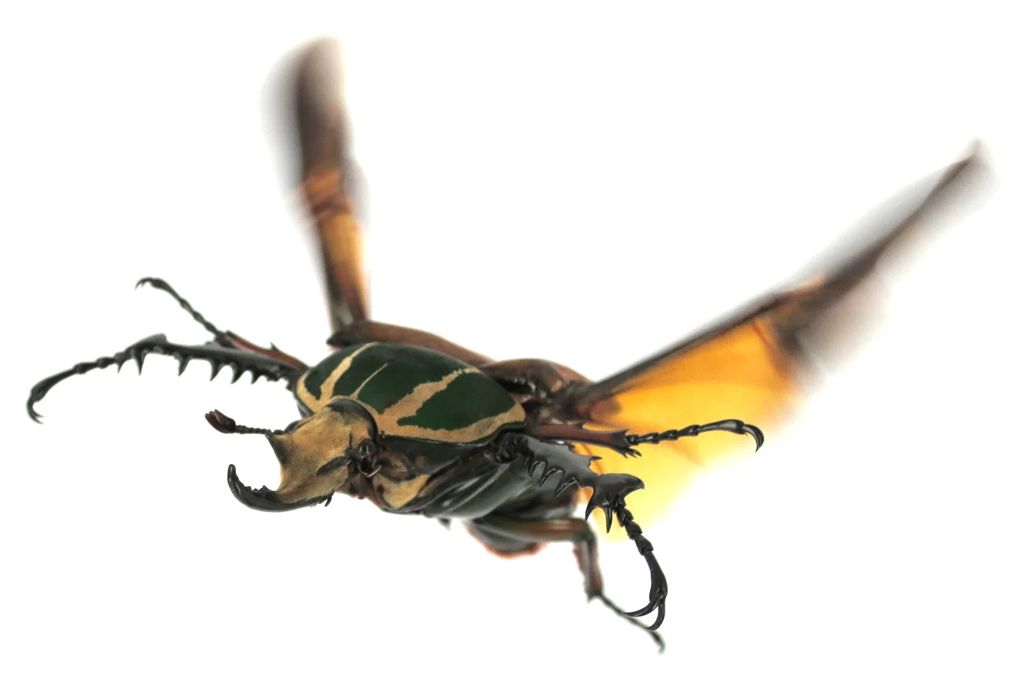
Discussion
Many studies confirmed that it is common to capture more beetles on nights with higher humidity
Sanger (2020) observed high humidity levels with increased beetle flight.
Wijierathana (2019) stated that climate conditions like humidity have a strong effect on energy metabolism and movement
High humidity also encourages fungi growth which is detrimental to beetle colony success.
Reasons for high humidity varies between different species and is understudied

Slide 16
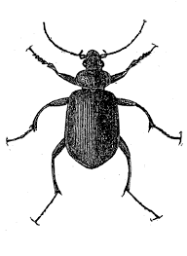
Discussion
Insect’s body temperature is dependent on abiotic factors
Higher temperatures and humidity can be related to vegetation growth
Increased temperature increases metabolism rates; consume more

Slide 17
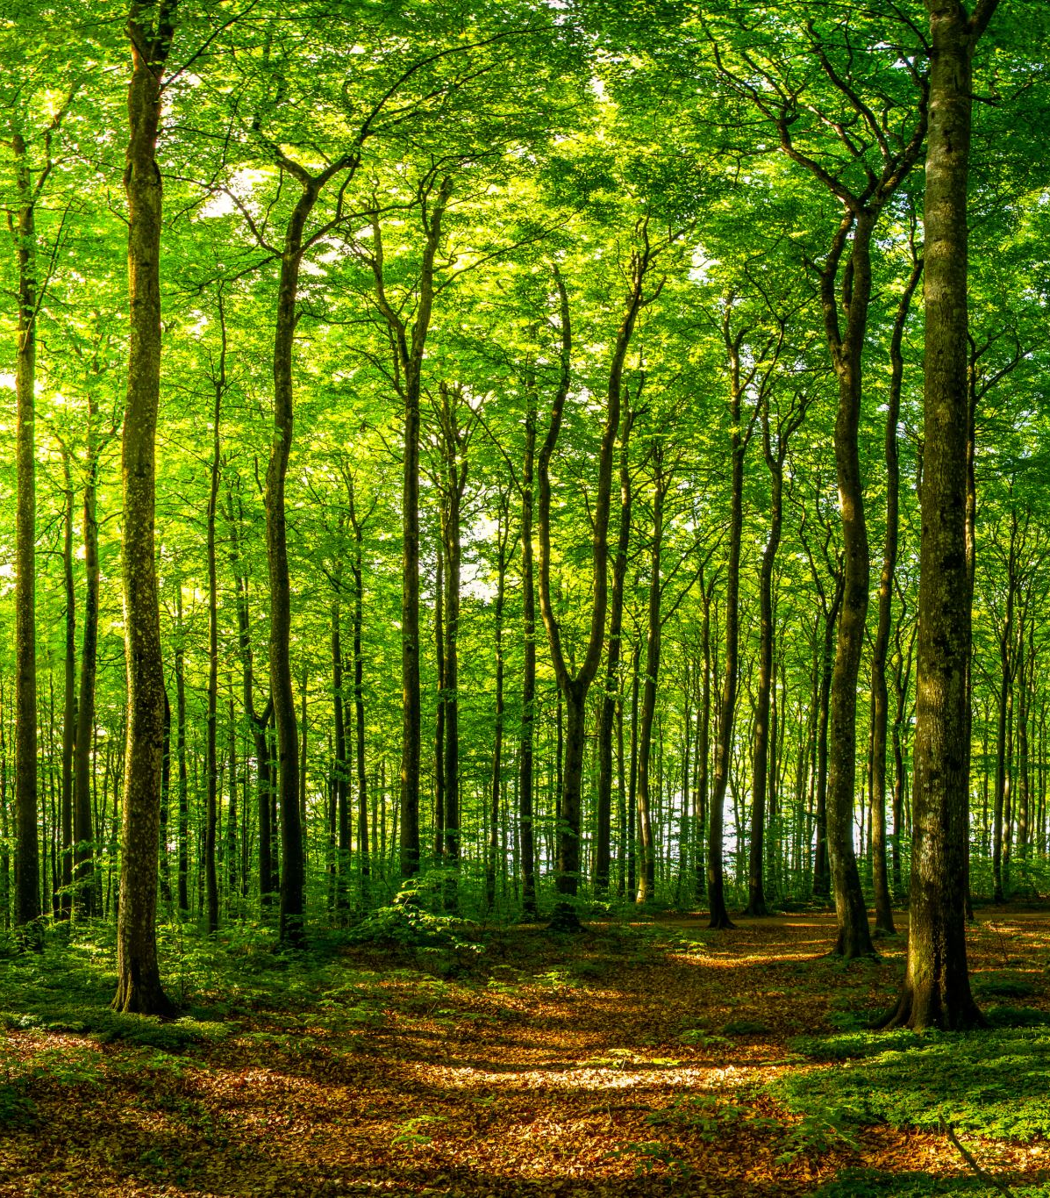
Discussion
Previous studies confirmed an increased biomass in thinned stands
Changes in microclimate following thinning, like increased windspeed and temperature
Larger sample size may have shown more significant results

Slide 18
Discussion
Slight increase in temperature can influence beetle populations
Increase can impact crop loss
2 degree increase in temp can cause loss of rice, corn and wheat production by 10-25%

Slide 19
Conclusion
Higher biomass of nocturnal beetles with higher humidity and temperature
Increased biomass in areas that are thinned when compared to a combination of management techniques
These results can assist managers in increasing food sources of insectivores and controlling pest species.

Slide 20
Acknowledgments
Thanks to Arkansas Tech, USFS and Arkansas Audubon Society for funding on this project.
Thanks to Dr. Jorista Garrie and Gemma Keegan for the opportunity and Dr. Chris Kellner for helping along the way.

Slide 21
Literature Cited
Bedick, Jon C., W. Wyatt Hoback, and Marc C. Albrecht. "High water‐loss rates and rapid dehydration in the burying beetle, Nicrophorus marginatus." Physiological Entomology 31.1 (2006): 23-29.
Colombini, I., and L. Chelazzi. "Inﬂuence of marine allochthonous input on sandy beach communities." Oceanography and Marine Biology, An Annual Review, Volume 41 (2003): 123-127.
Guerra, E. E., Blanco, C. M., and J. Garrie. 2019. The impact of prescribed fire on moth assemblages in the Boston Mountains and Ozark Highlands, in Arkansas. Journal of the Arkansas Academy of Science 73, 9.
Heepe, Lars, Jonas O. Wolff, and Stanislav N. Gorb. "Influence of ambient humidity on the attachment ability of ladybird beetles (Coccinella septempunctata)." Beilstein Journal of Nanotechnology 7.1 (2016): 1322-1329.
Mammola, Stefano, et al. "Seasonal dynamics and micro-climatic preference of two Alpine endemic hypogean beetles." International Journal of Speleology 44.3 (2015): 3.
Sanger Ciarleglio, J.E., Perez, K.M., Motola, H.L. and DiGangi, E.A. (2020), Recommendations for Maintaining a Dermestid Beetle Colony (Dermestes maculatus) for Processing Human Remains. J Forensic Sci, 65: 1698-1703. https://doi.org/10.1111/1556-4029.14470
Schulz, B. K., W. A. Bechtold, and S. J. Zarnoch, 2009. Sampling and estimation procedures for the vegetation diversity and structure indicator. Gen. Tech. Rep. PNW-GTR-781. Portland, OR: U.S. Department of Agriculture, Forest Service, Pacific Northwest Research Station. 53 p.
Ward, D.F.; New, T.R.; Yen, A.L. 2002. The beetle fauna of remnant eucalypt woodlands from the Northern Plains, Victoria, Australia. Journal of Insect Conservation 6: 39-45
Wickings, Kyle, and A. Stuart Grandy. "The oribatid mite Scheloribates moestus (Acari: Oribatida) alters litter chemistry and nutrient cycling during decomposition." Soil Biology and Biochemistry 43.2 (2011): 351-358.
Wijerathna, Asha, and Maya Evenden. "Effect of environmental conditions on flight capacity in Mountain Pine Beetle (Coleoptera: Curculionidae: Scolytinae)." Journal of Insect Behavior 33.5-6 (2020): 201-215.

Slide 22
Questions?

