Slide 1
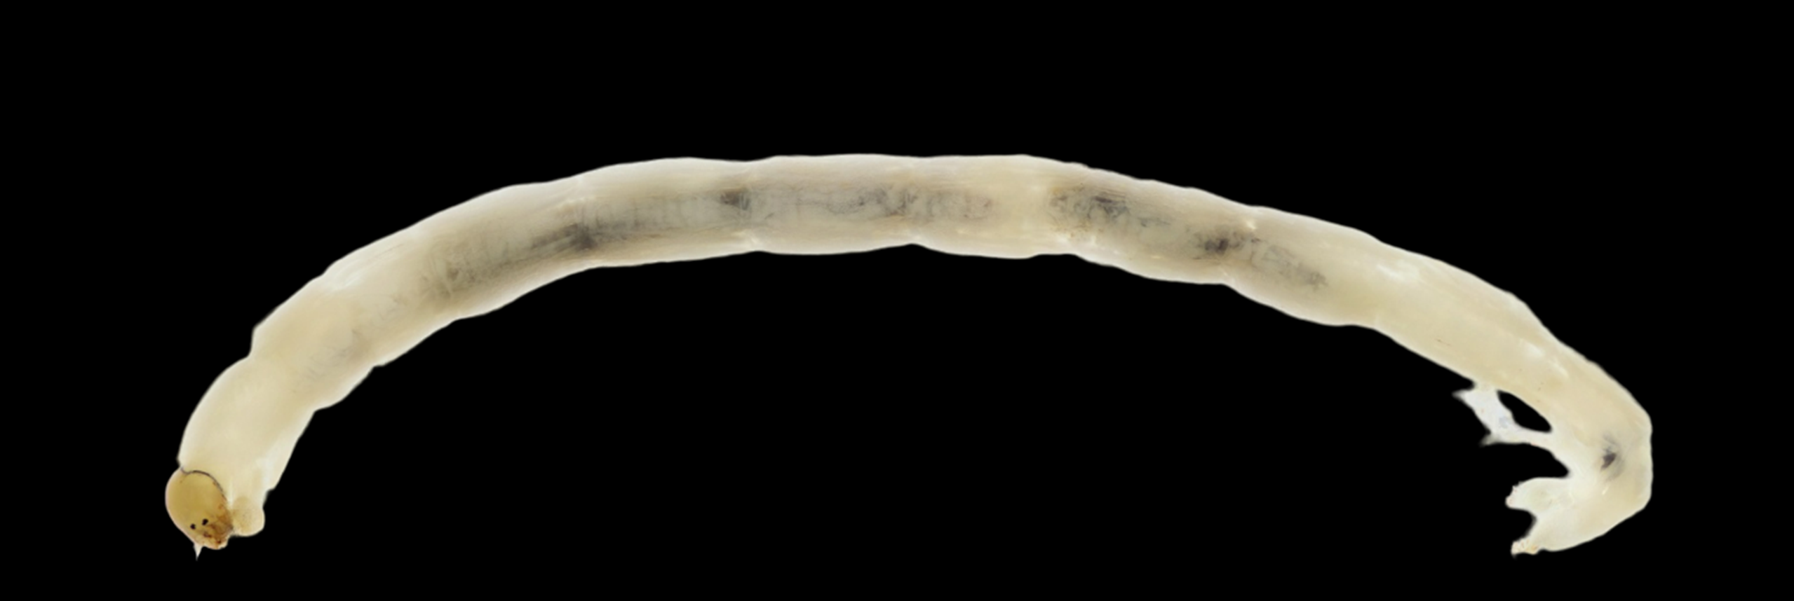
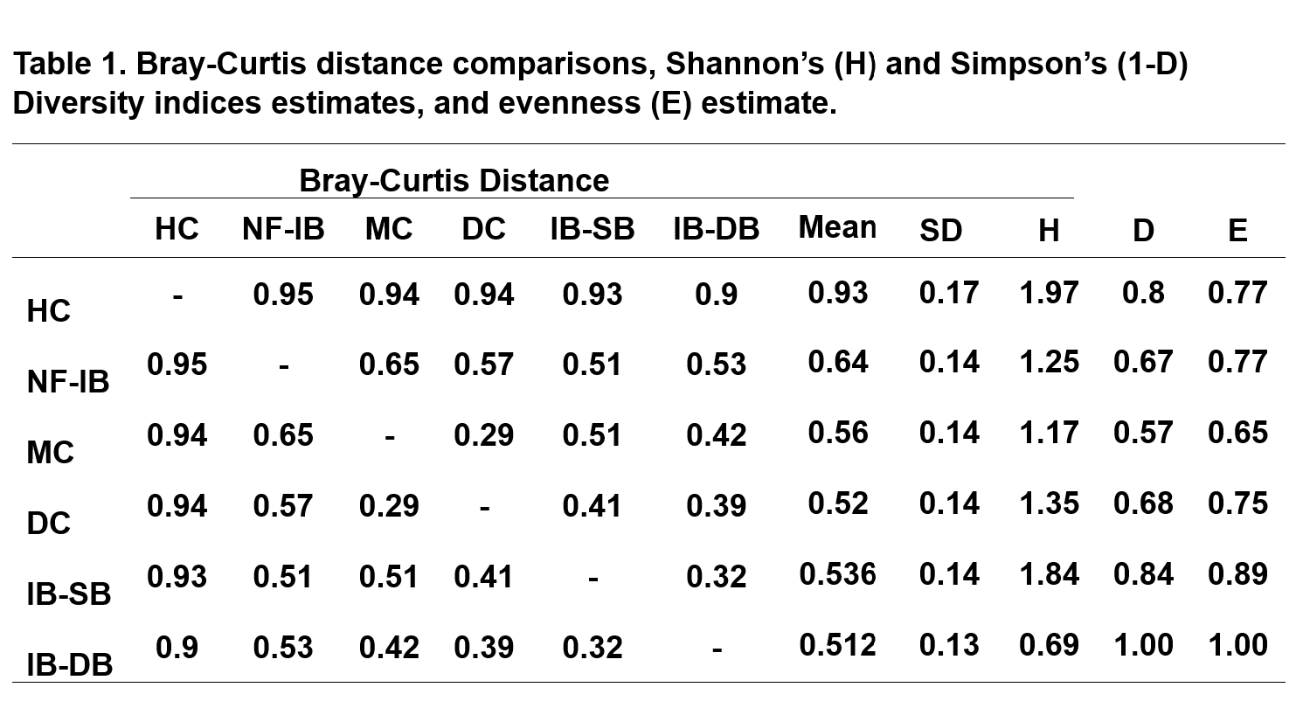
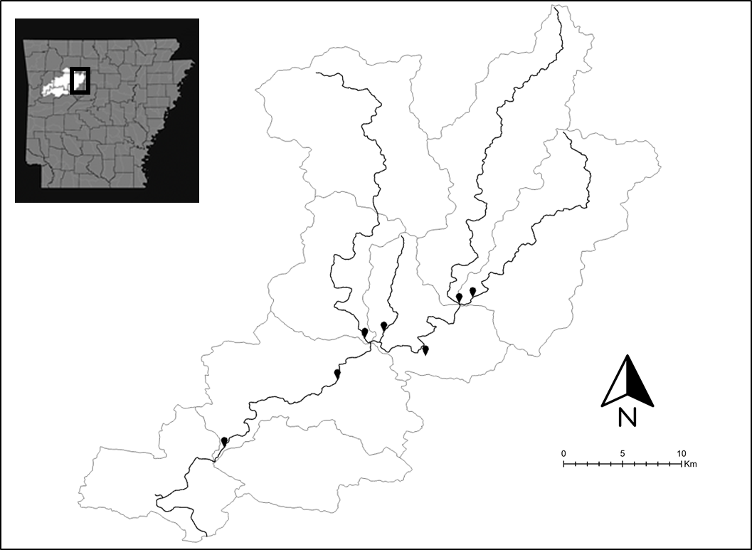
Spatial Assessment of Slender Madtom (Noturus exilis) Diets within the Illinois Bayou Brendon Mitchell and Kyler B. Hecke
Background
Diet-data collection is increasingly difficult for Madtoms, as most methods require the dissection of each specimen and the removal of the digestive tract, which is fatal (Tzilkowski and Stauffer 2004).
In result, the diets of many Madtom species have been relatively understudied.
The Slender Madtom (Noturus exilis; Nelson 1876) is one species where there is very little information on its diet.
A new study was needed to determine the diet of Slender Madtoms and to see if it varies on a spatial scale.
Results will be useful in determining the diet composition of Slender Madtoms across its range and support or oppose the use of gastric lavage on Madtom species.
Methods
Slender Madtoms were collected from four sites along the Illinois Bayou and three sites that are direct tributaries of the Illinois Bayou waterway during Fall 2023 (Figure 2).
Fish were collected using d-frame kicknets. Sampling took place for 1-hour at each site. There were two-five people sampling per sampling period. A total of 20 fish were targeted for each site.
Gastric lavage techniques (Giles 1980; Garvey and Chipps 2012) were used, by employing a medical grade plastic syringe (12 mL) and 1.6 mm medical grade tubing. Gastric lavage was performed two times for each individual fish. Fish were allowed to recover for 30-min. in aerated water before being released back into the respective stream.
All prey items were identified down to family using macroinvertebrates.org (Kautz et al. 2022).
Relative abundance (%) was estimated for the prey items from Slender Madtoms at each site. Bray-Curtis dissimilarity was used to assess the composition of prey items in fish from the seven sites. All statistical analyses were completed in Microsoft Excel (2023). Alpha levels of 0.05 were used for significance testing in all analyses.
Discussion
Diets from all sites were comprised mostly of Chironomids, suggesting that this prey item is an important part of Slender Madtom diets. There appears to be a spatial differences in Slender Madtom diets between upper versus downstream reaches of the Illinois Bayou and its tributaries.
Suggests these reaches support different aquatic-macroinvertebrate communities as you move downstream and that Madtoms diet is opportunistic to these communities or select reaches have preferred prey items that they selectively feed on.
Evidence of piscivory was found in dietary contents with multiple individuals having fish scales (cycloid and ctenoid), gills, a pectoral fin, and an anal fin.
No mortality during this study supports the use of gastric lavage on threatened/endangered species that would otherwise need lethal techniques or historical samples to study (Wagner and Roberts 2020). However, further testing on size requirements needs to be completed as individuals around or smaller than 45mm in total length showed signs of increased stress and longer recovery time.
Objectives of Study
Objective 1: To determine the diet of Slender Madtom.
Objective 2: To assess the spatial difference in Slender Madtom diets.
FIGURE 3: Chironomidae
FIGURE 4: Heptageniidae
FIGURE 5: Philopotamidae
Figure 1: A Slender Madtom (Noturus exilis), observed during sampling.
Literature Cited
-Bonar, S. A., et al., editors. 2009. Standard methods for sampling North America freshwater fishes. American Fisheries Society, Bethesda, MD.
-Garvey J. E., and S. R. Chipps. 2012. Diets and Energy Flow. Pages 733–779. in A.V. Zale, D.L. Parrish, and T. M. Sutton, editors. Fisheries Techniques, 3rd edition. American Fisheries Society, Bethesda, Maryland.
-Giles, N. 1980. A stomach sampler for use on live fish. Journal of Fish Biology 16:441–444.
-Kautz, A. R., wt al. 2022. Macroinvertebrates. org: Creating a Digital Teaching Collection of Common Freshwater Macroinvertebrates of Eastern North America. American Entomologist, 68(1), 28-31.
-Tzilkowski, C. J. and J. R. Stauffer Jr. 2004. Biology and diet of the Northern Madtom (Noturus stigmosus) and Stonecat (Noturus flavus) in French Creek, Pennsylvania. Journal of the Pennsylvania Academy of Science 78(1):3-11
-Wagner, M. D. and M. E. Roberts. 2020. Analysis of Piebald Madtom (Noturus gladiator) diet. Food Webs 22:e00136
Results
A total of 157 different prey items from 41 fish (43-88 mm), covering 2 classes (Insecta and Actinopterygii) and >6 orders were extracted from Slender Madtoms sampled in the Illinois Bayou watershed during October and November (2023).
The composition of prey items from the two sample sites with the greatest spatial difference (HC and IB-DB) showed a very strong dissimilarity (0.9) in dietary components (Table 1).
The primary dietary component of Slender Madtoms were Chironomidae (74), Heptageniidae (27), and Philopotamidae (18) with some individuals containing fish parts.
The Bray-Curtis analyses shows an average trend of increasing dissimilarity in dietary components with further spatial difference of sites (Table 1).
FIGURE 2: Map of the Illinois Bayou watershed, the sampling sites are identified by solid black location pinpoints.

